Slide 1
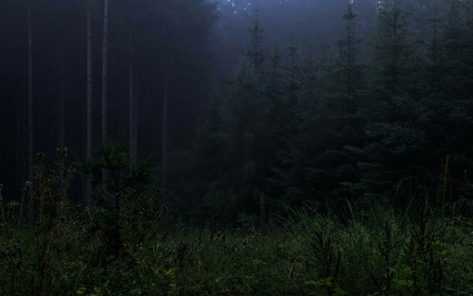
ENDANGERED ANIMALS
ENGLISH PROJECT:
ENDANGERED ANIMALS
MADE BY: BRUNA DUJMOVIĆ, DORA RAĐA & LARA JOVIŠIĆ

Slide 2
Let's start… We think people lost their awareness about animal importance. Animals would do anything to protect themselves just like humans, but what if it’s not possible?

Slide 3
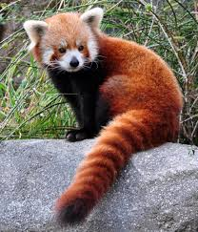
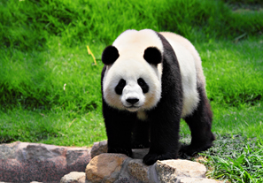
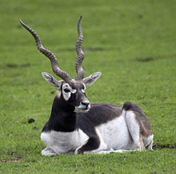
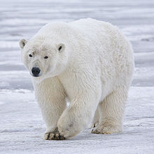
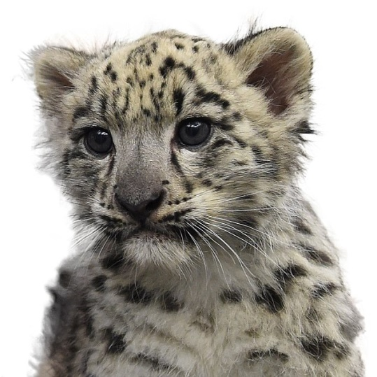
There are just so many endangered animals, so here are a few of them… - snow leopard - the blackbuck - red panda - giant panda - polar bear

Slide 4
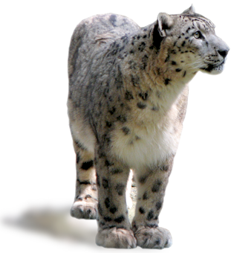
Snow leopard They have serious appetites. They use their powerful legs to jump up to 50 feet. Snow leopards have furry tails they put to good use. Their feet are built-in snowshoes Snow leopards and the places they call home urgently need our help.

Slide 5
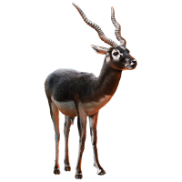
The blackbuck Males stand about 32 in. (81 cm) They are extremely swift animals They have been hunted intensively by humans, sometimes with the aid of cheetahs Blackbucks graze in herds of 10 to 100

Slide 6
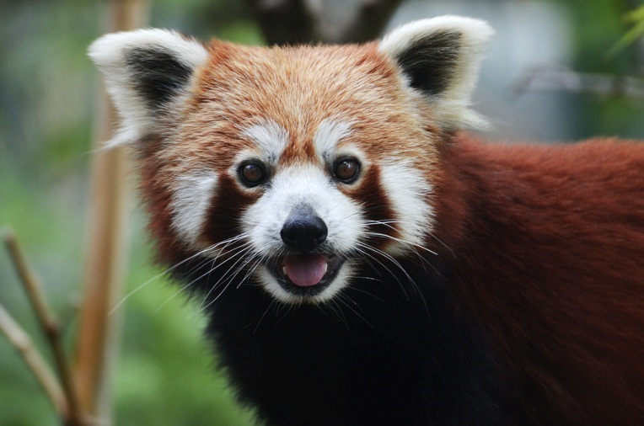
RED PANDA Currently, red pandas live in the Eastern Himalayas. they need to spend 13 hours a day eating and looking for food Red pandas escaped from zoos in London, Birmingham, and Rotterdam. Sadly, the red panda involved in the 1978 Rotterdam escape was found dead not long after the search for it began.

Slide 7
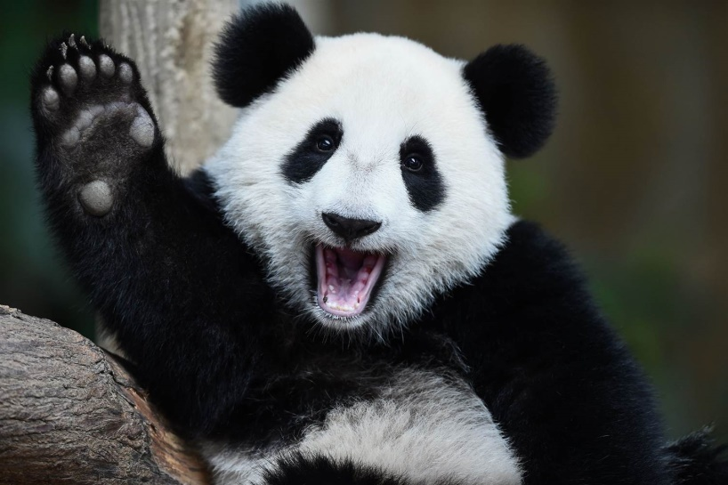
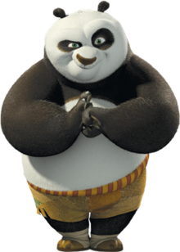
GIANT PANDA Pandas are usually born in August. Not all giant pandas are black and white! A few are brown and white. A 45 kilo adult spends 12-16 hours eating Cat type eyes help them to see in the dark.

Slide 8
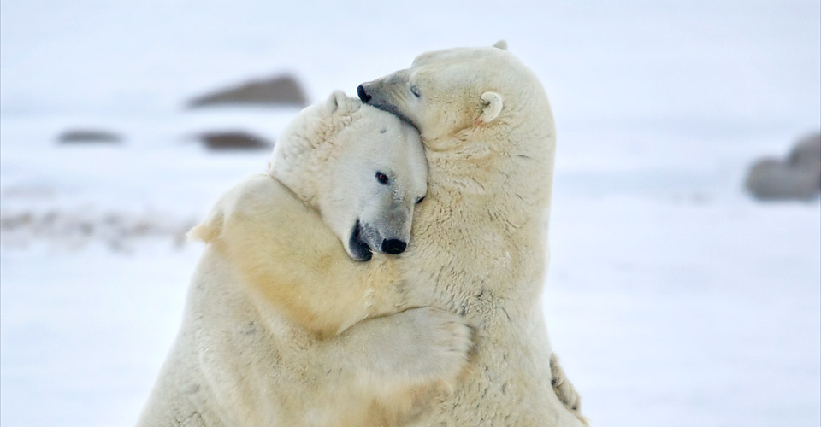
POLAR BEARS Polar bears feed almost exclusively on ringed seals and bearded seals Polar bears are only found in the Arctic. Pregnant polar bears need to eat a lot in the summer and fall The polar bear is the largest and most carnivorous member of the bear family.

Slide 9
The end…

