Slide 1
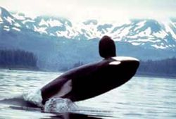
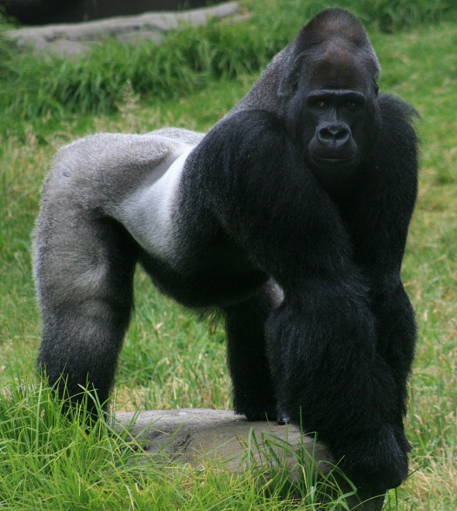
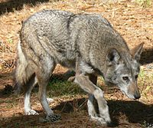
ENDANGERED ANIMALS

Slide 2
ENDANGERED ANIMALS
In the world there are lot of endangered animals
Mostly because of people who exterminated them and because of disappearance of their habitats
If people from all around the world raise their consciousness about endangered animals somehow they can save them
In this presentation I will show you 4 types of endangered animals
- red wolf
- gorilla
- killer whale
- polar bear

Slide 3
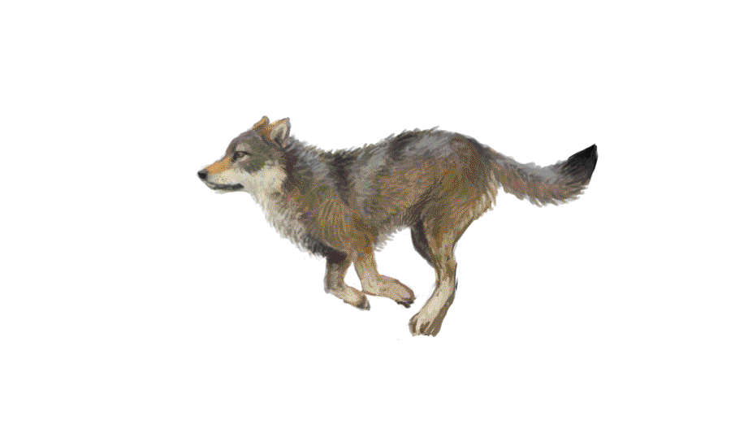
RED WOLF
2 species are extinct and the third one is also close to extinction
If people can still make an effort to prevent the extinction of red wolfs
There were 3 types of red wolf
In North Carolina there are 100 specimens of red wolf
Some organizations participate in the plan of red wolf survival

Slide 4
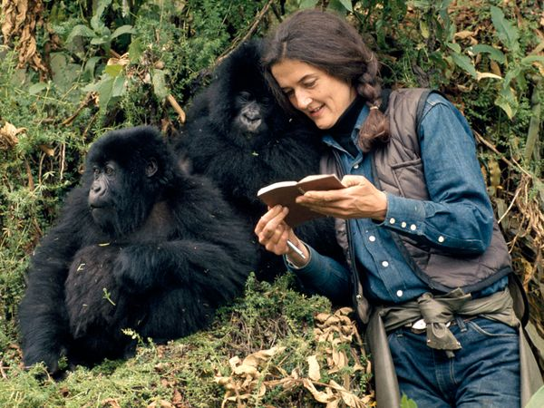
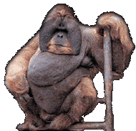
GORILLA
Diana Fossey and gorilla
Among the most critical animals to be extinct
Mostly because of humans , wars , hunt and lost habitat
In the world there are just 5000 east gorillas
If Diana Fossey will be an example we can save all gorillas from extintcion

Slide 5
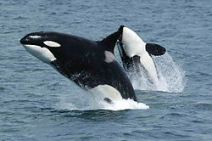
KILLER WHALE(ORCS)
Their biggest threat are the whalers
Once whalers caught 80 killer whales which are 3 families of that kind
They often live in water parks where they do some tricks and people treat them like slaves

Slide 6
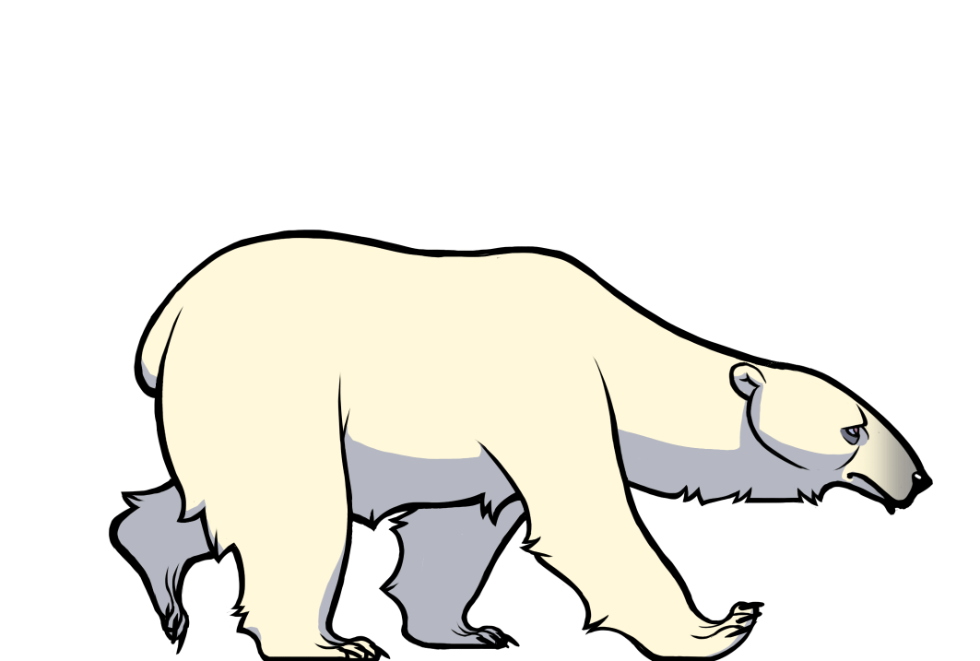
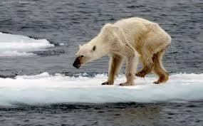
POLAR BEAR
They haven’t got natural enemies but their biggest enemies are warming and lack of food
In 1970 hunting was banned and number of polar bears increased to 3000
Big problems of polar bears are climate change and starvation
Once people chased them
Malnourished polar bear

Slide 7
THANK YOU FOR YOUR ATTENTION
MARTA

