Slide 1
ADVERTISING PRODUCTS
Toni Milina, 8.b
Mihael Jurić 8.b

Slide 2
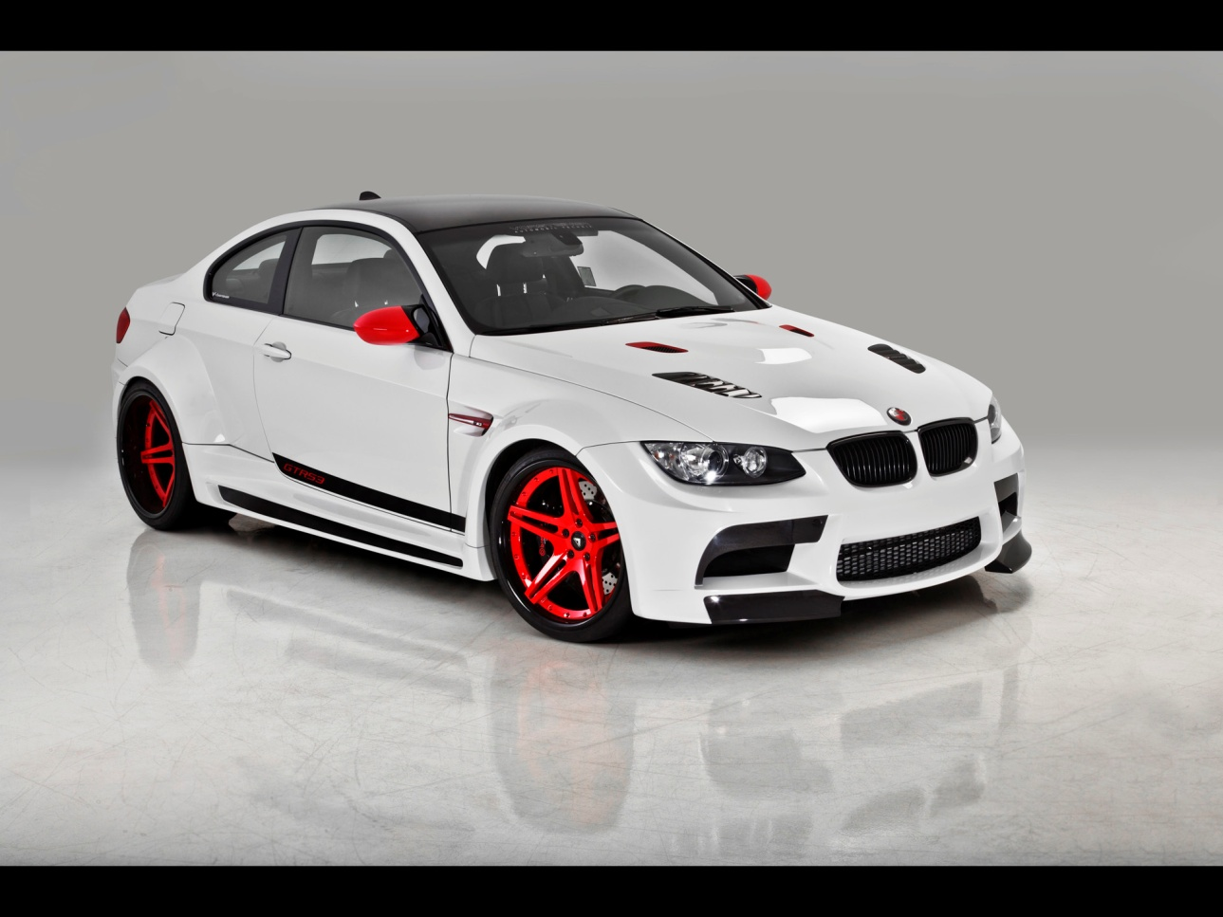
BMW
BMW is among the most famous car brands in the world

Slide 3
ADVANTAGES OF BMW
BMW is produced in Germany
Very good quality and safe car
It gives you comfort and pleasure while driving
It offers a choice of models that can surely meet your criteria

Slide 4
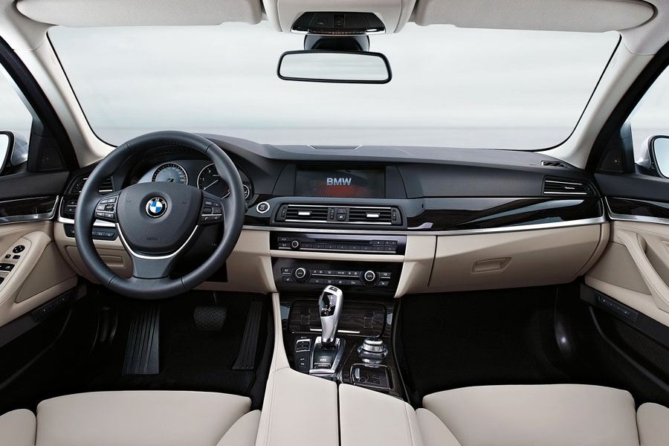
As we see it is very well equipped with new technology

Slide 5
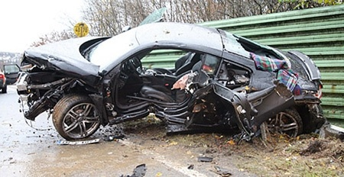
BAD SIDE
BMW is a very expensive car
A lot of money needs to be invested in order to maintain car
At some time it can achieve high speed which often causes traffic accidents

Slide 6
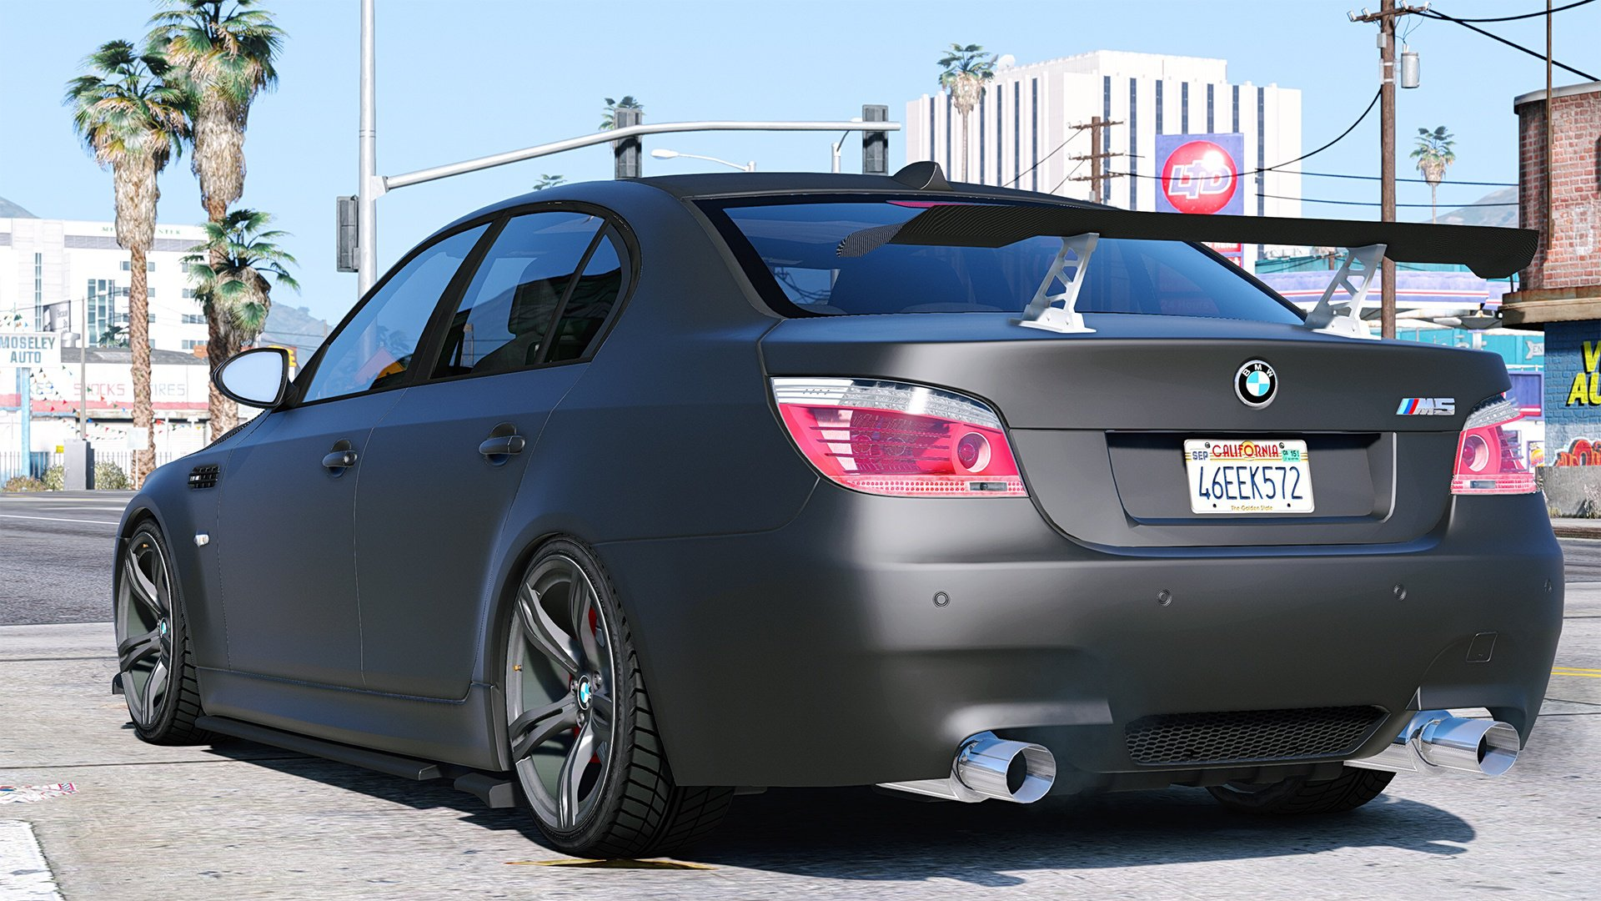
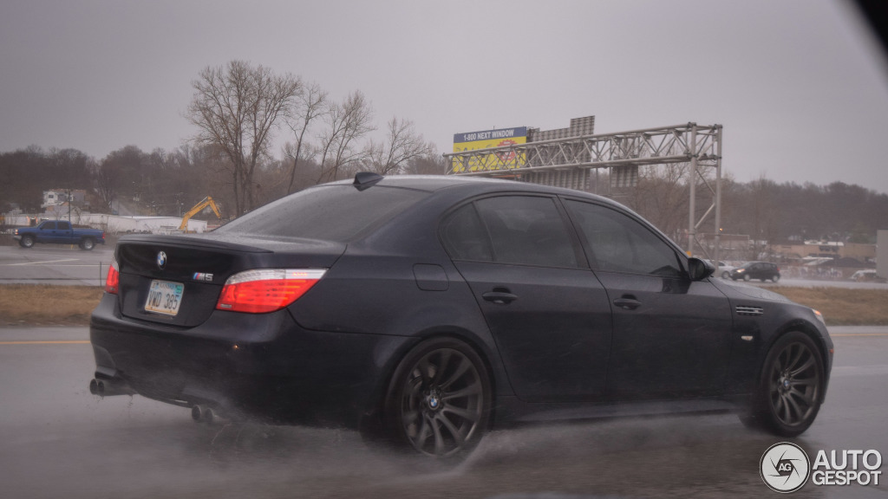

Slide 7
If you have enough money to take care of it and treat it as your pet and if you are responsible enough BMW is the right car for you

Slide 8
THE END

