Slide 1
Climate of Croatia
BY:MARA CAKTAŠ
TONIJA PERKOVIĆ
JELENA ROŽIĆ

Slide 3
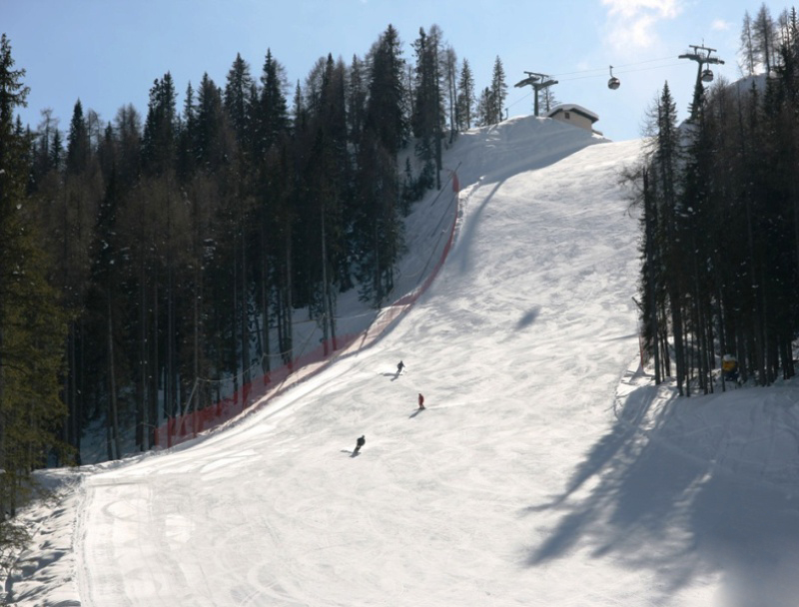
Winter temperatures range from -1 to 30°C in the continental region, -5 to 0°C in the mountain region and 5 to 10°C in the coastal region.

Slide 4
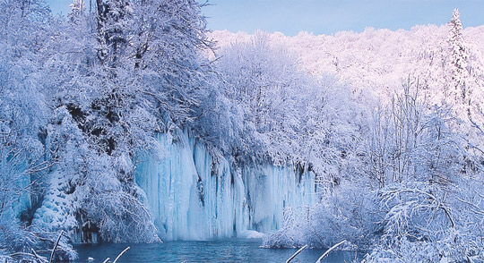
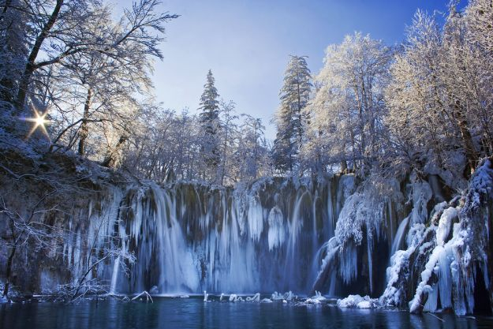
THE PLITVICE LAKES ARE ONE OF THE MOST BEAUTIFUL PLACES TO VISIT IN WINTER.

Slide 5
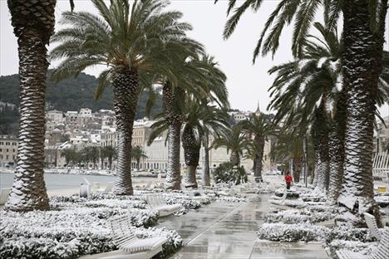
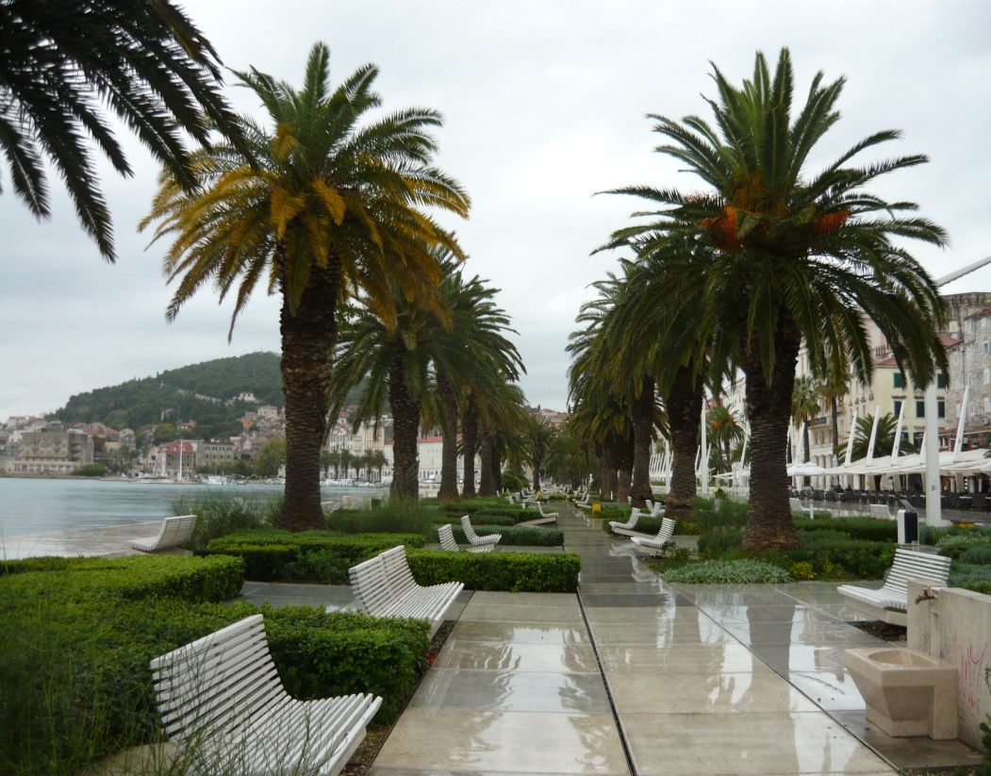
Winters in Split
Summers in Split

Slide 6
Summers in Croatia are hot and dry.

Slide 7
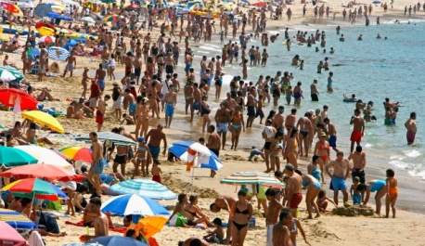
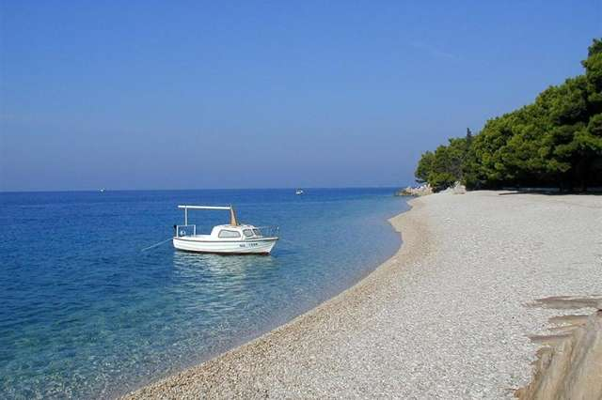
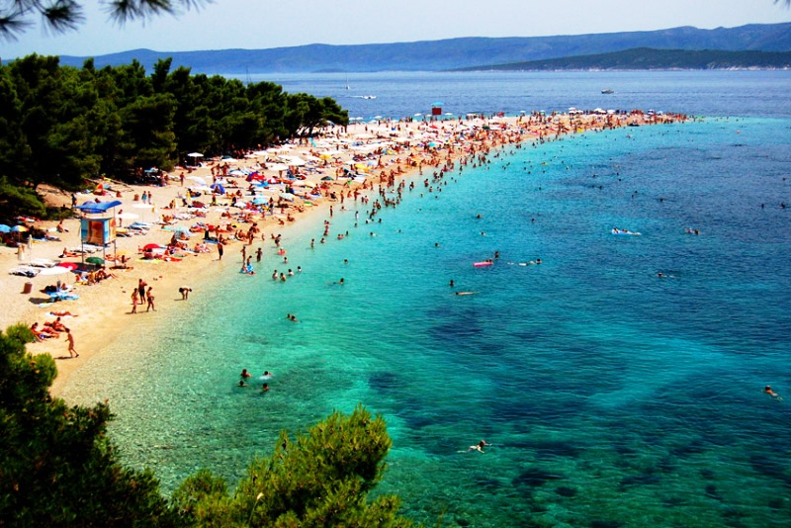

Slide 8
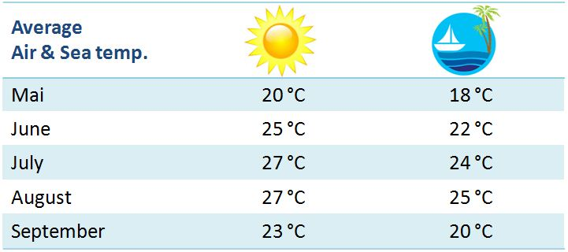
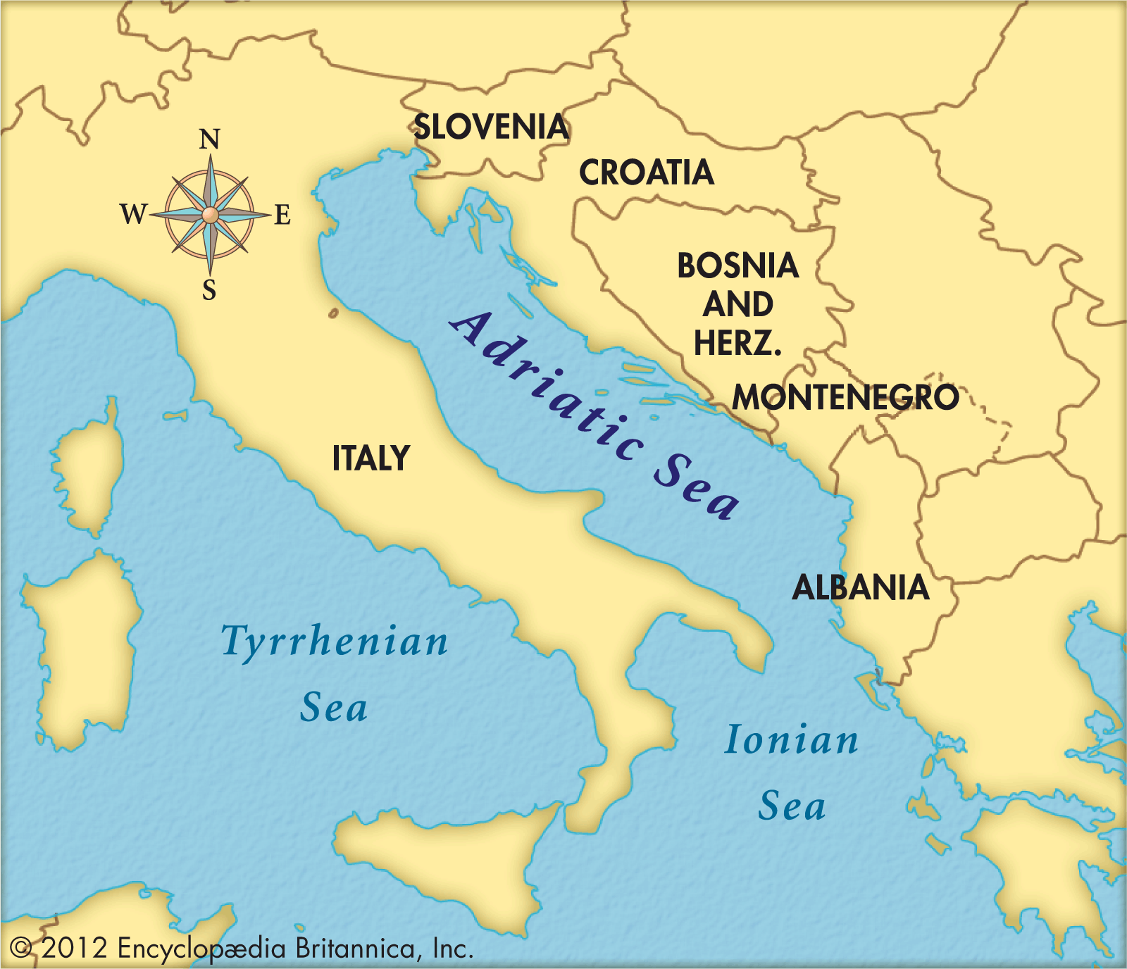
MAY
JUNE
JULY
AUGUST
SEPTEMBER

Slide 9
Croatia enjoys 2,715 hours of sunshine a year.That’s more than Sydney,Australia.
„Really?!!!!?????”

Slide 10
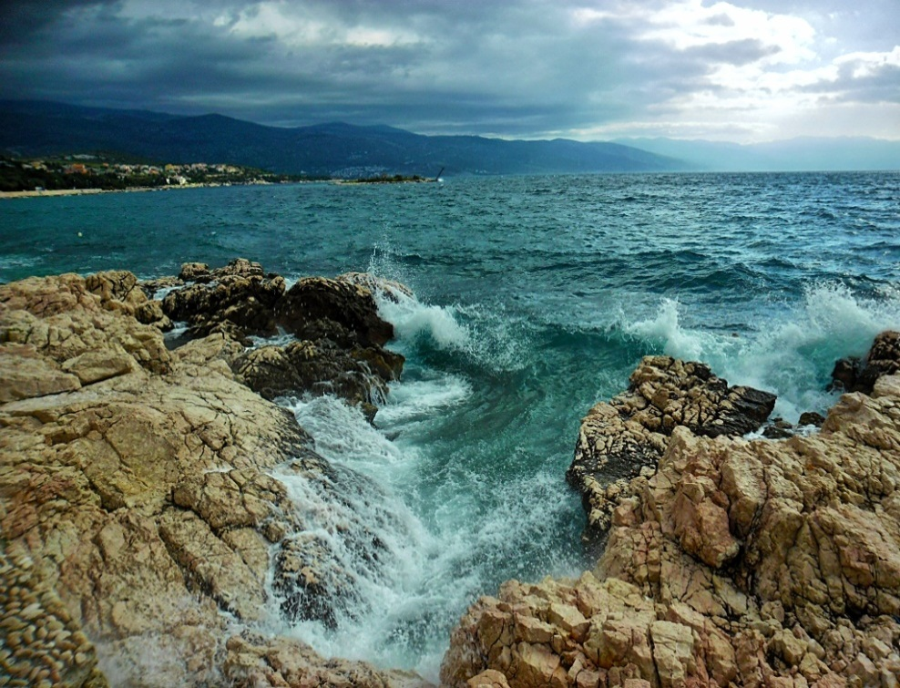
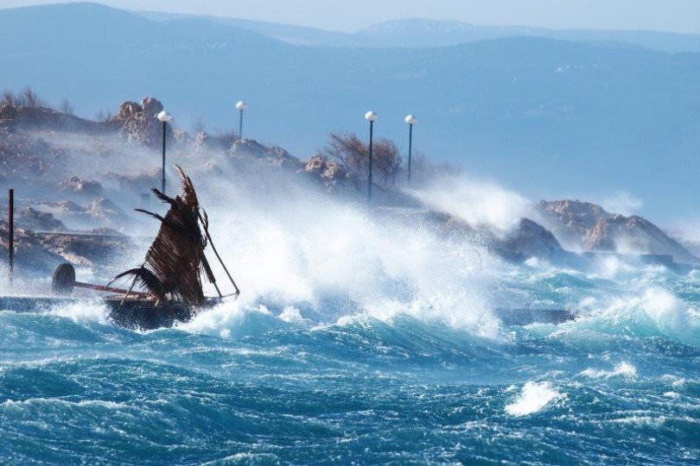
The most common winds in Dalmatia are bora and sirocco.
Bora
Sirocco

