Slide 1
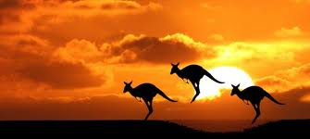
AUSTRALIA
AUSTRALIA

Slide 2
James Cook
He was british explorer and navigator
Cook made detailed maps of Newfoundland and made three voyages to the Pacific Ocean, during which he achieved the first recorded European contact with the eastern coastline of Australia and the Hawaiian islands.

Slide 3
GEOGRAPHICAL POSITION
Australia has six states—New South Wales (NSW), Queensland (QLD), South Australia (SA), Tasmania (TAS), Victoria (VIC) and Western Australia (WA)—and two major mainland territories—the Australian Capital Territory (ACT) and theNothern Teritorry (NT).
Each state and major mainland territory has its own parliament.

Slide 4
AUSTRALIAN CITIES

Slide 5
Australian population
The population of Australia is estimated to be 23,904,700 as of 22 September 2015. Australia is the 52nd most populous country in the world
Australia has fewer than three persons per square kilometre of total land area. With 89.01% of its population living in urban areas, Australia is one of the world's most urbanised countries.

Slide 6
AUSTRALIAN MONARCHY
The monarchy of Australia is a form of government in which a hereditary monarch is the sovereign.
The present monarch is Elizabeth II, styled Queen of Australia, who has reigned since 6 February 1952. She is represented in Australia by the governor-general.

Slide 7
KOALA
It is easily recognisable by its stout, tailless body and large head with round, fluffy ears and large, spoon-shaped nose.
The koala has a body length of 60–85 cm (24–33 in) and weighs 4–15

Slide 8
KANGAROO
Kangaroos have large, powerful legs, large feet adapted for leaping, a long muscular tail for balance, and a small head. Like most marsupials female kangaroos have a pouch called a marsupium.

Slide 9
PLATYPUS
Until the early 20th century, it was hunted for its fur, but it is now protected throughout its range. Although captive breeding programs have had only limited success and the platypus is vulnerable to the effects of pollution, it is not under any immediate threat.

Slide 10
DINGO
The dingo (Canis lupus dingo) is a free-ranging dog found mainly in Australia
The dingo's habitat ranges from deserts to grasslands and the edges of forests.

Slide 11
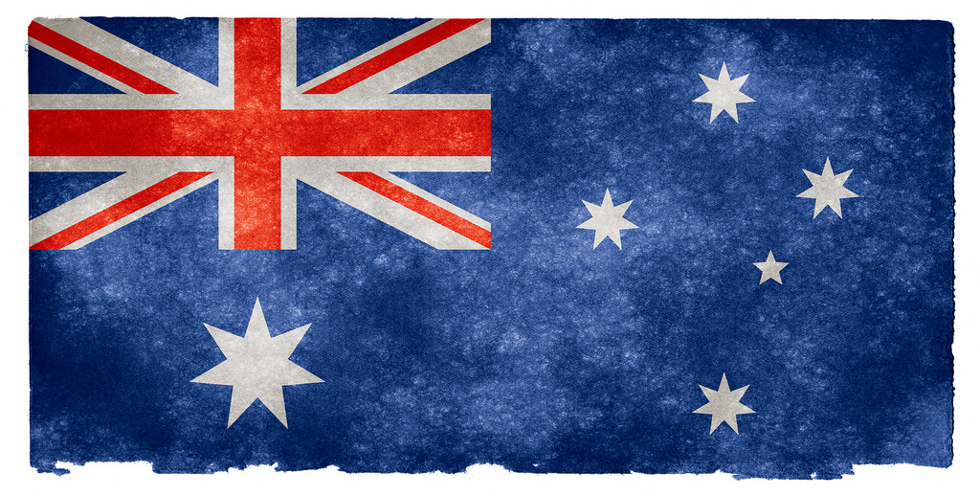
GOODBYE
By: Lucija Glavina
By: Lucija Glavina

