Slide 1
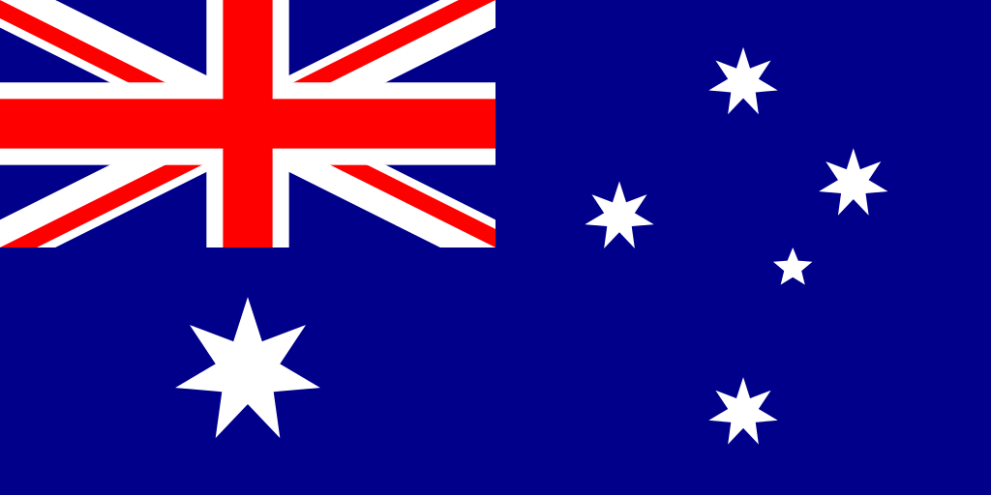
AUSTRALIA

Slide 2
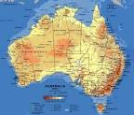
Australia is a country situated in the Southern hemisphere, between the Pacific ocean and the Indian ocean. Its official name is the Commonwealth of Australia.

Slide 3
ABOUT SOME CITIES…
The capital of Australia is Canberra.
The largest city of Australia is Sydney.
23-24 million people live in Australia.

Slide 4
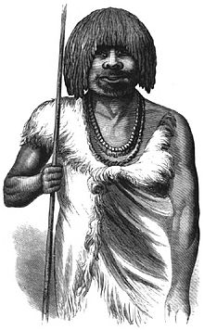
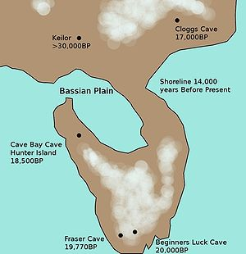
The Australian aboriginal people arrived in Australia more than 50 000 years ago. An example of Aboriginal land management was the Cumberland Plain, where Sydney is now.

Slide 5
SYMBOLS OF AUSTRALIA
These include animals like the kangaroo, the koala, the emu, the kookaburra and the platypus.
Also, the boomerang was used in some areas for sport and for hunting.
And, here they are…..

Slide 6
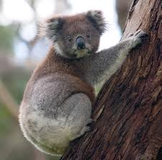
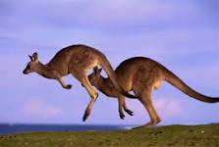
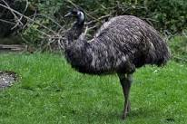
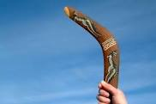
SYMBOLS

Slide 7
THE SYDNEY OPERA HOUSE
The Sydney Opera House is a multi-venue performing arts centre in Sydney, New South Wales, Australia. Situated on Bennelong Point in Sydney Harbour, close to the Sydney Harbour Bridge.

Slide 8
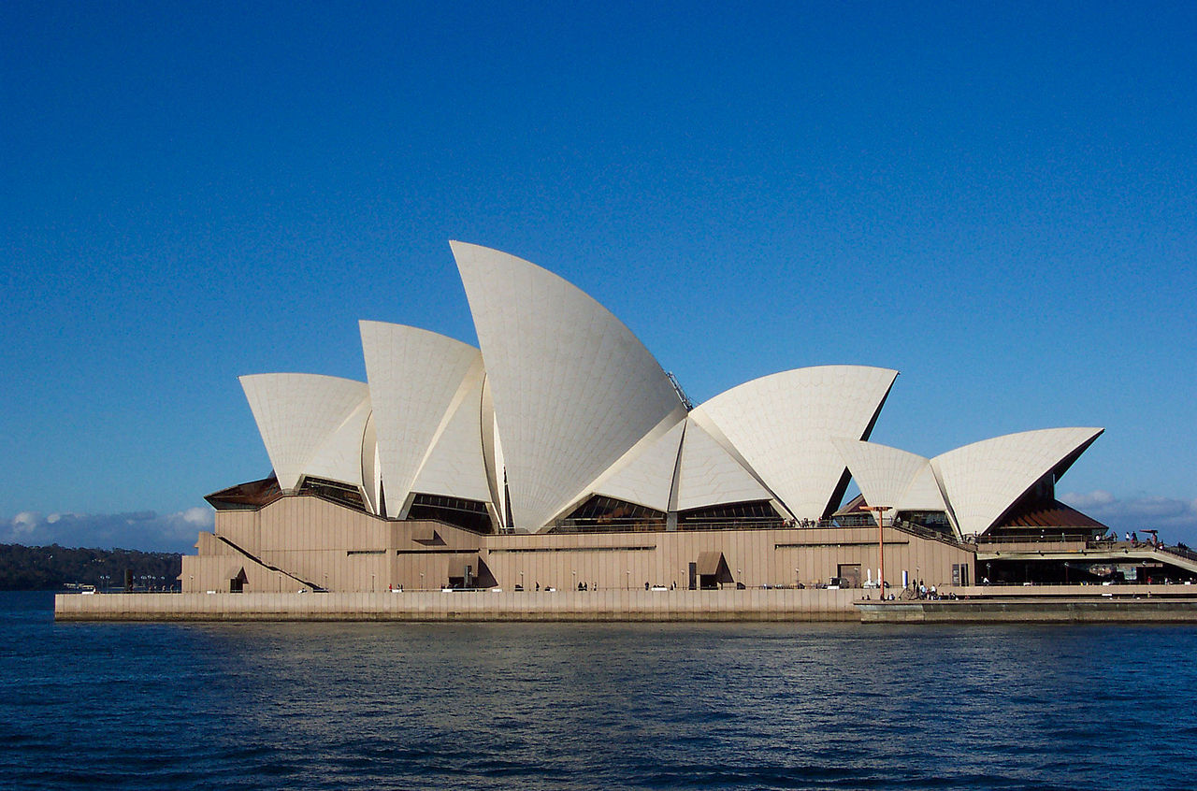

Slide 9
SCHOOL OF THE AIR
School of the Air is a generic term for schools including the primary and early secondary education of children in remote and outback Australia. In these areas, the school-age population is too small for a conventional school.
In the school of the Air you have classes at home.

Slide 10
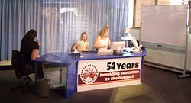
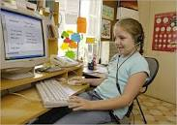
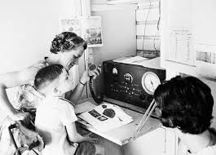

Slide 11
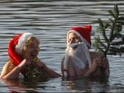
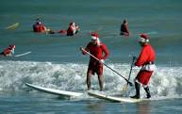
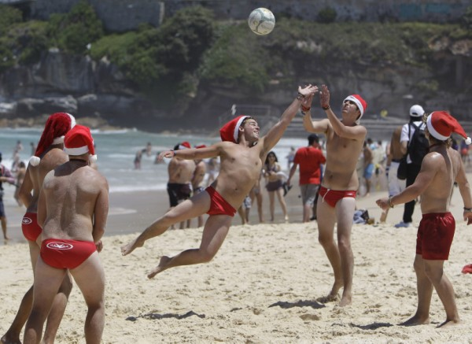
The Australian people celebrate Christmas in summer. Usually, they go on the beach surfing…

Slide 12
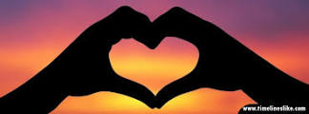
WE HOPE THAT YOU LEARNED SOMETHING ABOUT THIS BEAUTIFUL COUNTRY…… MARTA & LARA

