Slide 1
Wildlife warriors
By:Ivan Boban i Petar Varvodić 7.b

Slide 2
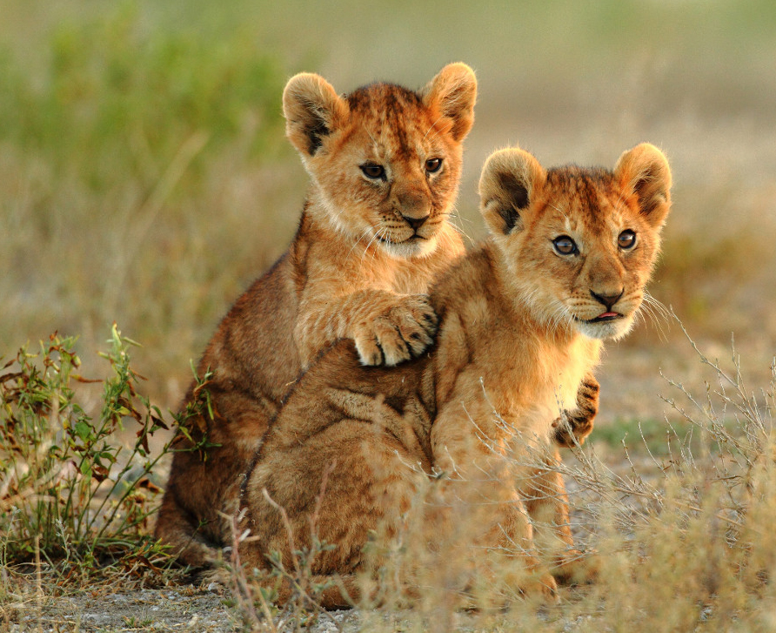
Lion
Lion family
Lion babies

Slide 3
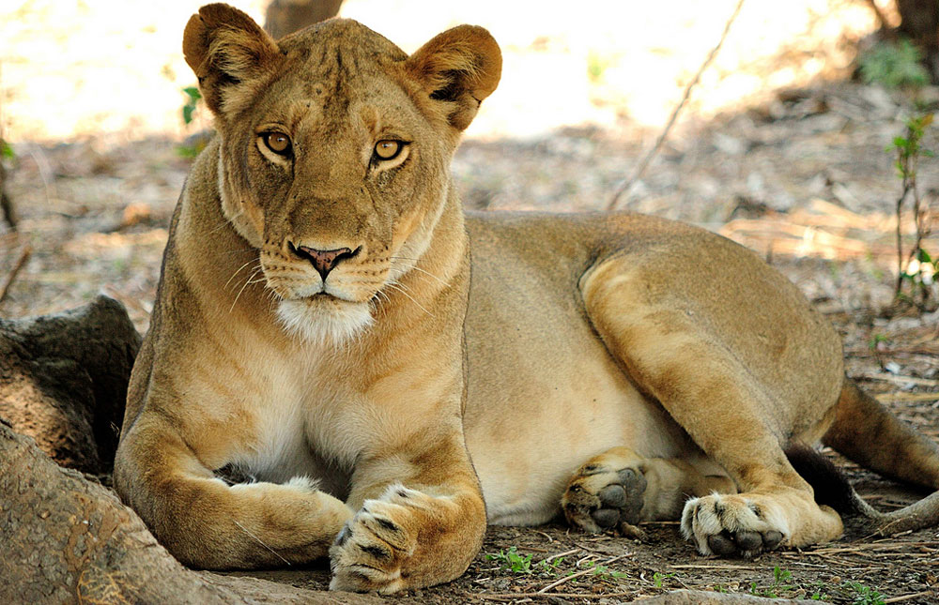
Male lion
Female lion

Slide 4
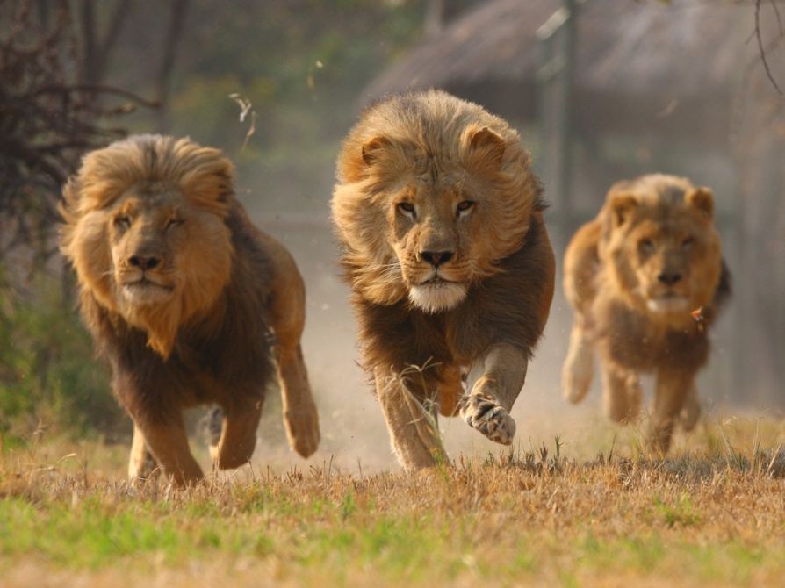
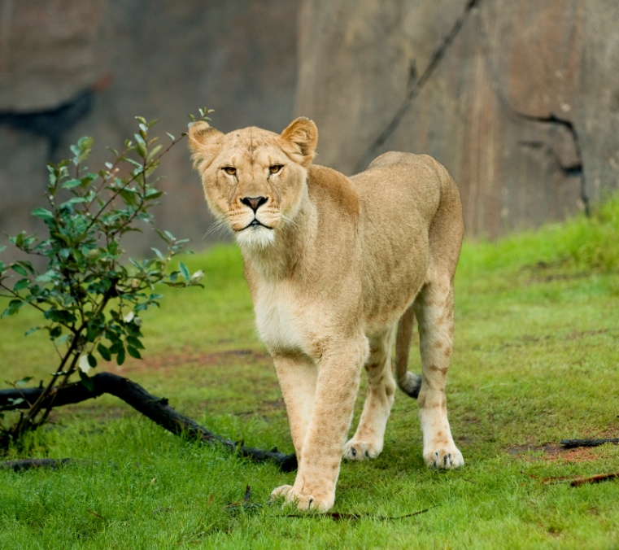
The lion (Panthera leo) is one of the five big cats in the genus Panthera and a member of the family Felidae.

Slide 5
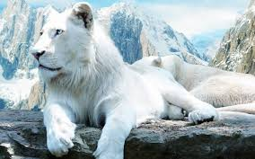
White lion
White lions owe their colouring to a recessive allele; they are rare forms of the subspecies Panthera leo krugeri.

Slide 6
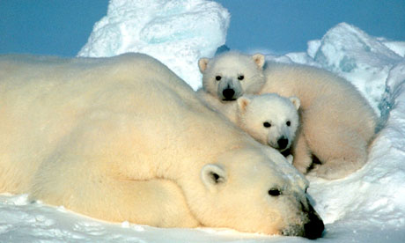
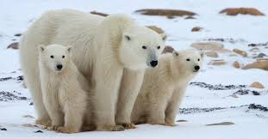
Polar bear
The polar bear (Ursus maritimus) is a carnivorous bear whose native range lies largely within the Arctic Circle, encompassing the Arctic Ocean, its surrounding seas and surrounding land masses.

Slide 7
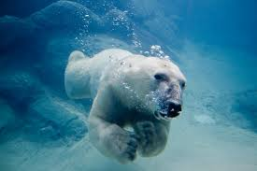
Polar bear waving.
Polar bear swimming.

Slide 8
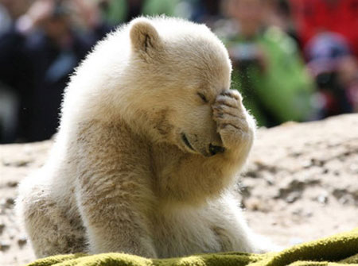

Slide 9
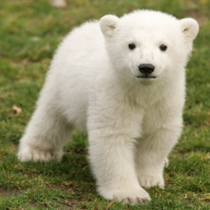
The polar bear is found in the Arctic Circle and adjacent land masses as far south as Newfoundland.
The polar bear is a marine mammal because it spends many months of the year at sea.

Slide 10
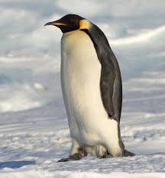
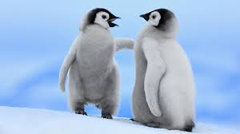
Penguin

Slide 11
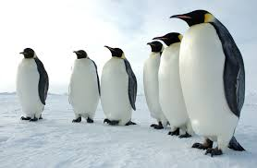
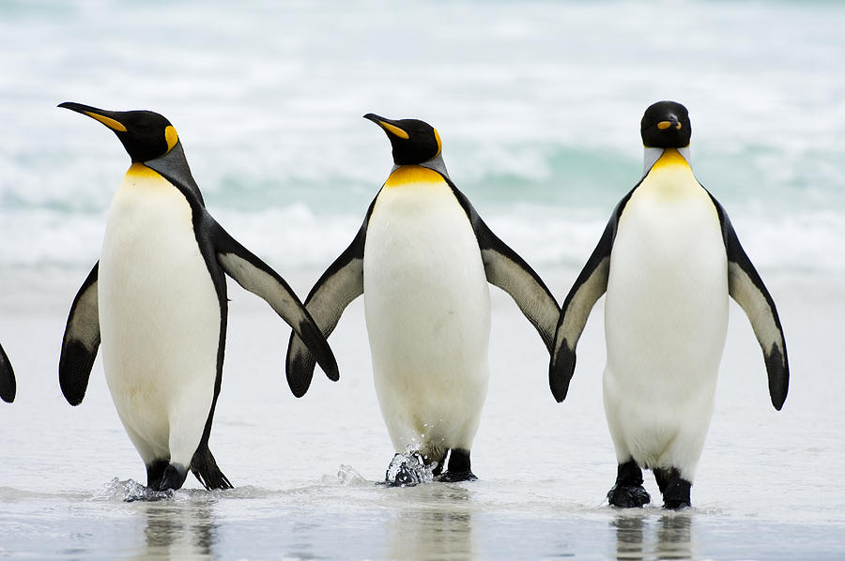
Penguins (order Sphenisciformes, family Spheniscidae) are a group of aquatic, flightless birds living almost exclusively in the Southern Hemisphere, especially in Antarctica.

