Slide 1
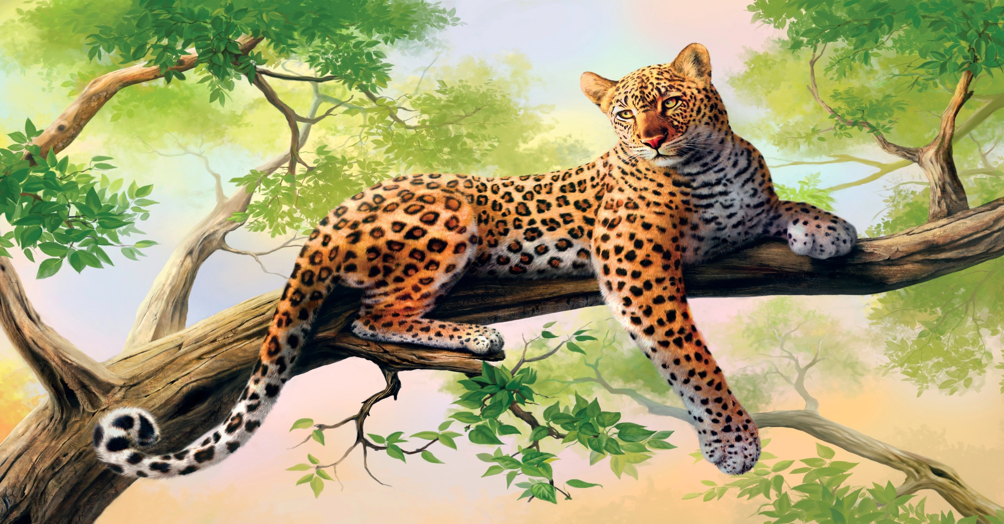
LEOPARD

Slide 2
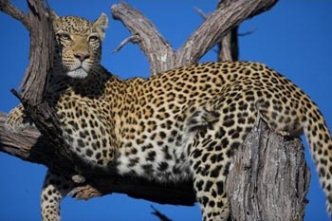
The leopard's success in the wild is due to its well camouflaged fur; its opportunistic hunting behaviour, broad diet, and strength to move heavy carcasses into trees; its ability to adapt to various habitats ranging from rainforest to steppe and including arid and montane areas; and to run at speeds up to 58 kilometres.

Slide 4
Unlike lions, they do not live in groups. The adult males live separately, and the females live only with their cubs. They live in habitats where there are some trees. They climb trees well, and do so regularly. They can carry prey up a tree and keep it safe from hyaenas and lions. Trees are its main escape from attacks by lions or packs of dogs. It is an ambush predator, and operates best where it has some cover.

Slide 5
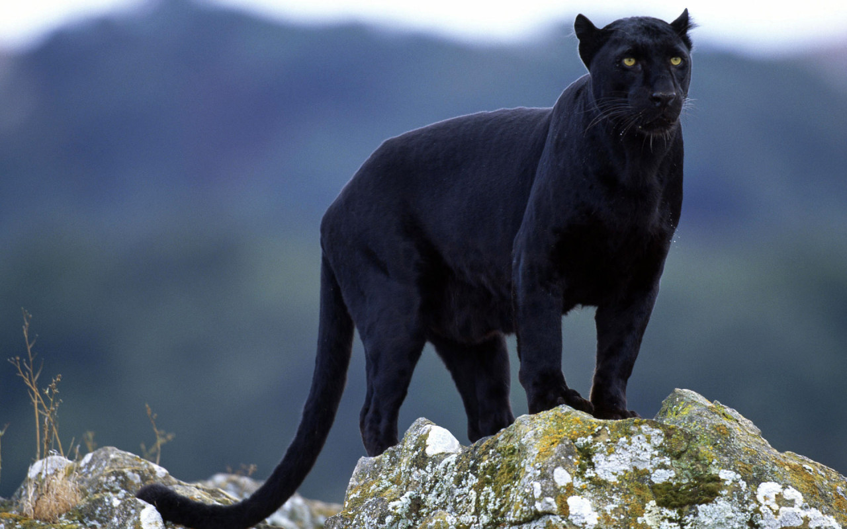
There are also often leopards who are completely black, those are also called black panthers. Male leopards are about 30% larger than female leopards.

Slide 6
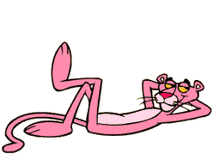
THE PINK PANTHER
One of the most known panther is THE PINK PANTHER that we all know from cartoon.

Slide 7
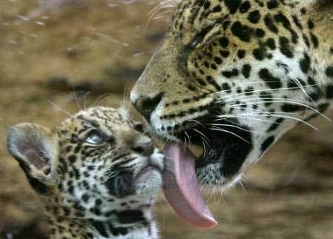
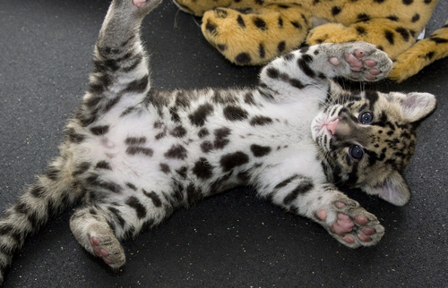
Female leopards can give birth at any time of the year. They usually have two grayish cubs with barely visible spots. The mother hides her cubs and moves them from one safe location to the next until they are old enough to begin playing and learning to hunt. Cubs live with their mothers for about two years—otherwise, leopards are solitary animals.

Slide 8
By:
Leon Arlović
Hrvoje Didak
Marko Majstorović
Hrvoje Munitić
Josip Melki

