Slide 1
Pumpkin
Monika Vrdoljak
7.b.
8 October, 2015

Slide 2
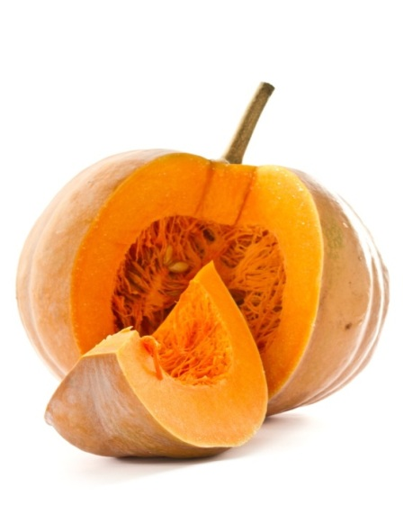
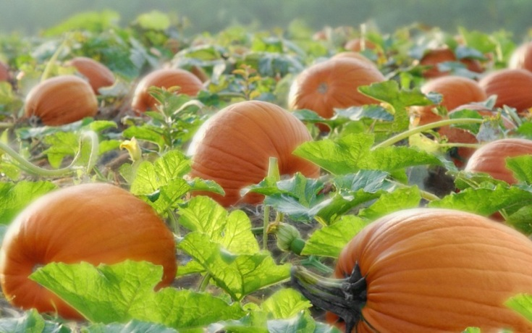
Pumpkin
If you think that the pumpkin is vegetable you are wrong.
A pumpkin is a fruit, because it has got seeds.
A pumpkin is a member of the cucurbit family like squash, cucumbers, luffas, watermelons and melons. Pumpkins come in a multitude of colors, shapes and sizes.

Slide 3
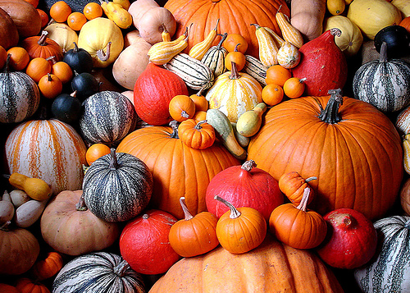
History
The word pumpkin originated from the Greek word Pepõn which means large melon. Pumpkins and squash are believed to have originated in the ancient Americas.

Slide 4
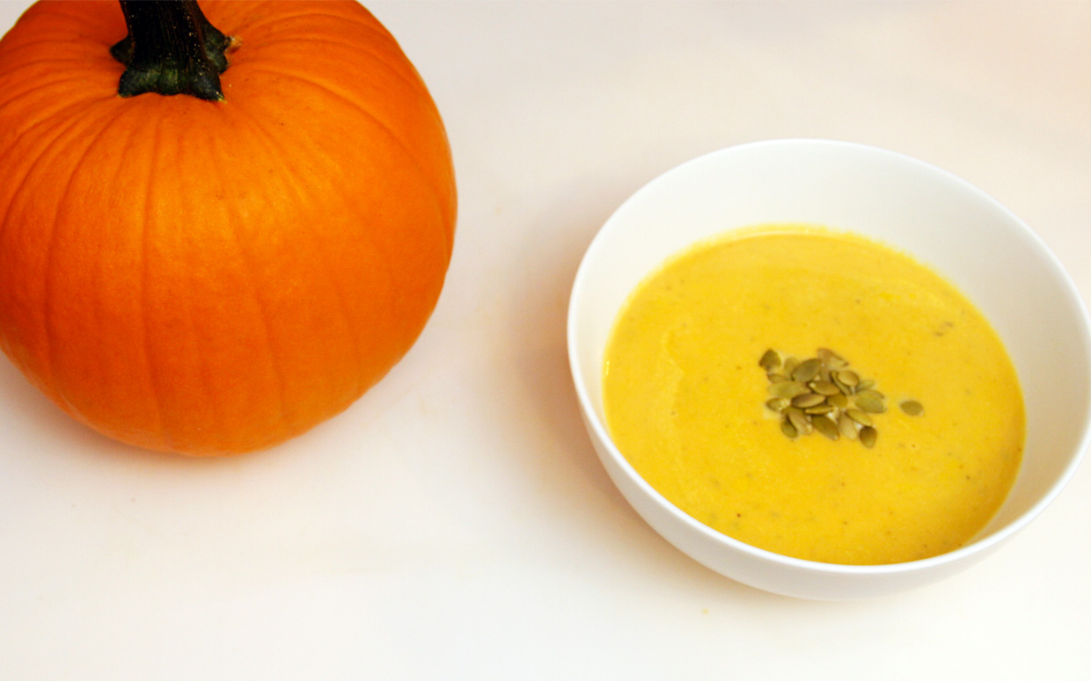
Recipe
Lazy Evening Pumpkin Soup
1 cup cream 1 onion, thinly sliced 1 bay leaf 1 cup chicken broth 1 cup pumpkin, cooked and mashed 1-1/2 tbsp melted butter 1-1/2 tbsp flour
1/2 tsp salt dash of pepper
Combine milk, onions and bay leaf in saucepan. Slowly bring to a boil. Strain, then combine strained ingredients with chicken broth and mashed pumpkin (save the milk). In a separate pan, make a roux by combining the butter and flour and cooking over low heat for 5 minutes. Add milk mixture to roux slowly and whisk until the soup is smooth. Season with salt and pepper. Simmer for 5 minutes to bring out the flavors.
Garnish with pomegranate seeds, parsley, and cream.

Slide 5
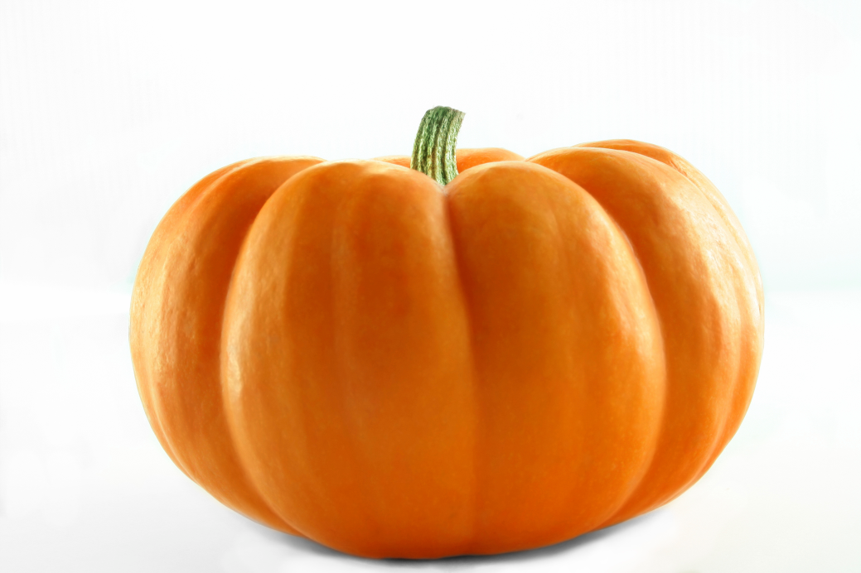
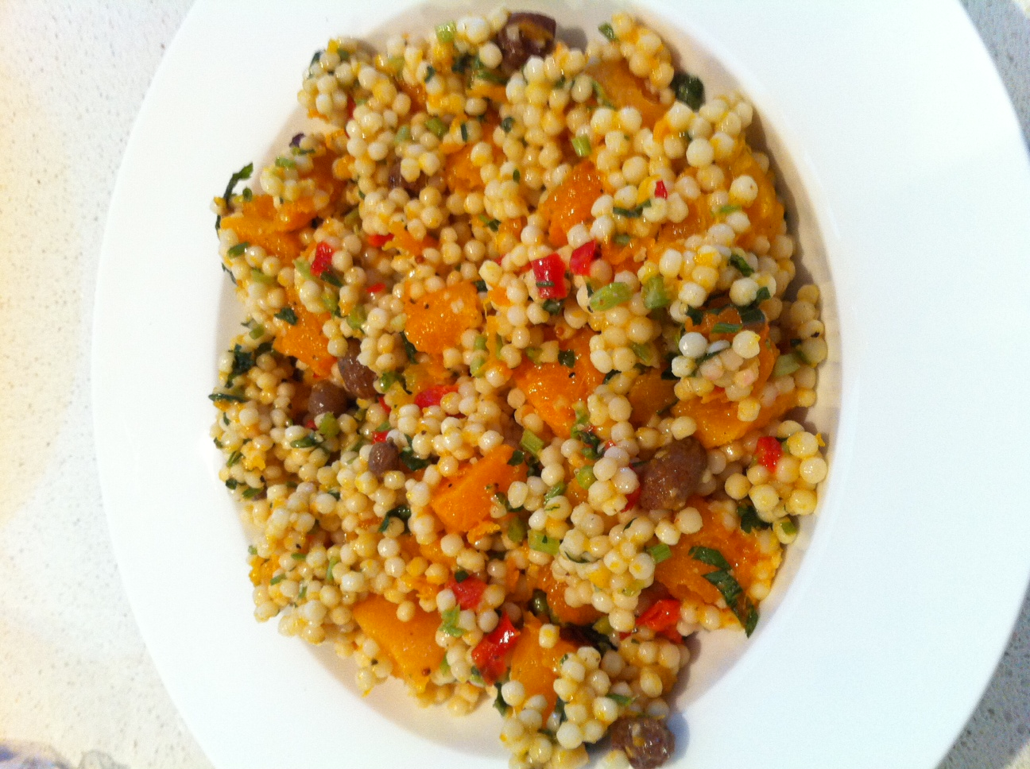
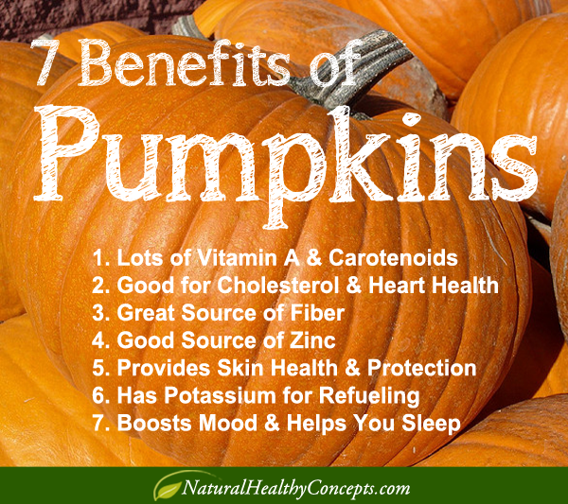
Health
Pumpkin contains vitamin A,vitamin C,vitamin E,
iron and magnesium.

Slide 6
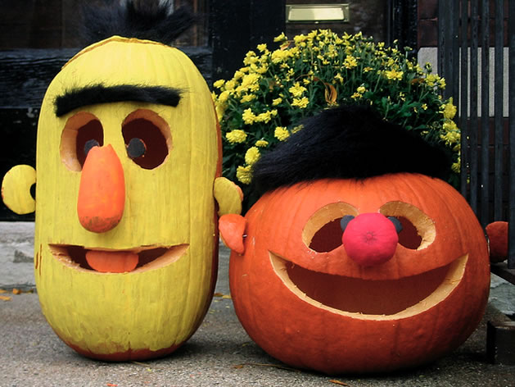
thanks for your attention ☺

