Slide 1
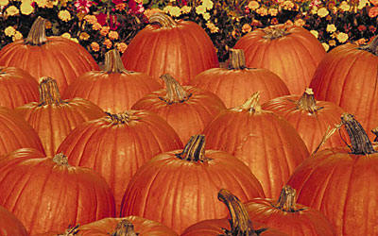
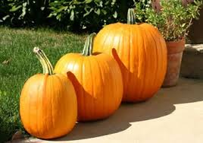
PUMPKIN
HABITATS,SOME PICTURES AND A VERIETY OF INTERESTING FACTS ABOUT PUMPKINS!!!!

Slide 2
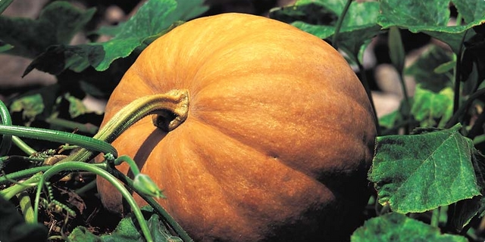
HABITATS
Pumpkins, like other squash, are native to North America. Pumpkins are widely grown for commercial use, and are used both in food and recreation. Pumpkin pie, for instance, is a traditional part of Thanksgiving meals in the United States, although commercially canned pumpkin puree and pumpkin pie fillings are usually made from different kinds of winter squash than the pumpkins frequently carved as jack-o'-lanterns for decoration around Halloween.

Slide 3
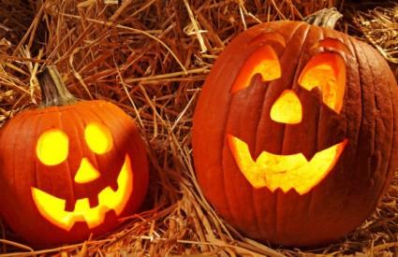
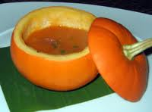
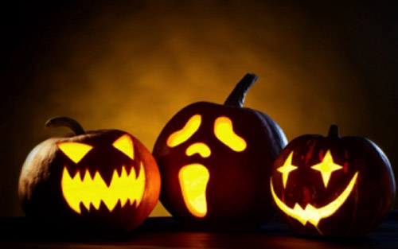
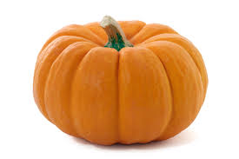
SOME PICTURES

