Slide 1
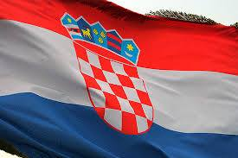
POPULATION

Slide 2
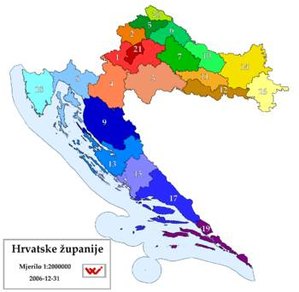
The whole Croatian territory is divided into twenty counties and the City of Zagreb, which has the status of a county. Name of Croatian counties is provided by the Counties, Cities and Municipalities in the Republic of Croatia, and is the basis of the name of the village where is the seat of the county assembly. The characteristics of the county coat of arms and flag. The coat of arms and flag shall be regulated by statute or statutory decision with prior approval of the Central State Office for Administration.

Slide 3
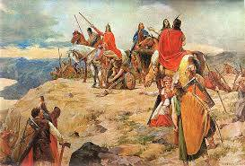
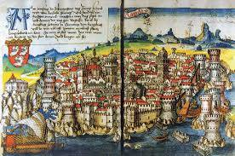
Of these Carpathian Croats one group broke away and fell to the south of the former Illyria, successfully opposed Avars and settled along the Croatia and Bosnia and Herzegovina. By imposing their indigenous language, gradually merged with different ethnic and cultural groups that are found.

Slide 4
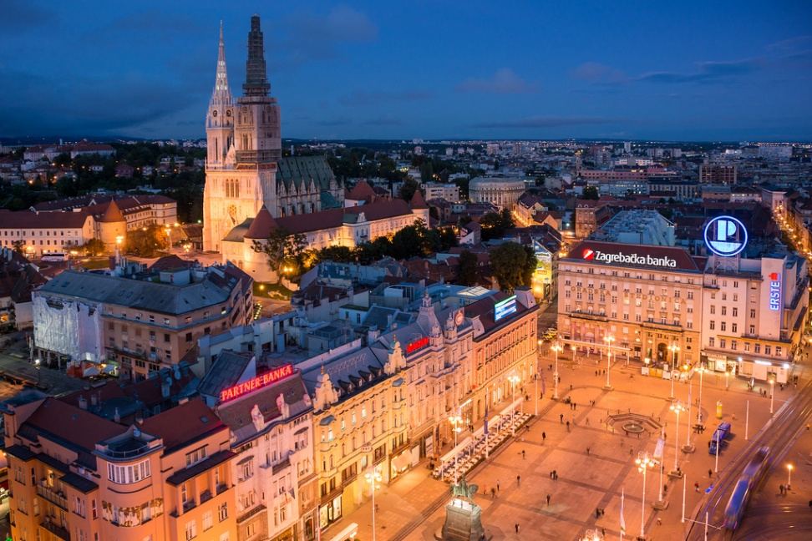
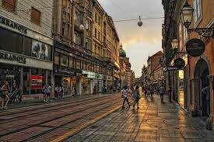
Zagreb is the Croatian capital, and largest city in Croatia by population. Historically, the city of Zagreb has grown from two villages in the neighboring hills, Gradec and Kaptol, which form the core of today's Zagreb, its historical centre. Zagreb is an administrative, economic, cultural, and scientific centre . Zagreb is a special single, territorial, administrative and self-governing unit with the position of the county ..

Slide 5
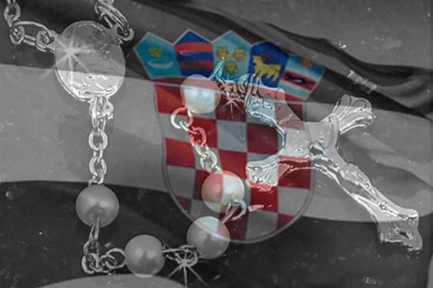
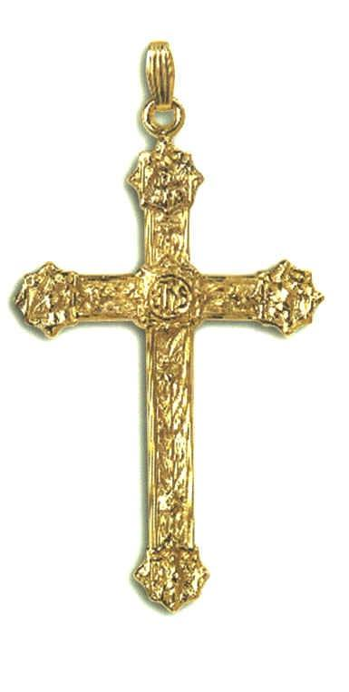
RELIGION Christianity is the most common religion of the Croatian people . According to the census of 2011, 86.28% of the population declare themselves to Roman Catholics.

Slide 6
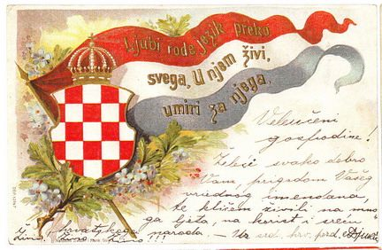
LANGUAGE In Croatia, the official language is Croatian, which is native to 95.60% of the population with the Latin alphabet, and in the county official and Italian who is the mother of 18,573 inhabitants. Other languages are languages settlers: Albanian, Bosnian, Bulgarian, Czech, Hebrew, Hungarian, Macedonian, German, Polish, Romanian, Russian, Slovak, Slovenian, Serbian, Italian, Turkish, Ukrainian .

Slide 7
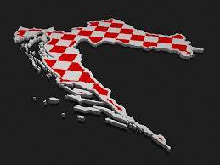
Thanks for your attention!
Made by:Ivana Melvan,Ana Šunjić,Petra Vuka

