Slide 1
CROATIA AND POLITICS
Grbeša,Vuković,Sarić I., Karaman Š.

Slide 2
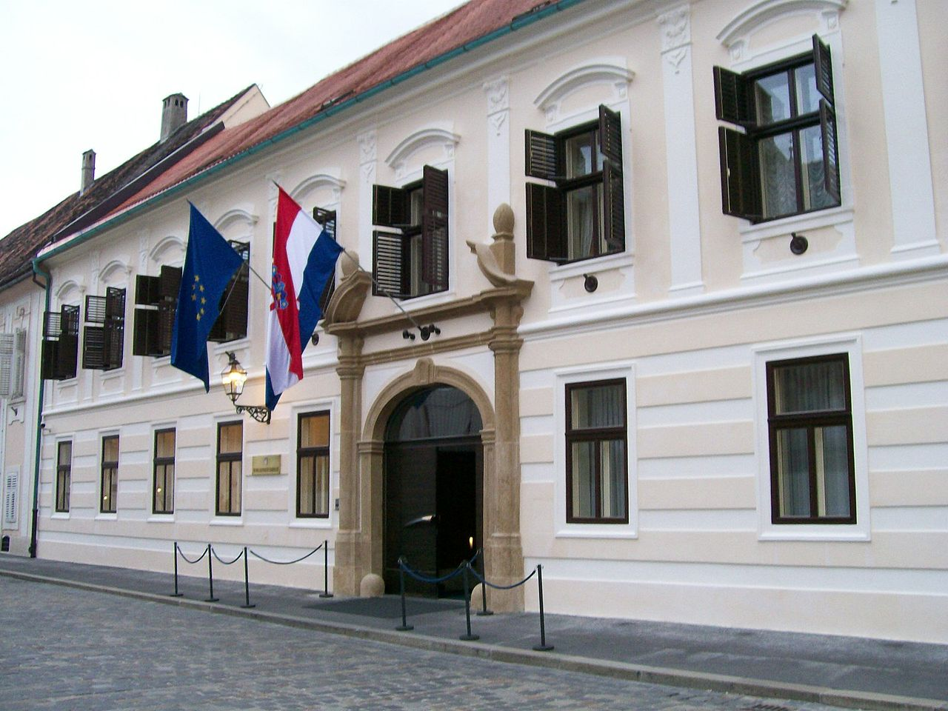
The politics of Croatia is defined by a parliamentary, representative democratic republic, where the Prime Minister of Croatia is the head of government in a multi-party system
The President of the Republic is the head of state; he or she is directly elected and serves a five-year term.

Slide 3
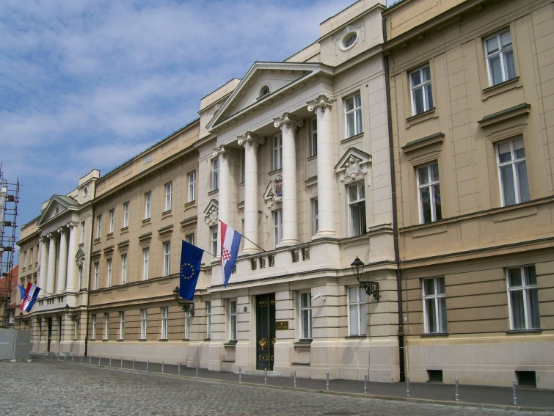
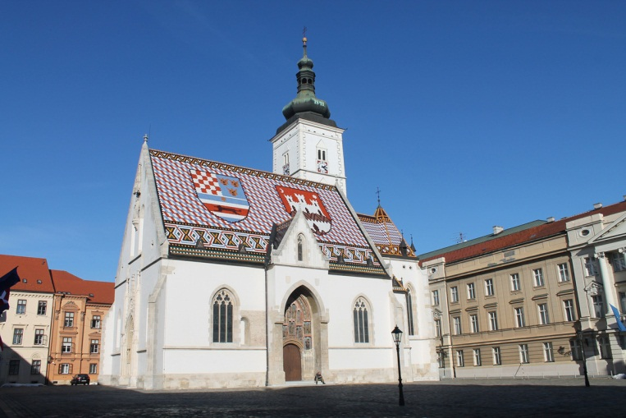
PARLIAMENT
The Parliament of Croatia is a unicameral legislative body
The building of the Croatian Parliament, the Parliamentary Palace, located in the Upper Town of Zagreb.

Slide 4
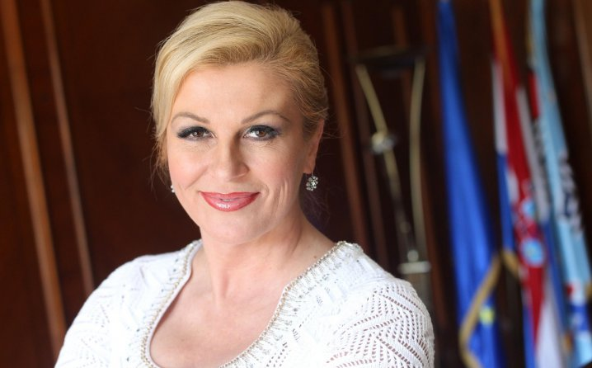
The President
-The first president of Croatia was Franjo Tuđman, the second Stjepan Mesić,the third one Ivo Josipović who was a university professor and composer. Today,the president of Croatia is Kolinda Grabar-Kitarović.
Kolinda Grabar was born on 29 April 1968 in Rijeka.

Slide 5
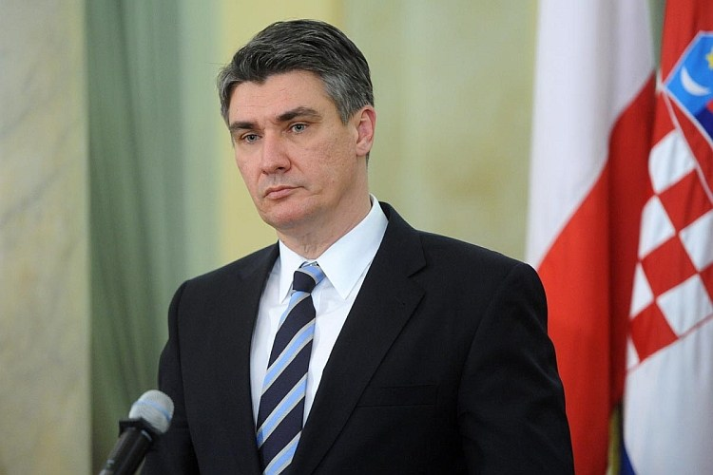
The Prime Minister
-Zoran MIlanović is Prime Minister of Croatia from 2011.
-He has been the leader and president of the Social Democratic Party of Croatia (SDP), the largest centre-left political party in Croatia, since 2007.

