Slide 1
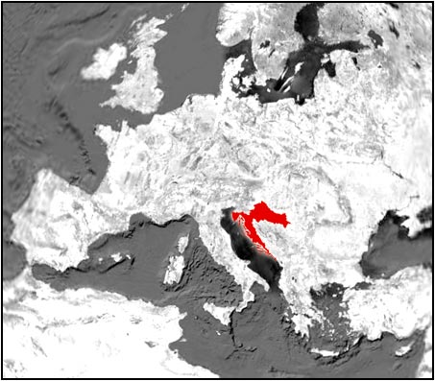
GEOGRAFICAL POSITION OF CROATIA
GEOGRAPHICAL POSITION
OF CROATIA

Slide 2
CROATIA BORDERS WITH
Croatia borders with

Slide 3
CROATIAN ISLANDS
CROATIAN ISLANDS

Slide 4
CROATIAN ISLANDS (TEXT)
This is a list of islands of Croatia. There are over a thousand islands in Croatia, the exact number varying according to definitions, and they cover a total area of about 3,300 km2.
The number and classification of islands in Croatia varies over time and across different measurements.

Slide 5
PLITVICE LAKES
PLITVICE LAKES
Plitvice Lakes National Park (Croatian: Nacionalni park Plitvička jezera, Plitvice ) is one of the oldest national parks in Southeast Europe and the largest national park in Croatia. In 1979, Plitvice Lakes National Park was added to the UNESCO World Heritage register.

Slide 6
CROATIAN RELIEF
CROATIAN TERRAIN

Slide 7
ZAGREB
ZAGREB – THE CAPITAL CITY
Zagreb is the Croatian capital, and the largest city in Croatia by population. Historically, the city of Zagreb has grown from two villages in the neighboring hills, Gradec and Kaptol, which form the core of today's Zagreb, its historical centre.

Slide 8
SPLIT
SPLIT – THE MOST BEAUTIFUL CITY IN THE WORLD
Split is the largest city in Dalmatia, the second largest city in Croatia, according to the last census, conducted in 2011, Split has 178,192 inhabitants. It is the second largest Croatian port and the third port on the Mediterranean by the number of passengers.

Slide 9
POLJUD
POLJUD – THE MOST IMPORTANT PART OF THE CITY
City Stadium, built in 1979, in a beautiful part of town, Poljud.
In all its splendor, in the form of shells, fits, just like it is here in the past, the views of the Mediterranean milieu, to which almost reach the sea waves.

Slide 10
VUKOVAR
CITY OF HEROES
Vukovar is an old baroque city, still best known for its terrible devastation during the war,among a number of attractive, but in the war severely damaged buildings.

Slide 11
THE END
WE LOVE CROATIA
BY: GORAN KARAMAN, FABIO SARIĆ,KRISTIJAN JURIĆ & VEDRAN BOBAN

