Slide 1
Culture

Slide 2
culture
Croats have been living in this area for 13 centuries.
Although there are many important historical sites from
earlier periods six places in Croatia have been marked
on the World Heritage List by UNESCO :
• The Euphrasian Basilica in Poreč
• The Chatedral of St. James in Šibenik
• The historic City of Trogir
• The historic complex of Split with the Palace of Diocletian
• The old City of Dubrovnik
• The Plitvice lakes

Slide 3
The euphrasian Basilica
The Euphrasian Basilica is a basilica in Poreč, Croatia.
The present basilica, dedicated to Mary, was built in the sixth century during the period of Bishop Euphrasius. It was built from 553 on the site of the older basilica.
For the construction, parts of the former church were used and the marble blocks were imported from the coast of the Sea of Marmara..

Slide 4
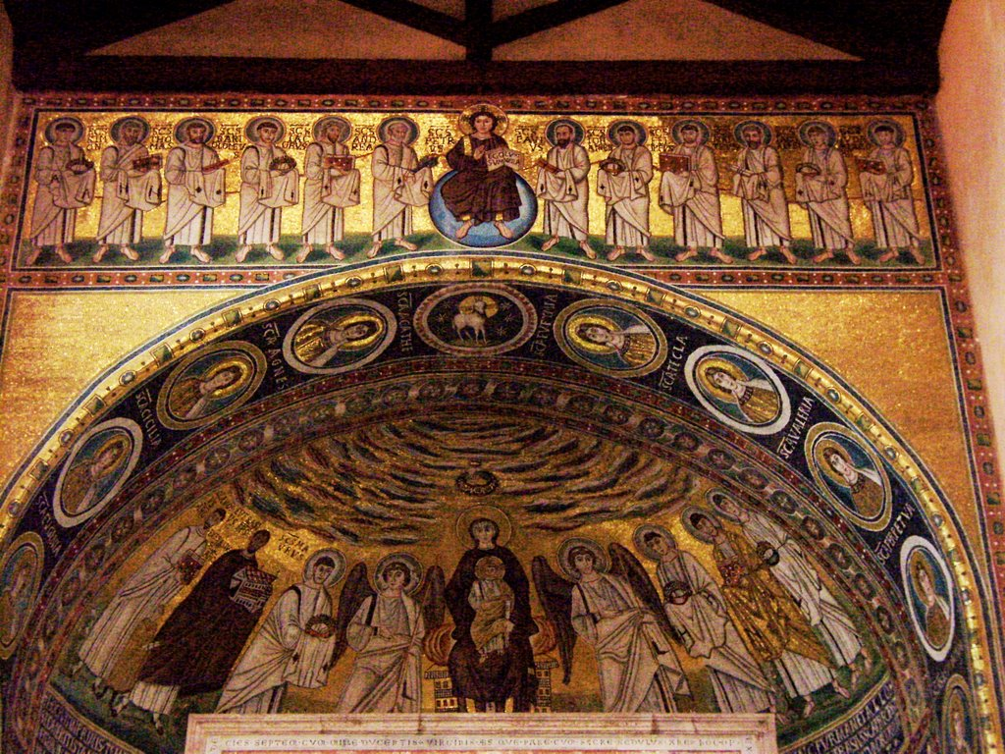
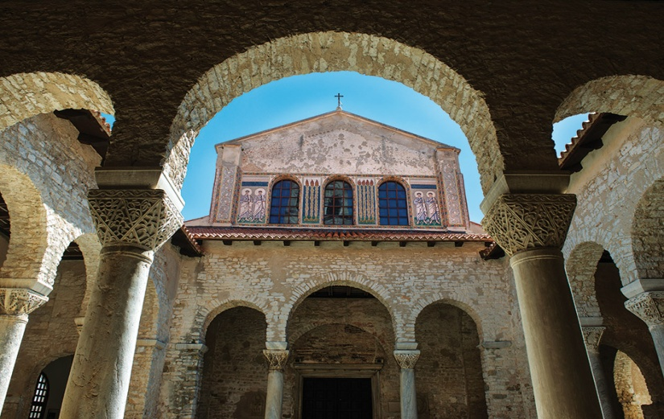
The euphrasian basilica

Slide 5
The chathedral of st. James in šibenik
The Cathedral of St. James is a triple-nave basilica with three apses and a dome (32 m high inside) in the city of Šibenik, Croatia.
It is the most important architectural monument of the Renaissance in the country.
Built entirely of stone and marble from the island of Brač, it was completed in three phases, from 1433 to 1441.

Slide 6
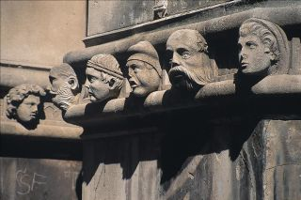
The chatedral of st. James in šibenik

Slide 7
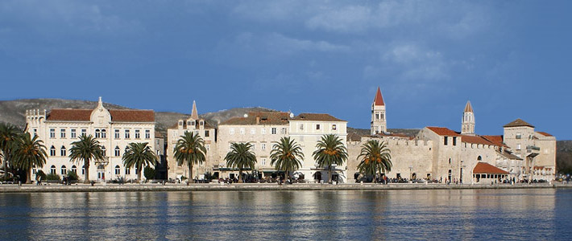
Trogir
Trogir is a historic town and harbour on the Adriatic coast in Split-Dalmatia County, Croatia. The historic city of Trogir is situated on a small island between the Croatian mainland and the island of Čiovo.
Since 1997, the historic centre of Trogir has been included in the UNESCO list of World Heritage Sites. The name comes from the Greek "tragos" (male goat).

Slide 8
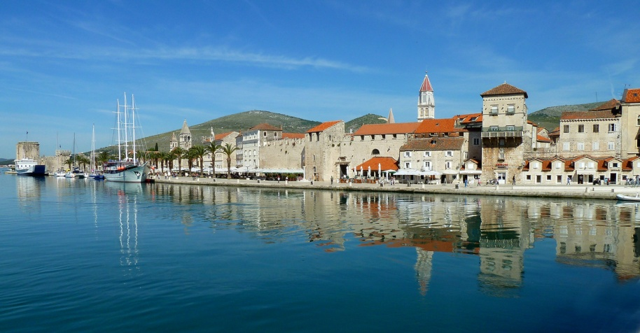
trogir

Slide 9
Diocletian’s Palace
Diocletian's Palace (Croatian: Dioklecijanova palača ) is an ancient palace built by the Roman emperor Diocletian at the turn of the fourth century AD, that today forms the centre of the city of Split.
In November 2006 the City Council decided to permit over twenty new buildings within the palace (including a shopping and garage complex), despite the fact that the palace had been declared a UNESCO World Heritage Monument
Diocletian built the massive palace in preparation for his retirement on. It lies in a bay on the south side of a short peninsula running out from the Dalmatian coast, four miles from Salona, the capital of the Roman province of Dalmatia .

Slide 10
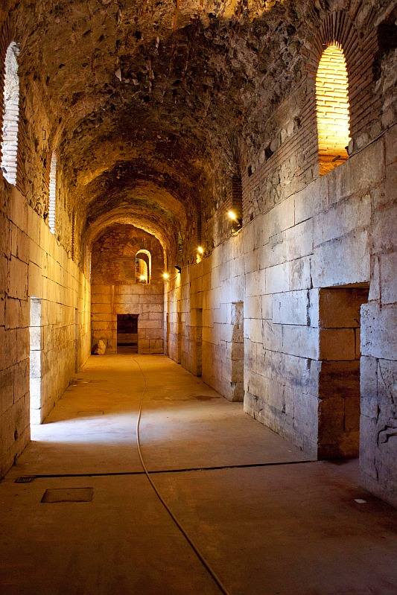
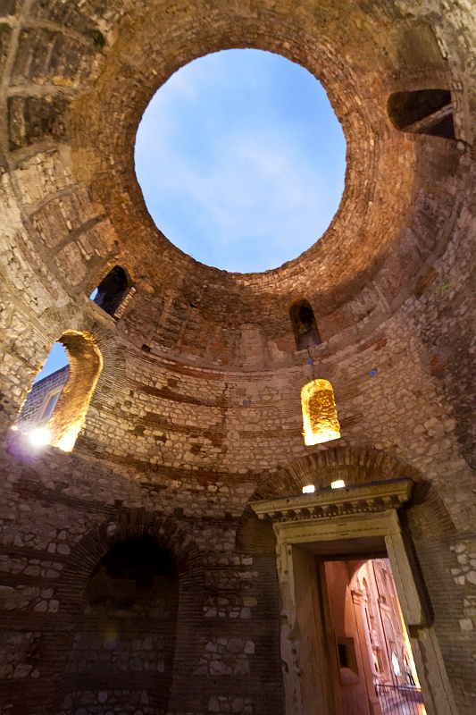
Diocletian’s palace

Slide 11
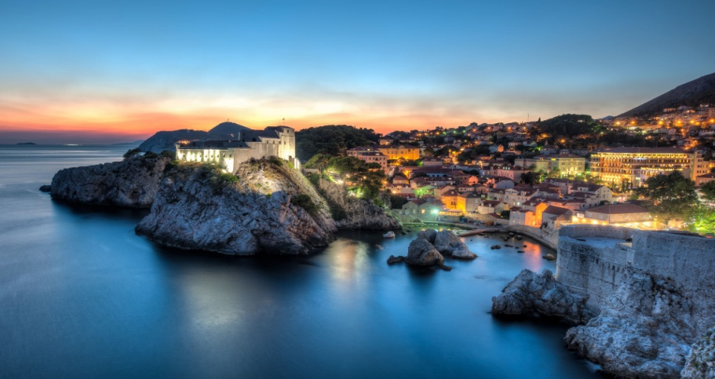
dubrovnik
Dubrovnik is a Croatian city on the Adriatic Sea, in the region of Dalmatia. It is one of the most prominent tourist destinations in the Mediterranean Sea, a seaport and the centre of Dubrovnik-Neretva County.
In 1979, the city of Dubrovnik joined the UNESCO list of World Heritage Sites Dubrovnik was founded in the 7th century on a rocky island named Laus, which is said to have provided shelter for refugees from the nearby city of Epidaurum.

Slide 12
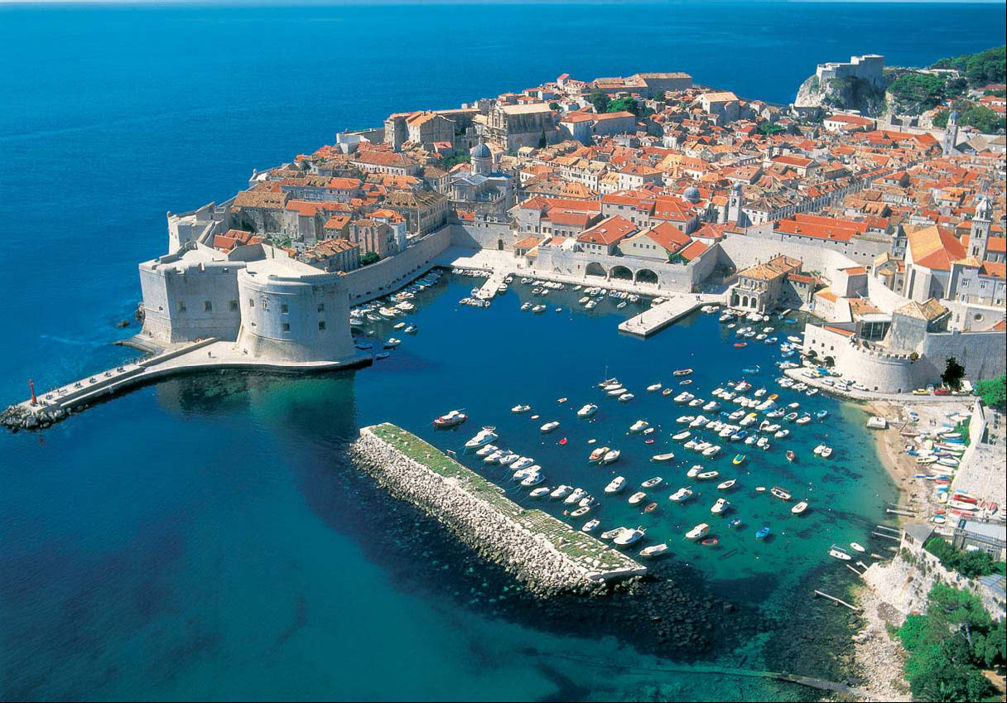
dubrovnik

Slide 13
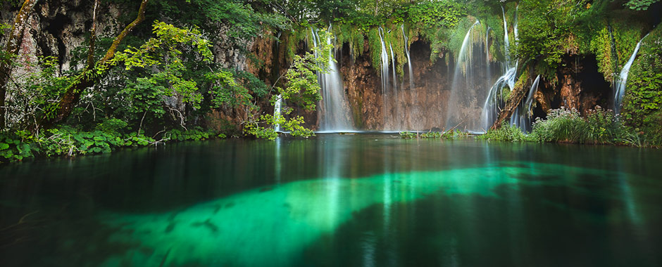
Plitvice lakes
Plitvice Lakes National Park (Croatian: Nacionalni park Plitvička jezera) is one of the oldest national parks in Southeast Europe and the largest national park in Croatia. The national park was founded in 1949 and is situated in the mountainous area of central Croatia, at the border to Bosnia and Herzegovina.
The important north-south road connection, which passes through the national park area, connects the Croatian inland with the Adriatic coastal region.

Slide 14
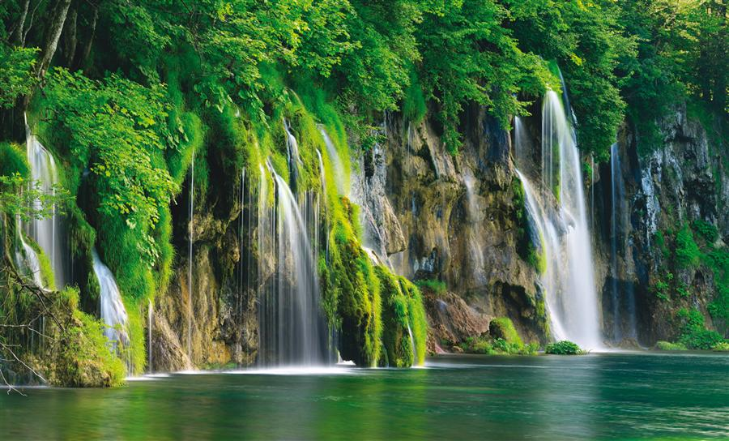
Plitvice lakes

Slide 15
zadar
Zadar is the 5th largest city in Croatia situated on the Adriatic Sea.
It is the centre of Zadar County and the wider northern Dalmatian region.
Zadar is a historical centre of Dalmatia as well as the seat of the Roman Catholic Archdiocese of Zadar.

Slide 16
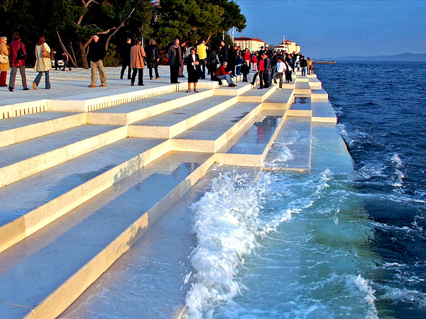
zadar

Slide 17
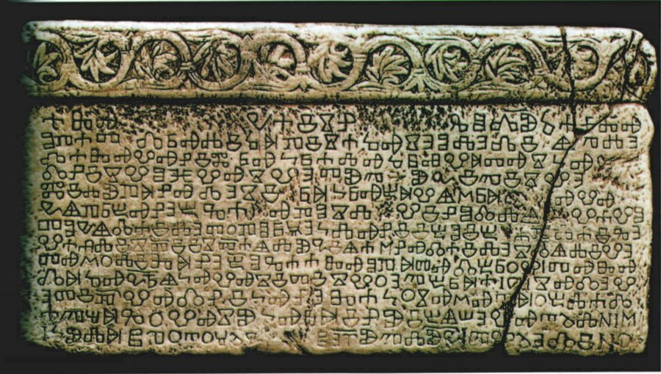
Baska tablet
Baska tablet (Croatian: Bašćanska ploča)
Is one of the first monuments containing an inscription in the Croatian recension of the Church Slavonic language, dating from 1100.

Slide 18
The zagreb Chatedral
Situated on Kaptol, it is a Roman Catholic institution and not only the tallest building in Croatia, but also the most monumental sacral building in Gothic style southeast of the Alps.

Slide 19
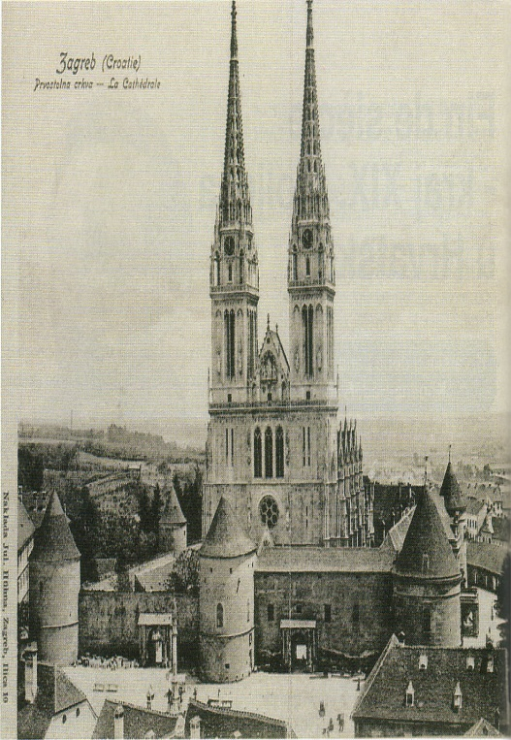
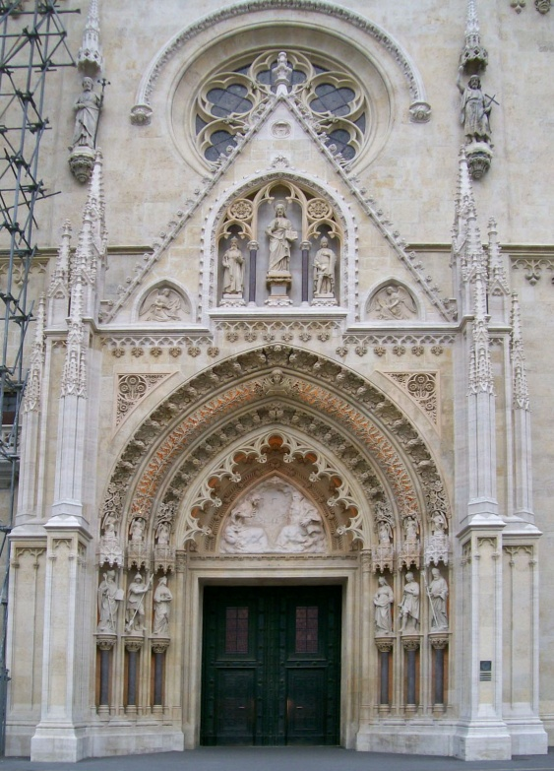
The zagreb chatedral

Slide 20
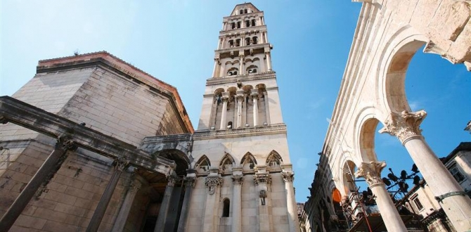
Cathedral of Saint Domnius
The Cathedral of Saint Domnius (Croatian: Katedrala Svetog Duje),
known locally as the Saint Dujam (Sveti Dujam) or colloquially Saint Duje (Sveti Duje), is the Catholic cathedral in Split, Croatia.
The cathedral is the seat of the Archdiocese of Split-Makarska, headed by Archbishop Marin Barišić.
The Cathedral of St. Duje is a complex of a church, formed from an Imperial Roman mausoleum, with a bell tower; strictly the church is dedicated to the Virgin Mary, and the bell tower to Saint Duje.
Together they form the Cathedral of St. Duje.

Slide 21
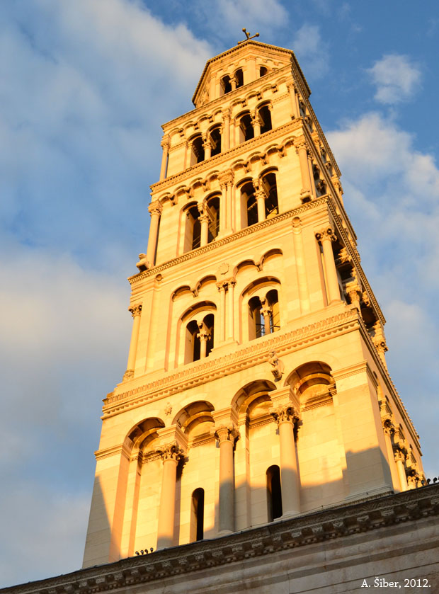
Chatedral of saint dominis

Slide 22
thanks for your attention
By: Jelena Boban
Tea Buzov
Maja Juric
8.B
Information by: Wikipedia

