Slide 1
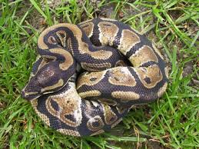
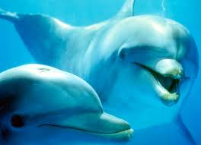
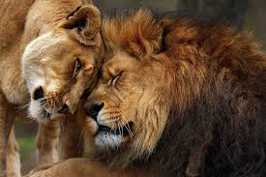
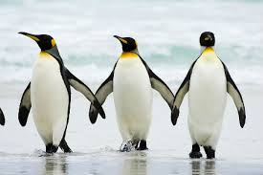
Animals
By: Fabio Sarić & Kristijan Jurić

Slide 2
Lion
The lion is one of the five big cats in the genus .Panthera The commonly used term African lion collectively denotes the several subspecies found in Africa. With some males exceeding 250 kg in weight it is the second-largest living cat after the tiger. Wild lions currently exist in sub-Saharan Africa and in Asia while other types of lions have disappeared from North Africa and Southwest Asia in historic times. Until about 10,000 years ago, the lion was the most widespread large land mammal after humans. The lion is a vulnerable species which can not be seen outside designated reserves and national parks.

Slide 3
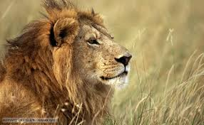

Slide 4
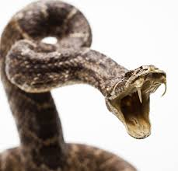
Snake
Snakes are elongated, legless, carnivorous reptiles of the suborder Serpentes that can be distinguished from legless lizards by their lack of eyelids and external ears. Many species of snakes have skulls with several more joints than their lizard ancestors, enabling them to swallow prey much larger than their heads with their highly mobile jaws.

Slide 5
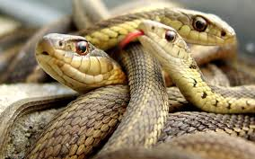

Slide 6
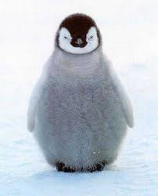
Penguin
Penguins are a group of aquatic, flightless birds living almost exclusively in the Southern Hemisphere, especially in Antarctica. Highly adapted for life in the water, penguins have counter shaded dark and white plumage, and their wings have evolved into flippers. Most penguins feed on krill, fish, squid and other forms of sealife caught while swimming underwater. They spend about half of their lives on land and half in the oceans.

Slide 7
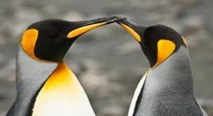

Slide 8
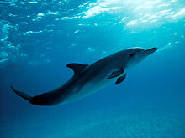
D0lphins
These marine mammals are related to whales and porpoises. They are found worldwide, mostly in the shallower seas of the continental shelves. As the name implies, these dolphins tend to be found in the open seas, unlike the river dolphins.
Six of the larger species, the killer whale, pilot , melon-headed, pygmy killer and false killer whales, are commonly called whales, rather than dolphins; they are also sometimes collectively known as "blackfish"

Slide 9
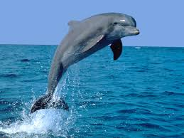

Slide 10
Polar bear
It is a large bear, an adult male weighs around 350–700 kg , while an adult female is about half that size. Although it is the sister species of the brown bear, it has many body characteristics adapted for cold temperatures, for moving across snow, ice, and open water, and for hunting the seals which make up most of its diet. Although most polar bears are born on land, they spend most of their time at sea.

Slide 11
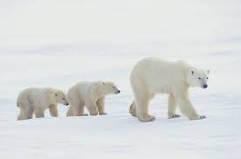

Slide 12
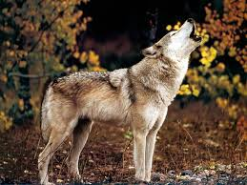

Slide 13
Elephant
Two species are traditionally recognised, the African elephant and the Asian elephant , although some evidence suggests that African bush elephants and African forest elephants are separate species. Elephants are scattered throughout sub-Saharan Africa, South Asia, and Southeast Asia. Male African elephants are the largest surviving terrestrial animals and can reach a height of 4 m and weigh 7,000 kg.

Slide 14
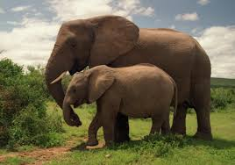

Slide 15
Thank you for your attention!!!

