Slide 1
PLUM

Slide 2
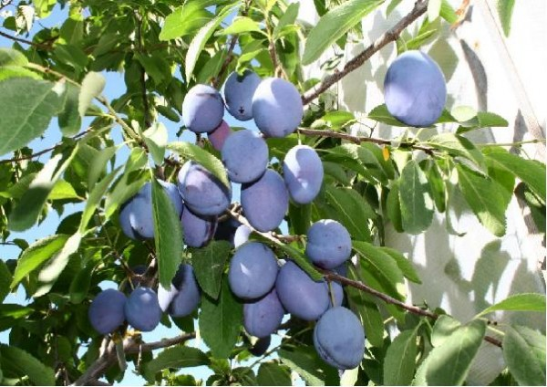
basics of plums
Plum is a type of fruit that grows on a tree, a round or oval fruit. Blue, red or yellow. The flesh is sweet, yellowish in color with stone in the middle.

Slide 3
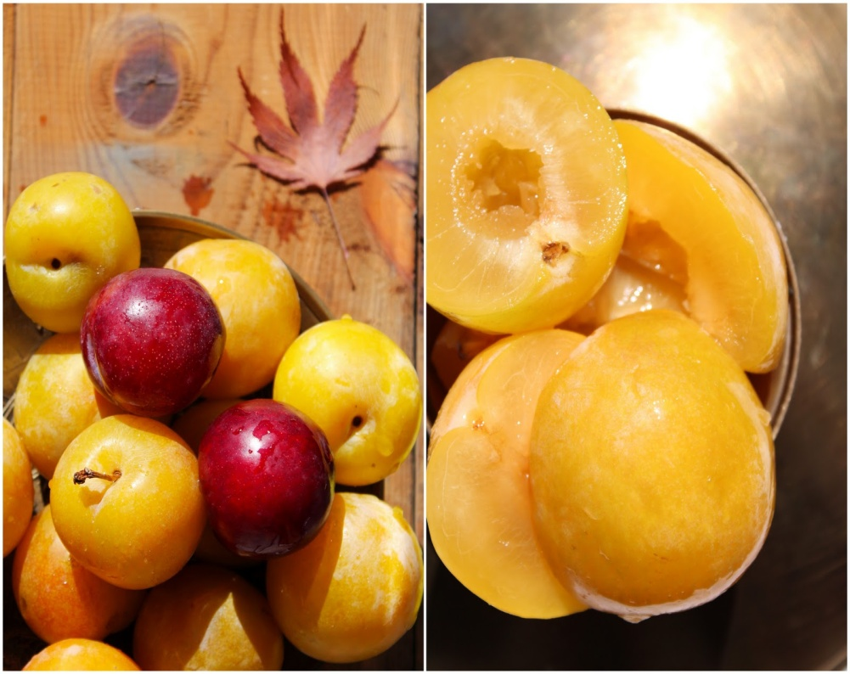
YELLOW PLUM
This yellow plum is little bit smaller but it is as sweet as purple one.
Yellow plum

Slide 4
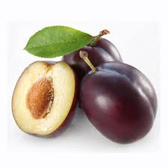
Phylogenetically speaking, plum belongs to the same genus, which includes white plum, almond, peach, apricot, laurel cherry, cherry and cherry plum fruit that have a pit.

Slide 5
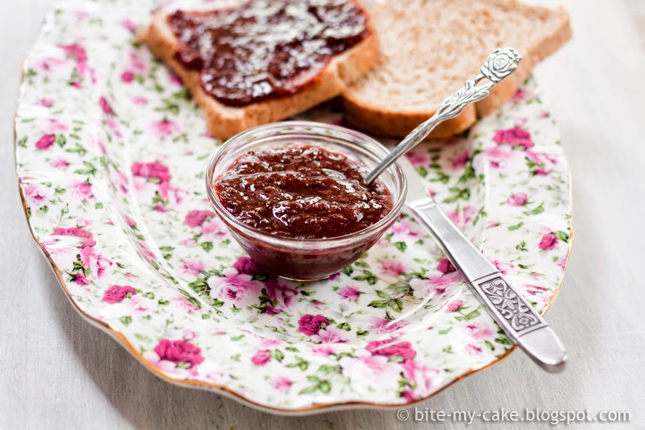
Plums are healthy !
It is eaten fresh and dried and used for the production of spirits, jams and to prepare some dishes such as dumplings.

Slide 6
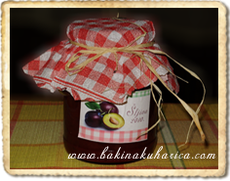
Plum jam according to a traditional recipe
Plum jam, made by our grandmothers, is my favorite breakfast. Its only drawback is too much sugar.

Slide 7
this presentation is made
ZOLJE
DUJE
NEDO
ŠAFRO
NIKE
Sources:
-Wikipedia
-Stare Hrvatske voćke

