Slide 1
The plum
CREATED BY: Laura Perković, Bruna Radić, Petra Babić, Jasna Uvodić.
TEACHER: Gordana Čović.

Slide 2
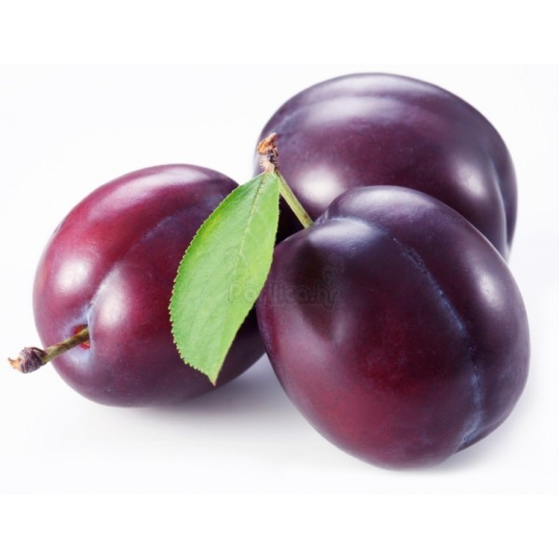
General information
A plum is a drupe fruit of the subgenus Prunus.
Mature plum fruit may have a dusty-white coating that gives them a glaucous appearance.
Dried plum fruits are called dried plums or prunes, although prunes are a distinct type of plum, and may have antedated the fruits now commonly known as plums.

Slide 3
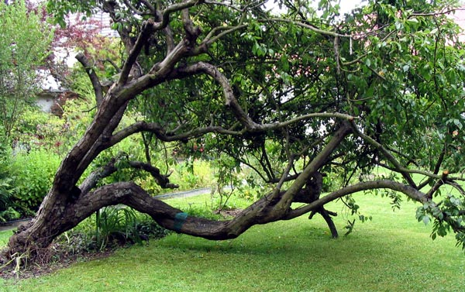
description
Plums are a diverse group of species. The commercially important plum trees are medium sized, usually pruned to 5-6 meters height.

Slide 4
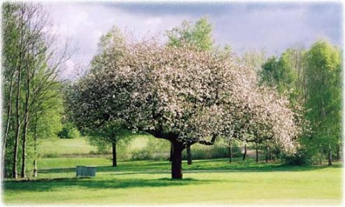
Plum blossom
The trees can reach 12 meters in height and spread across 10 meters. They blossom in different months in different parts of the world.

Slide 5
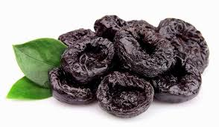
history
Plums may have been one of the first fruits domesticated by humans.
Plum remains have been found in Neolithic age archaeological sites along with olives, grapes and figs.

Slide 6
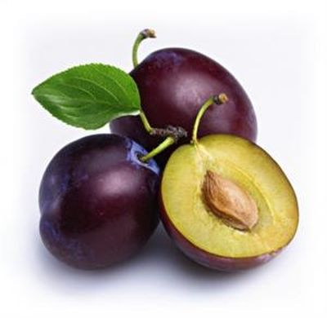
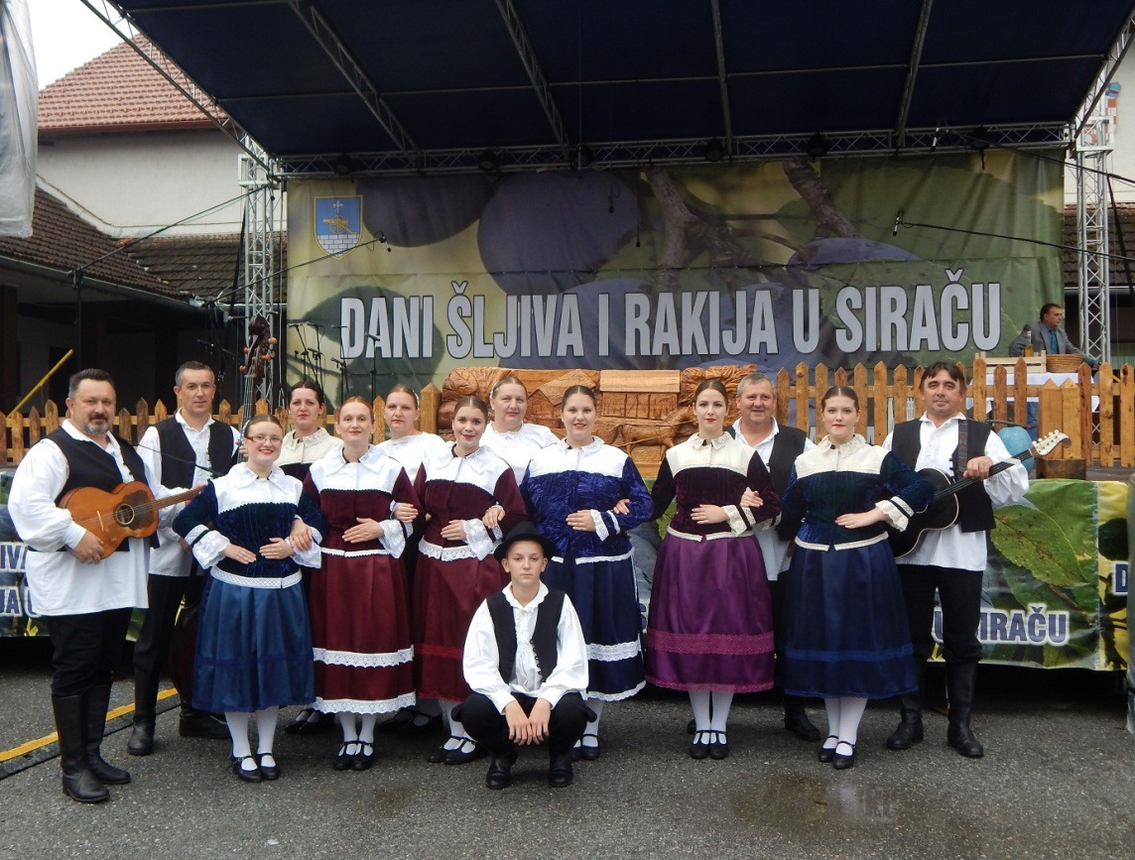
Plum day
Plum Day is celebrated in some parts of Croatia, mostly in Slavonia. People usually make traditional plum dishes.

Slide 7
