Slide 1
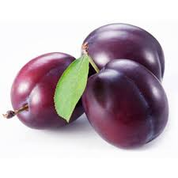
Plum

Slide 2
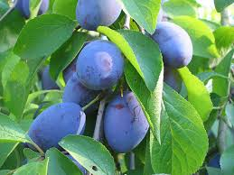
Let`s meet plum
-purple fruit
-sweet and delicious
-harvested in August

Slide 3
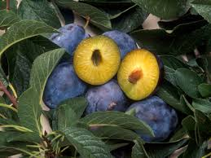
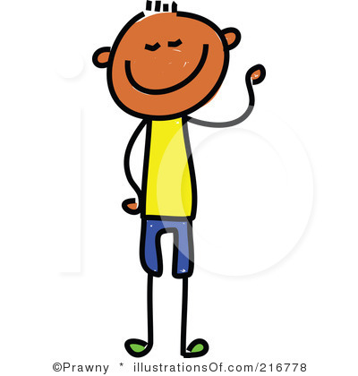
Plum
Hy,I like plum!
You?
Plum
Plum
Notes:
Plum

Slide 4
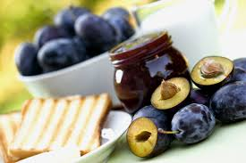
Marmelade
Jams and marmelades are made of plums.They are tasty and healthy,especially for old people. Marmelades are one of the best preserves.

Slide 5
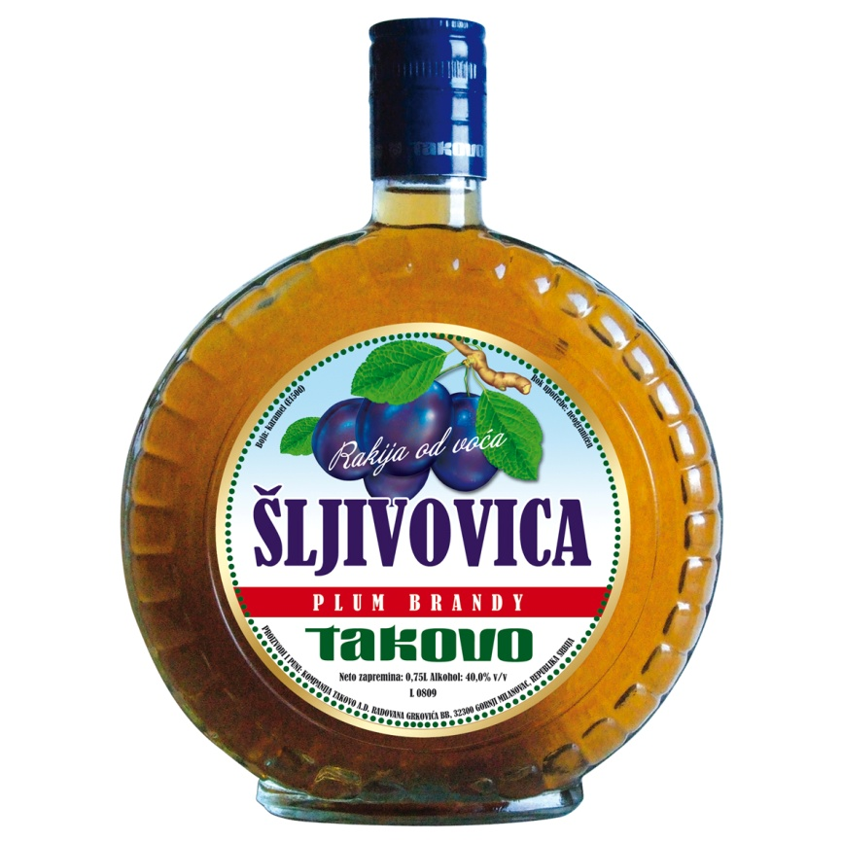
Šljivovica
-drink for old people
-it can be brown or white
-it`s healthy

Slide 6
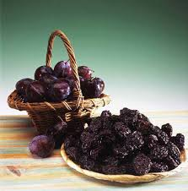
Suvice
Suvice are dry plums.It takes several months to make plums dry.Suvice are dried in dark and cold places.

Slide 7
Thanks for watching.
By:Matea Lauš,Josip Galić,Karmen Gazibara and Antonija Jogunić.

