Slide 1
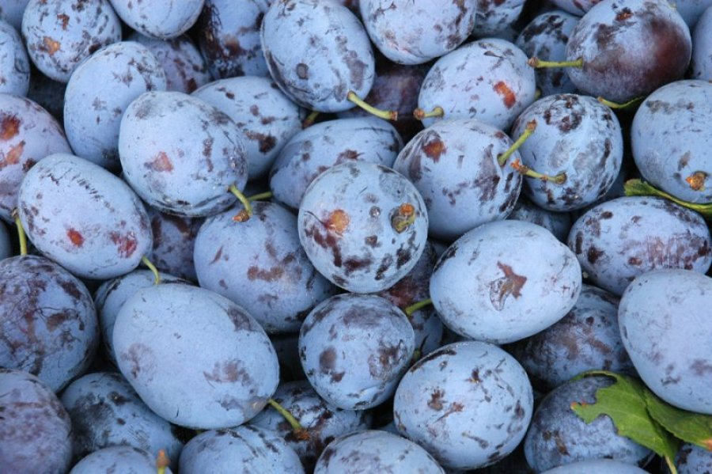
Plum
By: Iva Plazibat, Nina Rađa and Morena Kurtović

Slide 2
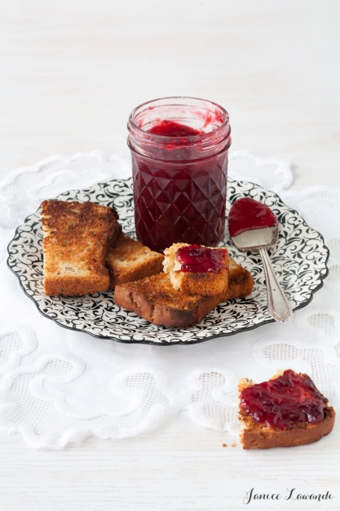
The Plum day
The 17th of october we celebrate as the Plum day in our school. Some places have special events these days.On those events you can try plum tarts,jams and other products.People make and try some brandy and of course...
have a lot of fun!

Slide 3
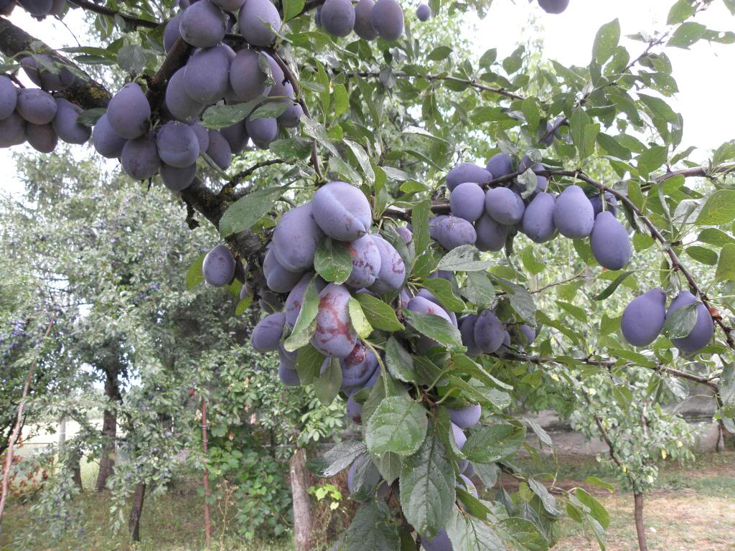
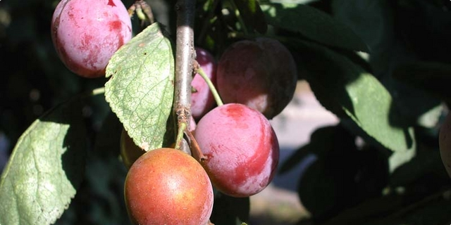
Origin
It comes from Asia and it has been known in Antiquity.In the past,the plum was first planted in Babilon and Syria.

Slide 4
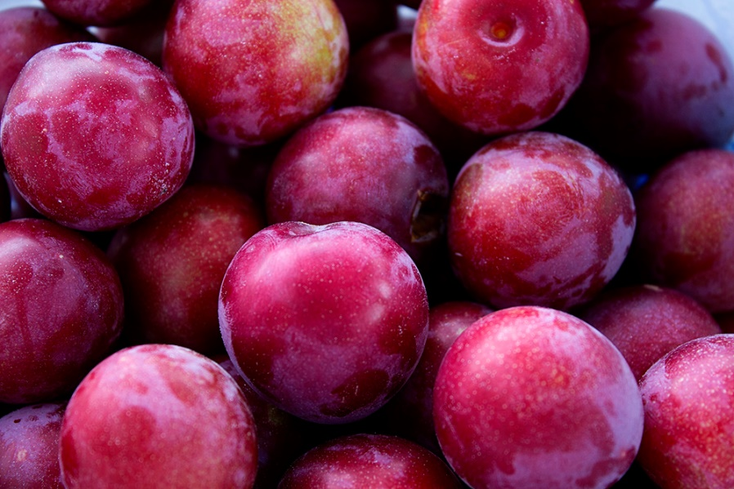
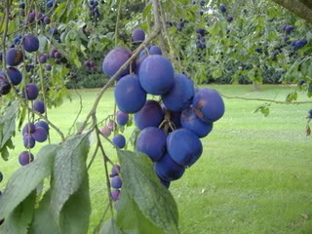
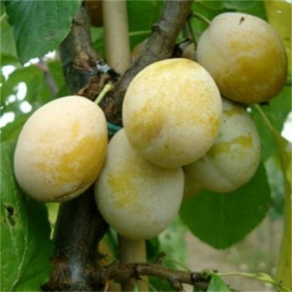
There are few types of plums, for example:
-Merryweather
-Shropshire Prune
-Early Rivers

Slide 5
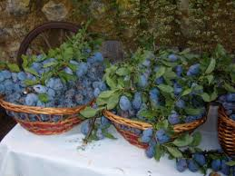
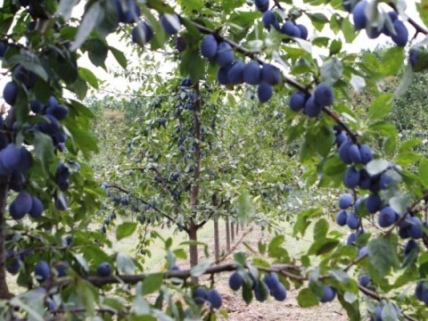
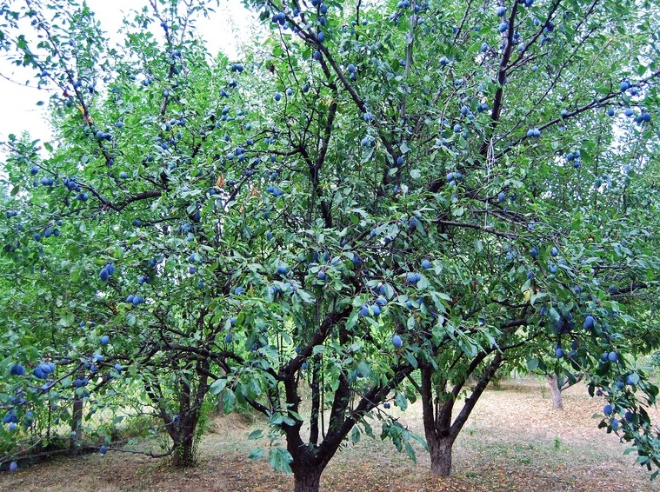
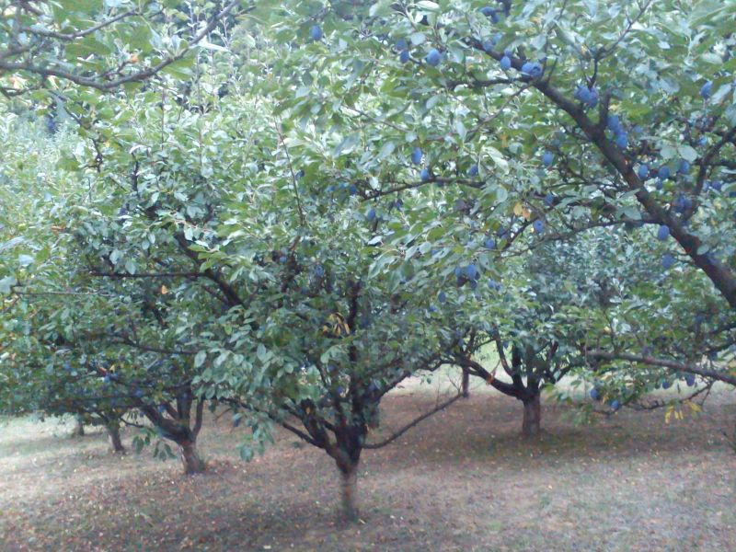
Plum growing as a medium sized tree, more or less luxuriant growth.

Slide 6
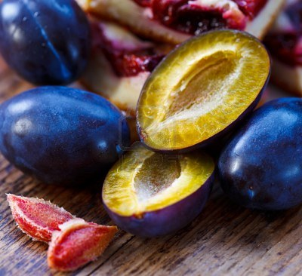
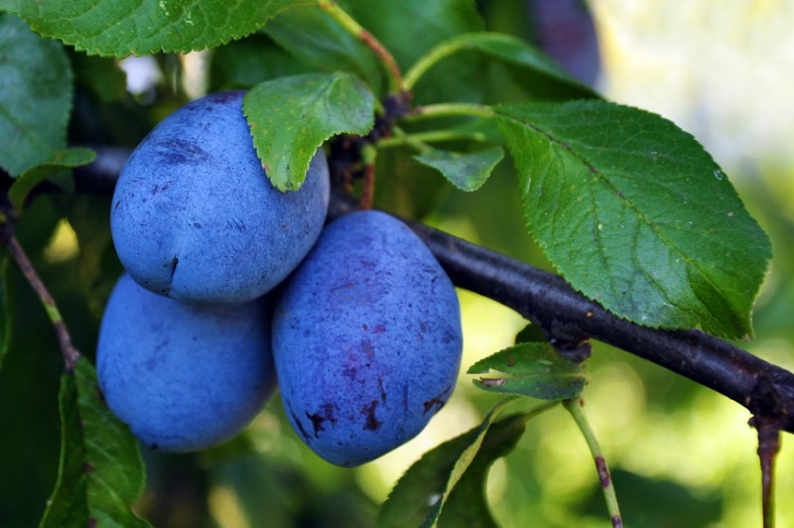
Plums have smooth-textured yellow-green flesh and its skin, which ranges from dark blue to indigo to near-black depending on the variety.

Slide 7
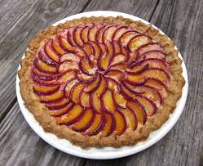
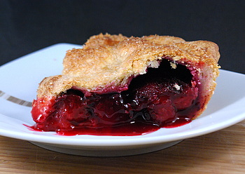
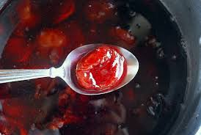
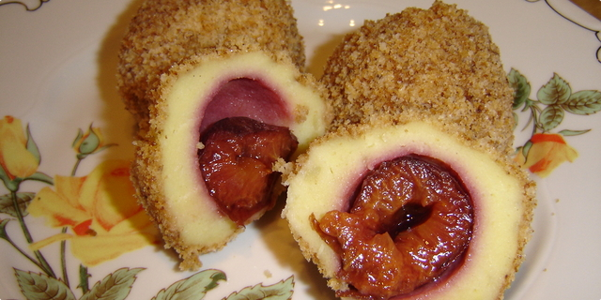
Dishes with plums
Using plums you can make a lot of products:
pies
teas
dumplings
juices
tarts

Slide 8
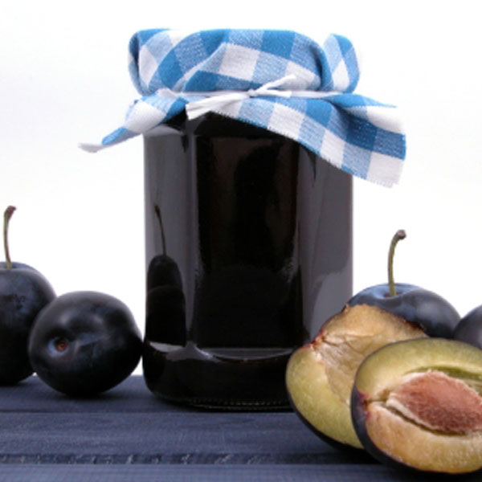
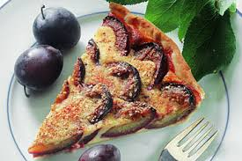
Fresh plums are an excellent source of vitamin C, which is a powerful natural antioxidant . Plums can also be frozen and stored for up to 3 months.

Slide 9
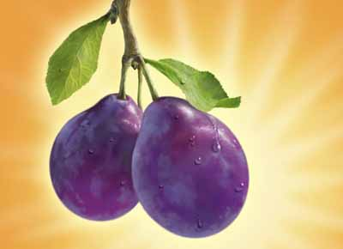
Literature
We used for this presentation:
Wikipedia
Coolinarka
Plums tags
Thanks for watching!
Bye!

