Slide 1
PLUMS
By:Antonio Šakić
David Molnar

Slide 2
History
Plums may have been one of the first fruits domesticated by humans.
Diocletian first planted plums in our country.
Charles the Great planted the first plums in Europe.

Slide 3
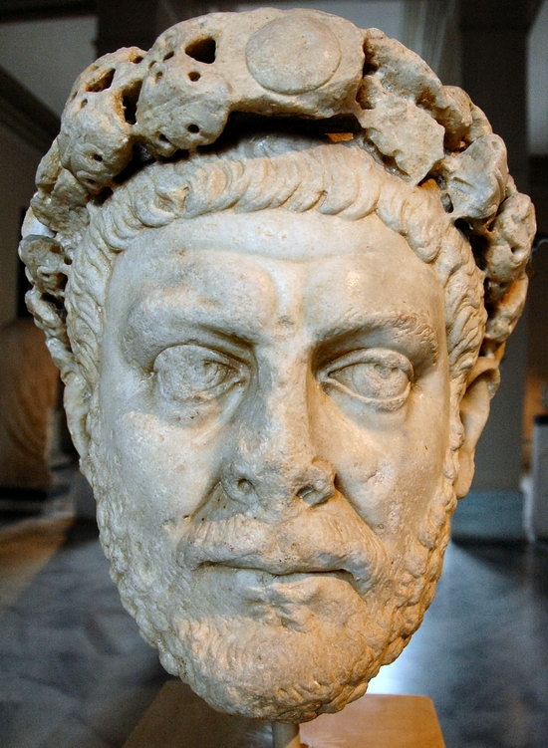
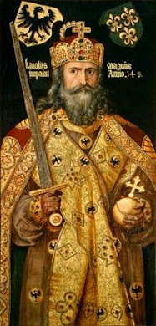

Slide 4
Characteristics
Plums are trees that usually grows from 3 to 10 meters,leaves and flowers are growing at the same time.
Fruit of plum is meaty and juicy.
There are a lot of different kinds of plums.

Slide 5
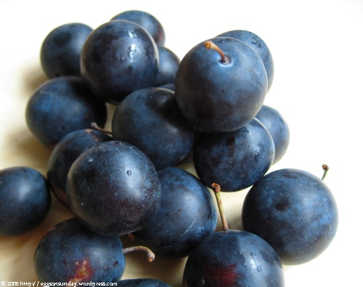
Kinds of plums
Damson plums

Slide 6
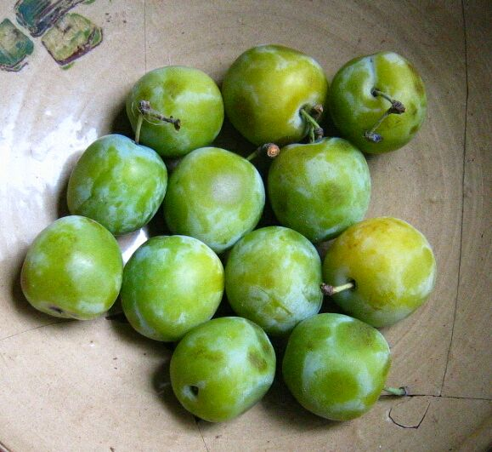
Greengage plum

Slide 7
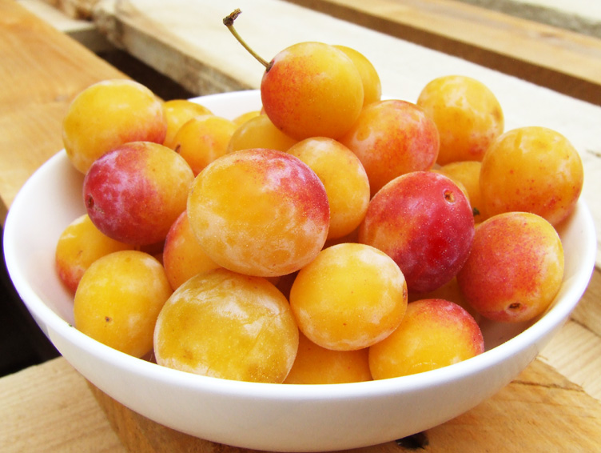
Mirabelle plums
customer

Slide 8
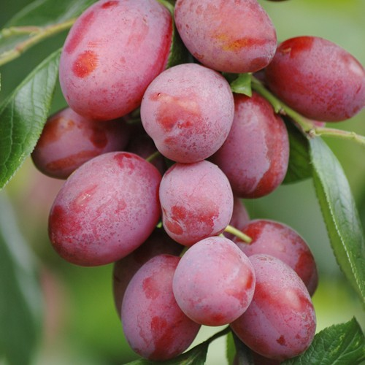
Victoria plums
announcing

