Slide 1
Plum
Made by :
Ante Mihaljević
Roko Gazibara

Slide 2
Plums
Grow on tree
Round and oval fruit
Blue,red or yellow in color
The flesh is sweet, yellowish in color with stone in middle

Slide 3
Types of plums
Bistrica – our local variety of unknown origin.
Stanley-new varitey grown in the United States.
Čaćanska rodna- the variety orginated in Serbia by crossing cultivar Stanley and Bistrica.

Slide 4
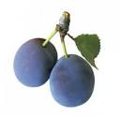
Bistrica Stanley
Čaćanska rodna

Slide 5
Healing properties of plums
Plum helps us in:
Diffuculty with concentration
Strengthens the heart and immune system
Regulates digestion

Slide 6
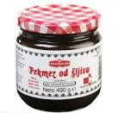
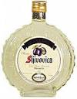
What can you make with plum?
Delicious jam
Compotes
Plum brandy

