Slide 1
GEOGRAPHICAL POSITION OF CROATIA

Slide 2
CROATIA IN EUROPE
CONTINENT:Europe
REGION:Central Europe and Southeastern Europe
COORDINATES: 45°8′30″N 16°13′45”E

Slide 3
BORDERS
BORDERS:
BiH(933km)
Slovenia(501km)
Hungary(329km)
Serbia(241km)
Montenegro(25km)

Slide 4
AREA
TOTAL:56,594km2
Land-99%(56.414km2)
Water-1%(128km)
Ranked:127

Slide 5
COASTLINE
Coastline:5.835km
Land-1.777km
Islands-4.058km

Slide 6
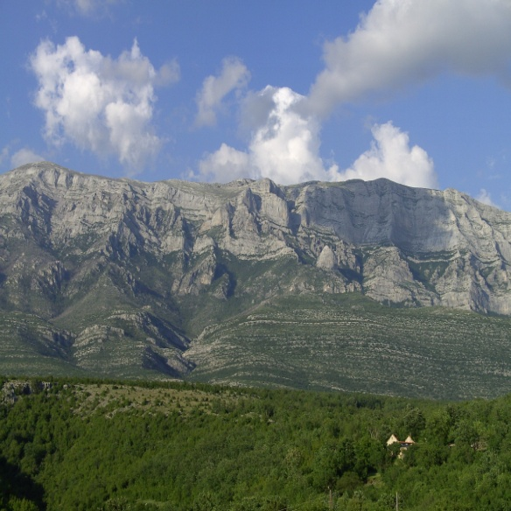
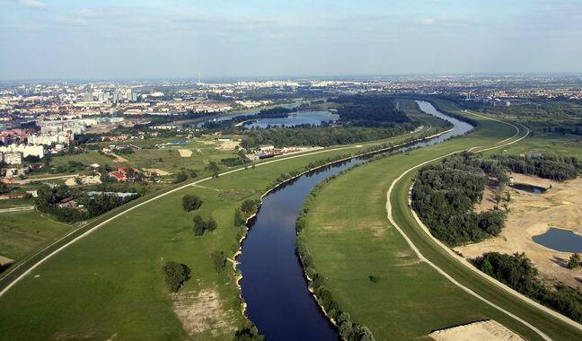
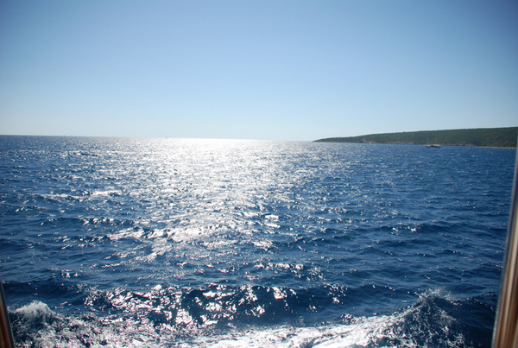
FEATURES
HIGHEST POINT:
-Dinara(1.831m)
LOWEST POINT:
-Adriatic Sea(0m)
LONGEST RIVER:
-Sava(562km)
LARGEST LAKE:
-Lake Vrane(30.7km2)

Slide 7
COUNTY
COUNTY:
First 5-
1.Ličko-senjska
2.Splitsko-dalmatinsaka
3.Sisačko-moslovačak
4.Osječko-baranjska
5.Zadarska

Slide 8
CROATIA IN THE WORLD
Croatia on the world map is very small and unimportant for larger states,but no matter how small it is ,for us, it is the sweetest and the most beautiful country.

Slide 9
THIS PRESENTATION is MADE by
Petra Babić
Iris Kunac
Ivan Zolje
Duje Vrdoljak
Nediljko B.-Labinčić
Petar Šafradin
Nikola Munitić
SOURCES OF INFORMATION:WIKIPEDIA

