Slide 1
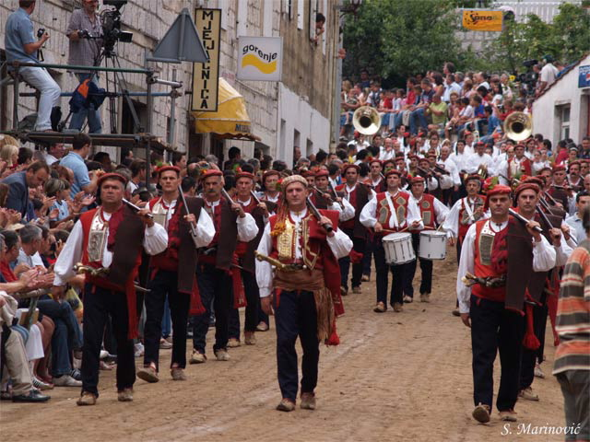
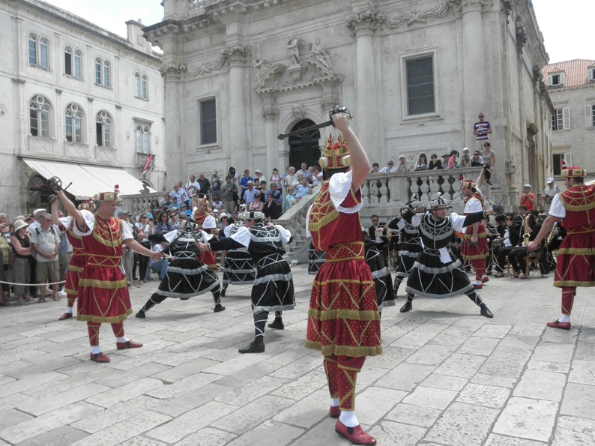
Croatian Culture

Slide 2
The UNESCO has marked seven places in Croatia as World Heritage Sites:
Episcopal complex of the Euphrasian Basilica in the historic center of Poreč
The cathedral of St. James in Šibenik
Historic city of Trogir
Diocletian's Palace, built by Roman Emperor Diocletian
Old city of Dubrovnik
Plitvice Lakes
Stari Grad Plain on the Adriatic island of Hvar, parceled by Ancient Greece

Slide 3
Euphrasian basilica
is one of the best examples of early Byzantine architecture in the Mediterranean region.

Slide 4
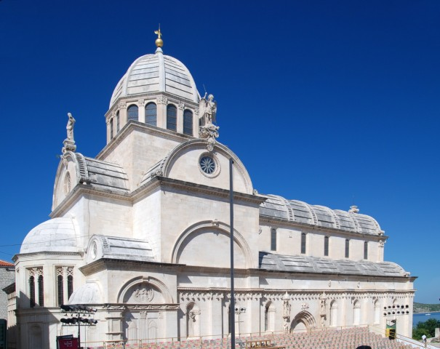
Cathedral St. James in Šibenik
The Cathedral of St. James (Croatian: Katedrala sv. Jakova) in Šibenik, Croatia is a triple-nave basilica with three apses and a dome 32 m high inside

Slide 5
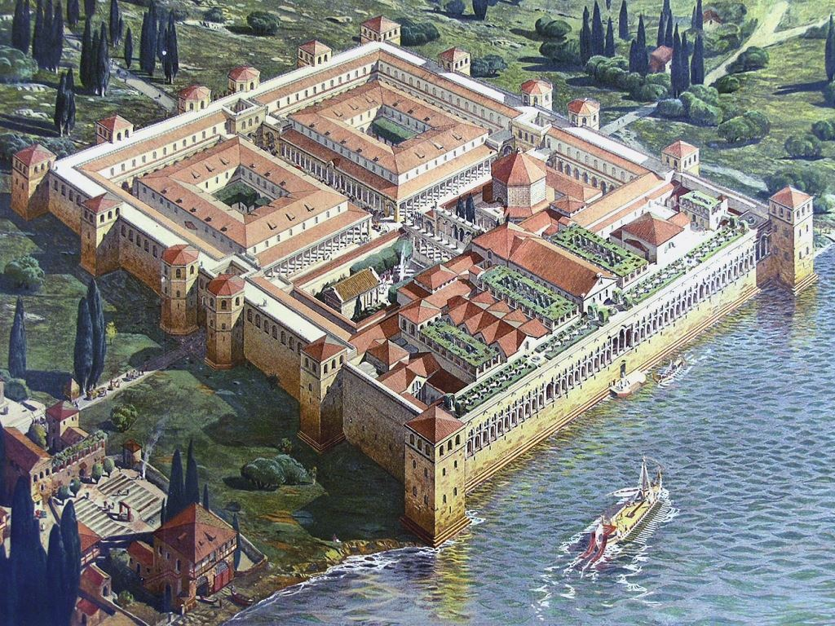
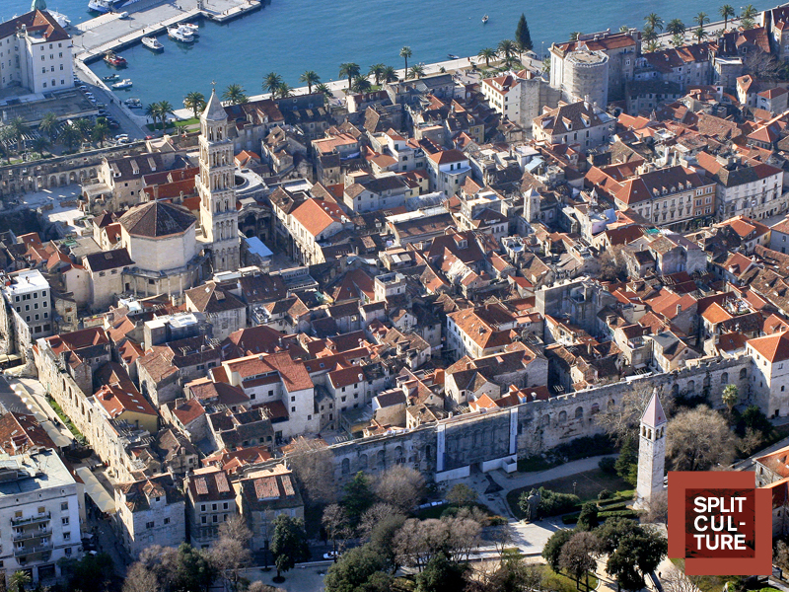
Diocletian palace
Diocletian's Palace (Croatian: Dioklecijanova palača, pronounce is an ancient palace built by the Roman emperorDiocletian at the turn of the fourth century CE, that today forms the center of the city of Split

Slide 6
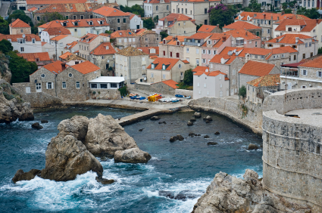
Old city of Dubrovnik
Dubrovnik ( Italian: Ragusa) is a Croatian city on the Adriatic Sea, in the region of Dalmatia. It is one of the most prominent tourist destinations in the Mediterranean

Slide 7
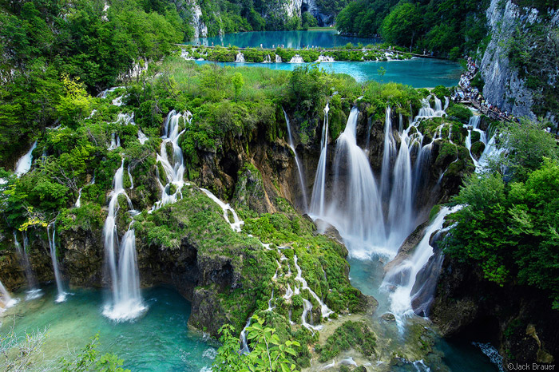
Plitvice lakes
Plitvice Lakes National Park (Croatian: Nacionalni park Plitvička jezera) is the oldest national park inSoutheast Europe and the largest national park in Croatia.

Slide 8
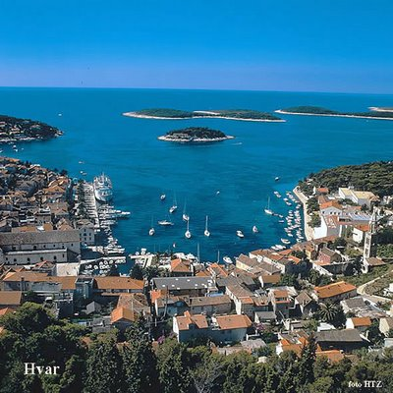
Stari Grad Plain
The Stari Grad Plain on the island of Hvar is an agricultural landscape that was set up by the ancient Greek colonists in the 4th century BC, and remains in use.

Slide 9
Presentation made by:
Josip Galić
Vjekoslav Pleština
Antonio Lekić
Branimir Didak
Željko Deković
8a
O.Š Petra Kružića

