Slide 1
Croatian Politics
Made by:Dora Uvodić,Mare Valenta,Jasna Uvodić,Bruna Radić, Laura Perković and Antonija Jogunić.
Teacher:Gordana Čović

Slide 2
About:
Croatian Parliament is the representative body of the citizens and the legislative body of the Republic of Croatia.
The building of the Croatian Parliament, the Parliamentary Palace, located in the Upper Town of Zagreb.

Slide 3
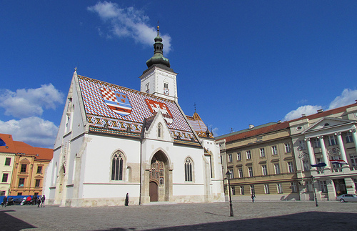
Croatian parliament

Slide 4
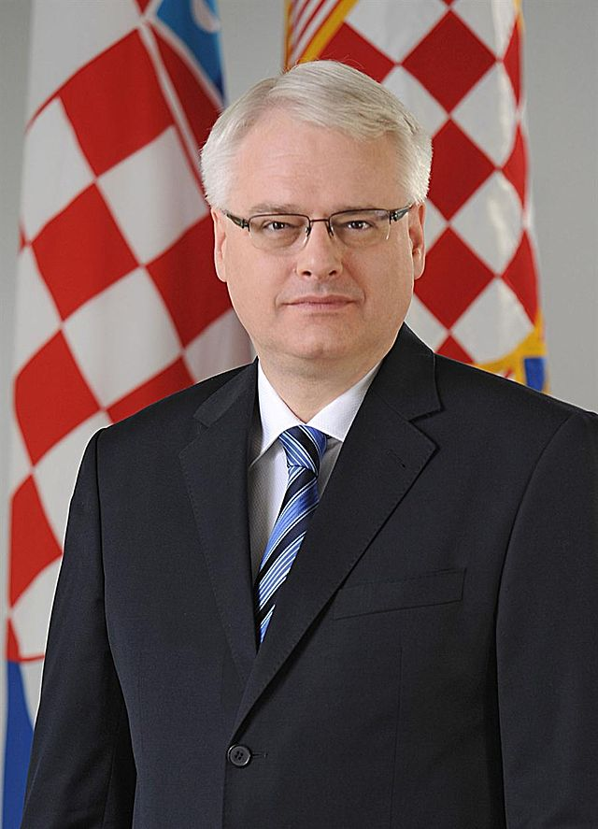
The President
Ivo Josipović (Zagreb, 28 August 1957) is the third president of the Croatian.
A university professor, composer, politician, member of the 6th Croatian Parliament, elected in 2010 for a third of Croatian President.

Slide 5
The Prime Minister
Zoran Milanović (born 30 October 1966) is a Croatian politician who was Prime Minister from 2011.
After graduating from the Faculty of Law in Zagreb, Milanović started working at the Ministry of Foreign Affairs. He has served as an advisor to the Croatian Mission to the European Union and NATO in Brussels.

Slide 6
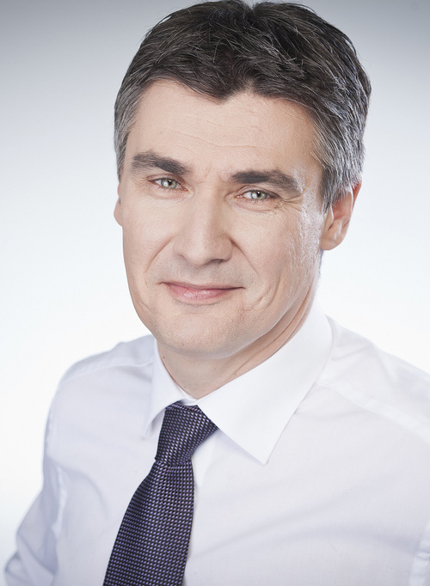
Zoran Milanović-The prime minister

