Slide 1
CLIMATE IN CROATIA
NAPRAVILI:
Roko Gazibara
Ante Mihaljević
Antonio Šakić
David Molnar
Stipe Majstorović

Slide 2
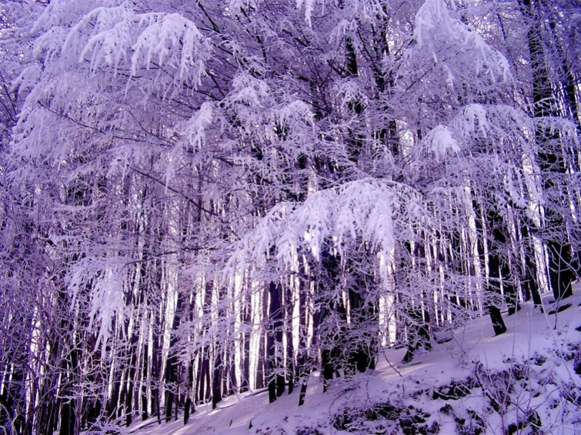
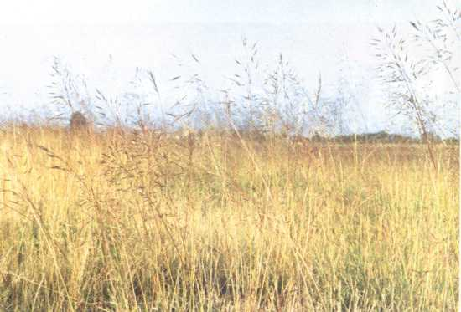
Continental climate
A continentale climate prevails in the north of Croatia.
Summers are hot and winters are cold and humid.

Slide 3
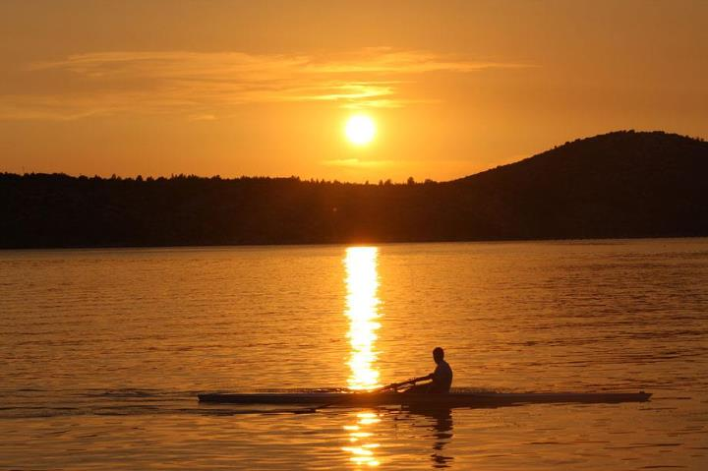
Mediterranean climate
Along the Adriatic coast,the climate is Mediterranean.
Summers are very hot and dry,and winters are mild with temperatures rarely dropping below 5ºC.

Slide 4
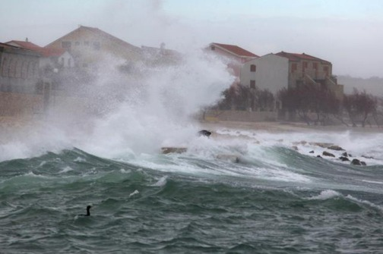
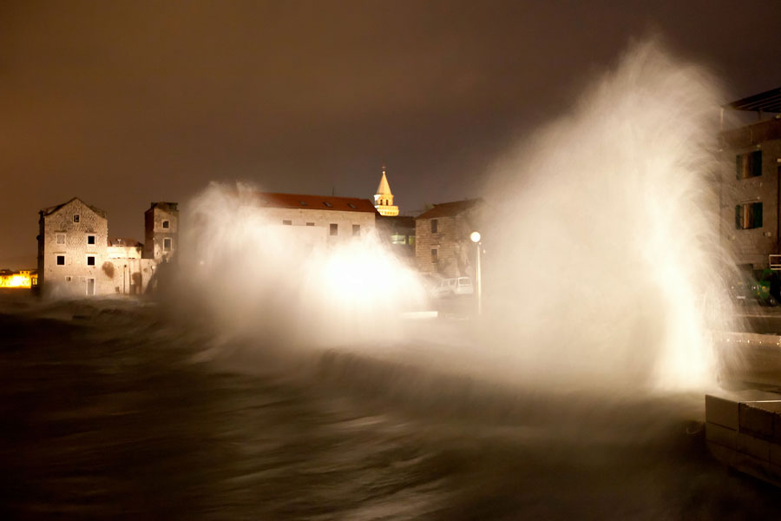
Winds in Croatia
In Croatia,the winds appear different than they were,especially in the Adriatic ,the most important bora and sirocco.
Bora
Sirocco

Slide 5
Rainfall in Croatia
Rainfall is usually in the form of rain and sometimes snow (in the colder part of year).

Slide 6
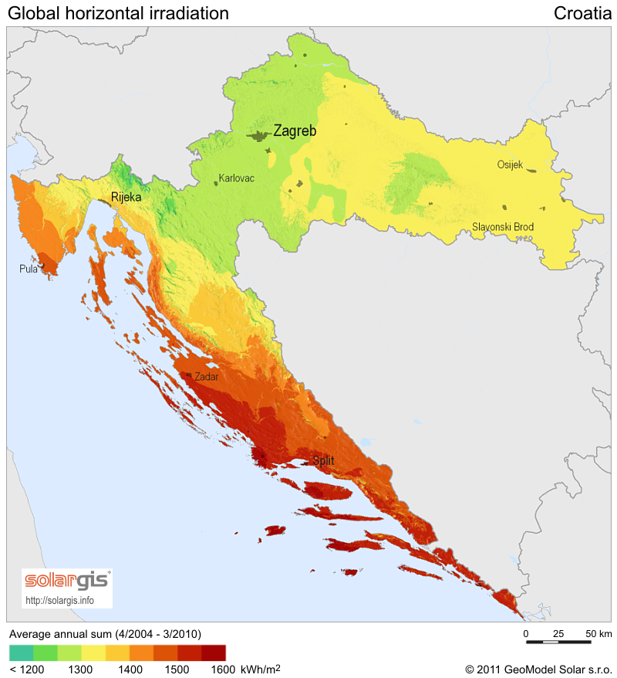
Duration of sunshine
The average duration of sunshine in Croatia is increasing from west to east and from north to south.Sunniest island- Hvar

