Slide 1
Medicinal Herbs
Marina Bulić,6.b
Teacher:Marijana Buljan
T

Slide 2
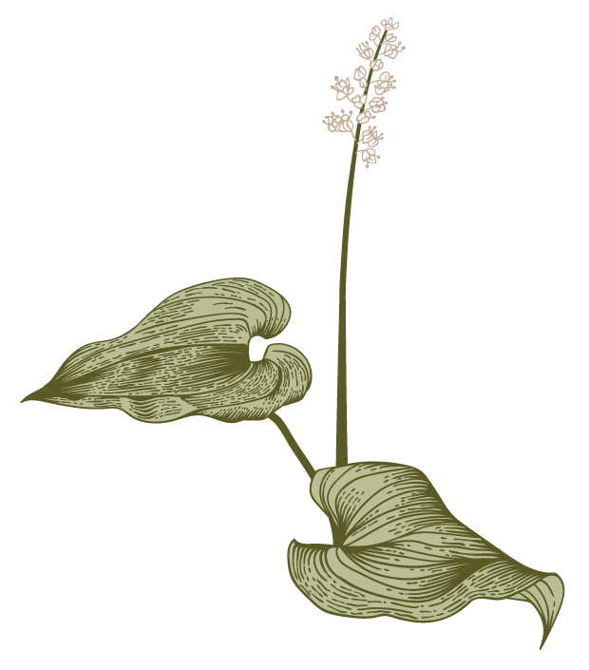
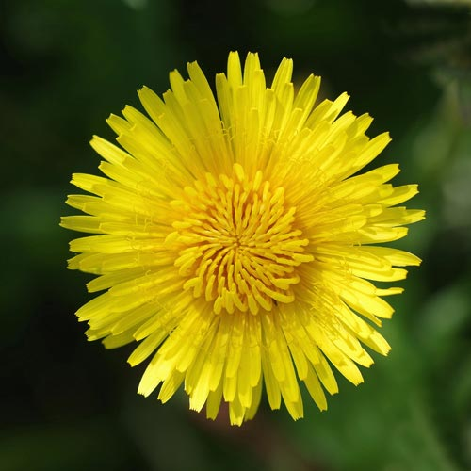
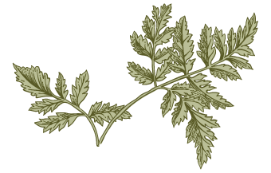
Dandelion
The leaves are used to stimulate the appetite and help digestion.
Dandelion flower has antioxidant properties.
Dandelion may also help improve the immune system

Slide 3
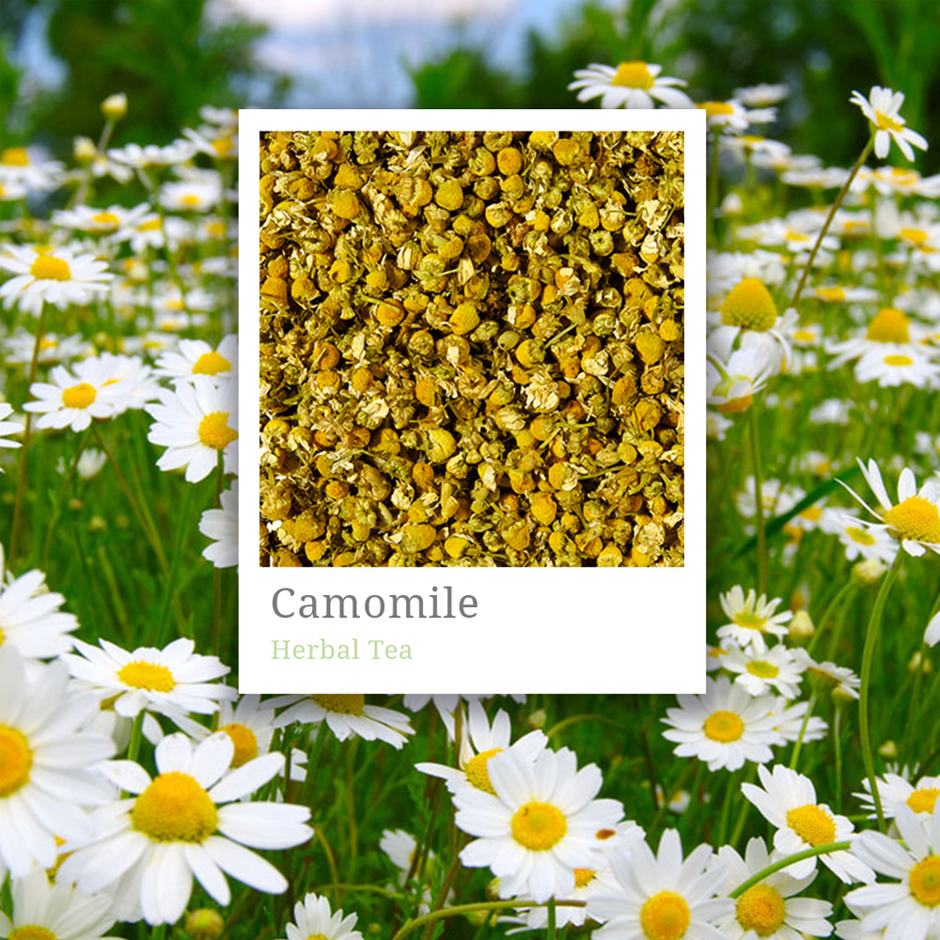
Chamomile
Is the common name for several daisy-like plants of the family Asteraceae. Two of the species, Matricaria chamomilla and Chamaemelum nobile, are commonly used to make herbal infusions for beverages.

Slide 4
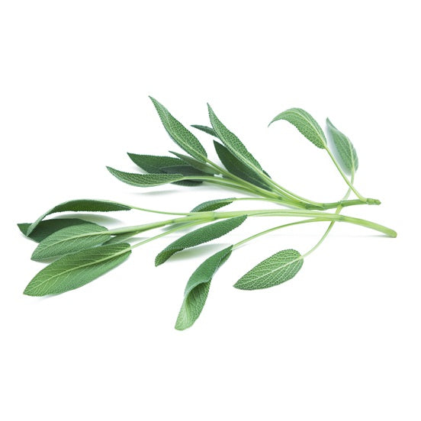
Sage
Sage, (Salvia officinalis), also called common sage or garden sage, aromatic herb of the mint family (Lamiaceae) cultivated for its pungent edible leaves
Sage is native to the Mediterranean region and is used fresh or dried as a flavouring in many foods, particularly in stuffings for poultry and pork and in sausages.
Visualize customer directed convergence

Slide 5
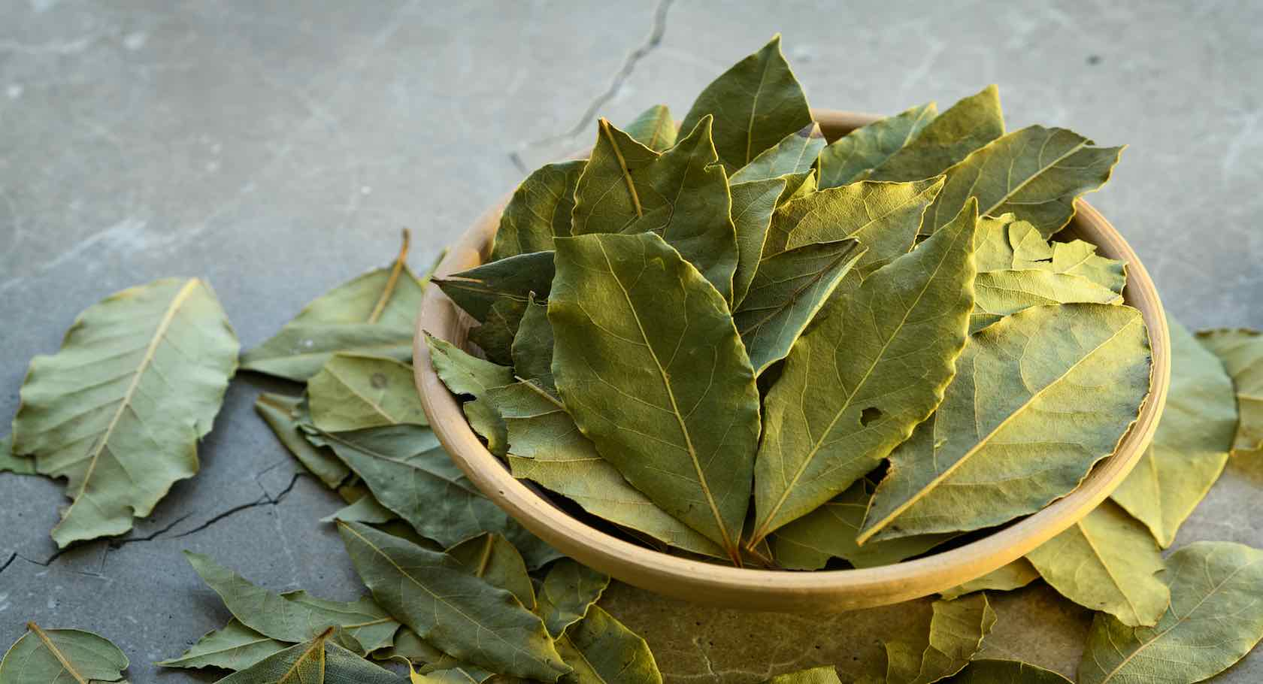
Bay leaf
The bay leaf is an aromatic leaf commonly used as a herb in cooking.
It can be used whole, either dried or fresh, in which case it is removed from the dish before consumption, or less commonly used in ground form.
The flavor that a bay leaf imparts to a dish has not been universally agreed upon, but most agree it is a subtle addition.

Slide 6
Thank you for your attention
Links :
Information : https://en.m.wikipedia.org/wiki/Main_Page
Photos:
https://images.app.goo.gl/ubfxXQEuehDB2fuH7
https://images.app.goo.gl/9GhvJfS7KXe4GXLF7
https://images.app.goo.gl/MuDH4dJAo1NRFn368
https://images.app.goo.gl/1DzCKa37Mwx5yMtT9

