Slide 1
MEDICINAL HERBS
ST. JOHNS WORT or lat. HYPERICUM PERFORATUM
Eva Jaman student-Marijana Buljan teacher

Slide 2
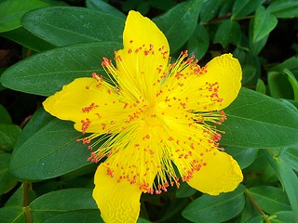
What is st. John’s wort?
Perennial herbaceous plant with a branched root
The stem is upright, 20 to 100 cm high
Yellow flowers
Blossom: from May to September

Slide 3
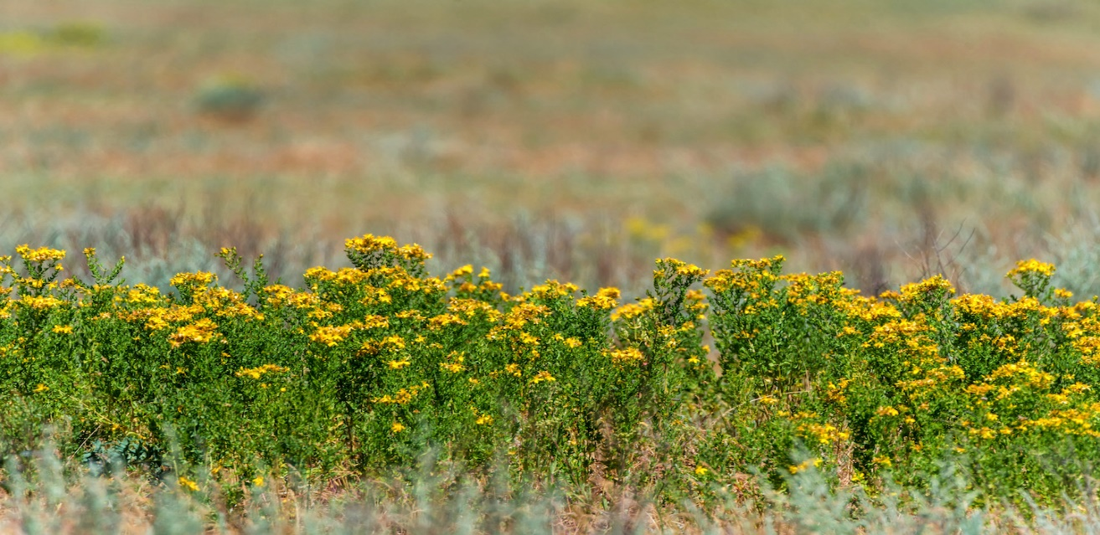
Habitat
Europe, Western Asia, South Africa and North Africa
Usually growing along roadsides or the edges of fields
The plant requires medium rich soil and moderately warm and bright habitats

Slide 4
What is it used for?
St. Johns wort is promoted for mental difficulties (depression, ADHD hyperactivity disorder)
Also: high temperature, wounds, headaches, stomach and skin deseases

Slide 5
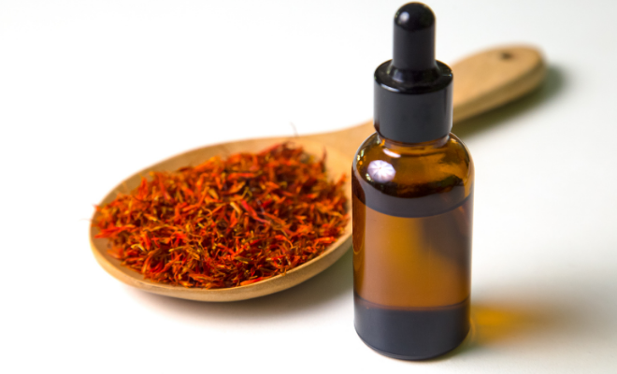
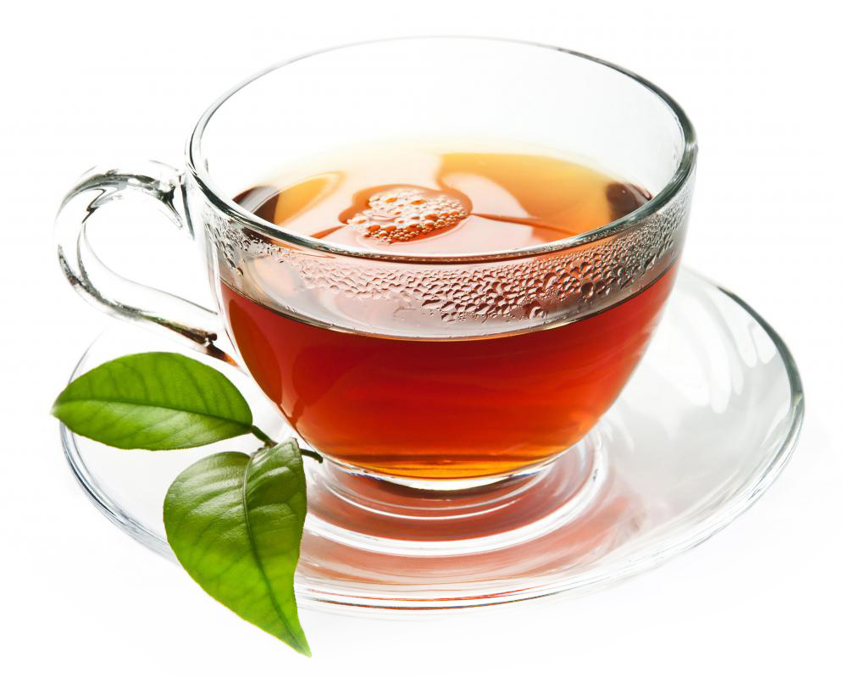
How do we use st. John’s wort?
Fresh or dry parts of the flower are usually used for teas, oils, tinctures or creames

Slide 6
SOURCES
https://unrulygardening.com/foraging-st-johns-wort/
https://en.wikipedia.org/wiki/Hypericum_perforatum
https://www.tvornicazdravehrane.com/zdravi-kutak/prirodna-kozmetika/macerat-gospine-trave-nezaobilazan-sastojak-savrsenih-kozmetickih-pripravaka-68349/
https://www.adiva.hr/nutricionizam/ljekovito-bilje/gospina-trava-biljni-antidepresiv/

Slide 7
Thank you for your attention!

