Slide 1
Medicinal herbs
Tomislav Knezevic, 5.b

Slide 2
Medicinal herbs
Medicinal herbs are plants that we use to treat disease.
Some of medicinal herbs are:
Ginko
Tumeric
Flax seed
Lavender
Chamomile
Rosemary

Slide 3
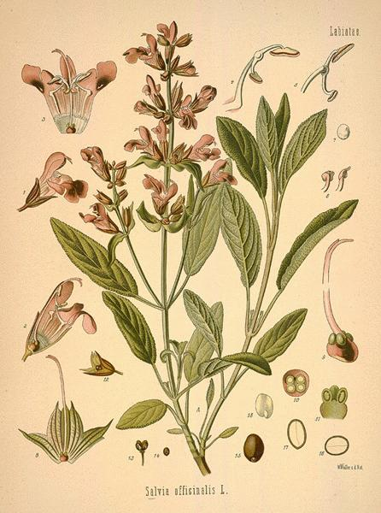
Sage
Sage is used as spice and for health purposes.
Sage is very high in vitamin K and contains inerals like magnesium and zinc.
Sage may help control blood sugar levels and it can be use for the treatment of deppresion.

Slide 4
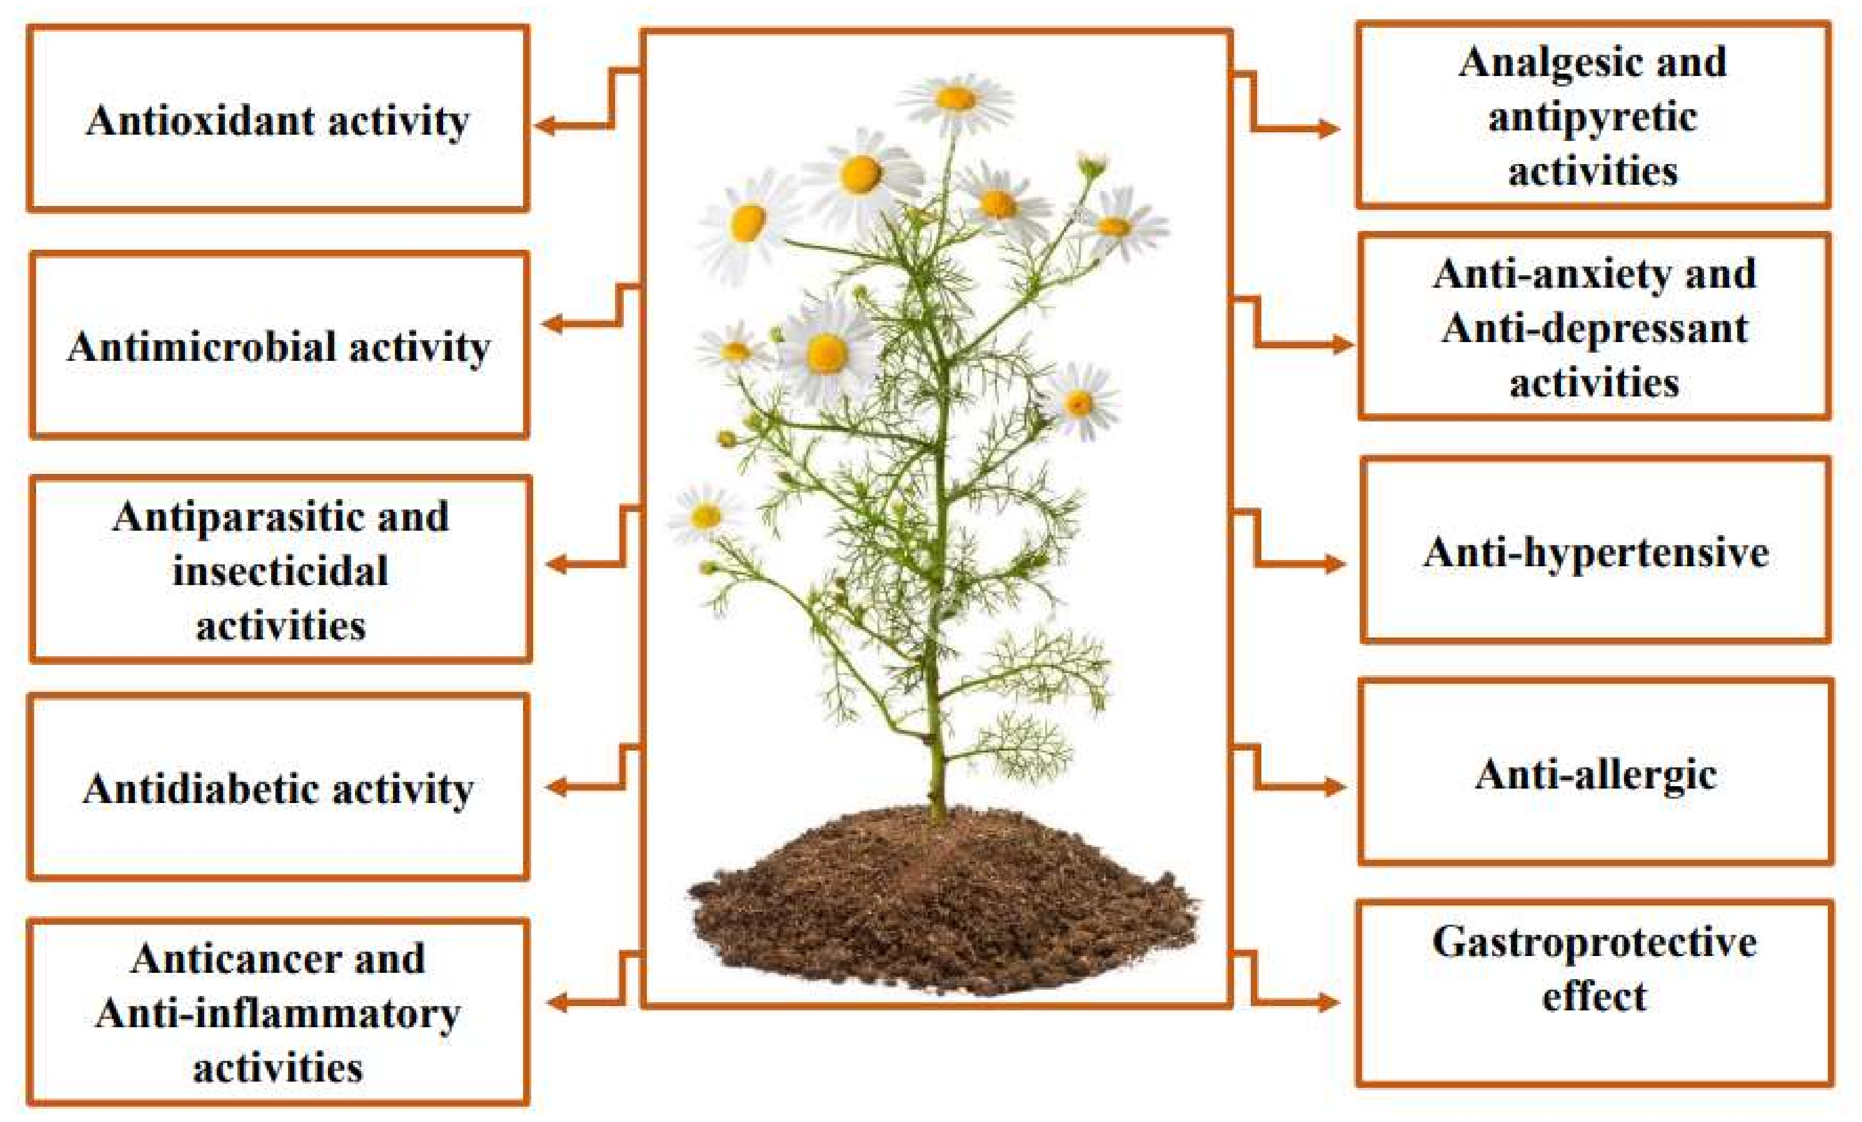
Chamomile
Chamomile is used for many problems like hight fever, menstrual disorders, insomnia and hemorrhoids.
Oil of chamomile is used in cosmetics and aromatherapy.

Slide 5
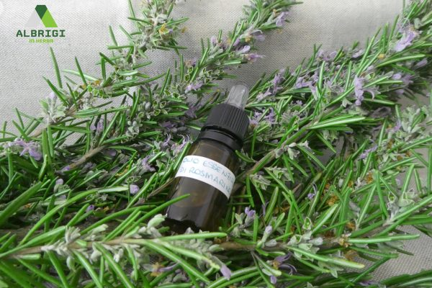
Rosemary
Rosemary is a herb. The leaf and oil are used in food and also to make medicine.
Rosemary is traditionally used to help to improve memory, boost the immune system and promote hair growth.

Slide 6
Sources:
https://en.wikipedia.org/wiki/Medicinal_plants
https://www.nccih.nih.gov/health/sage
https://www.ncbi.nlm.nih.gov/pmc/articles/PMC2995283/
https://www.medicalnewstoday.com/articles/266370

