Slide 1
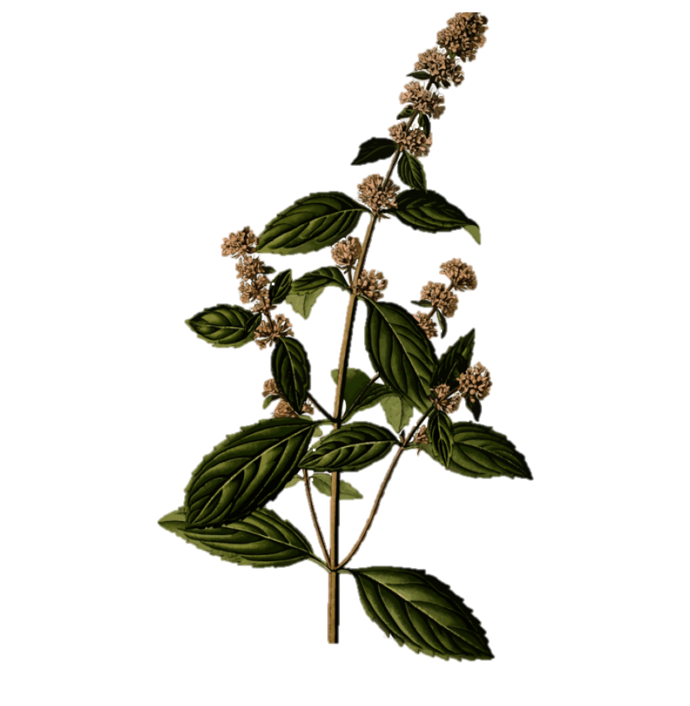
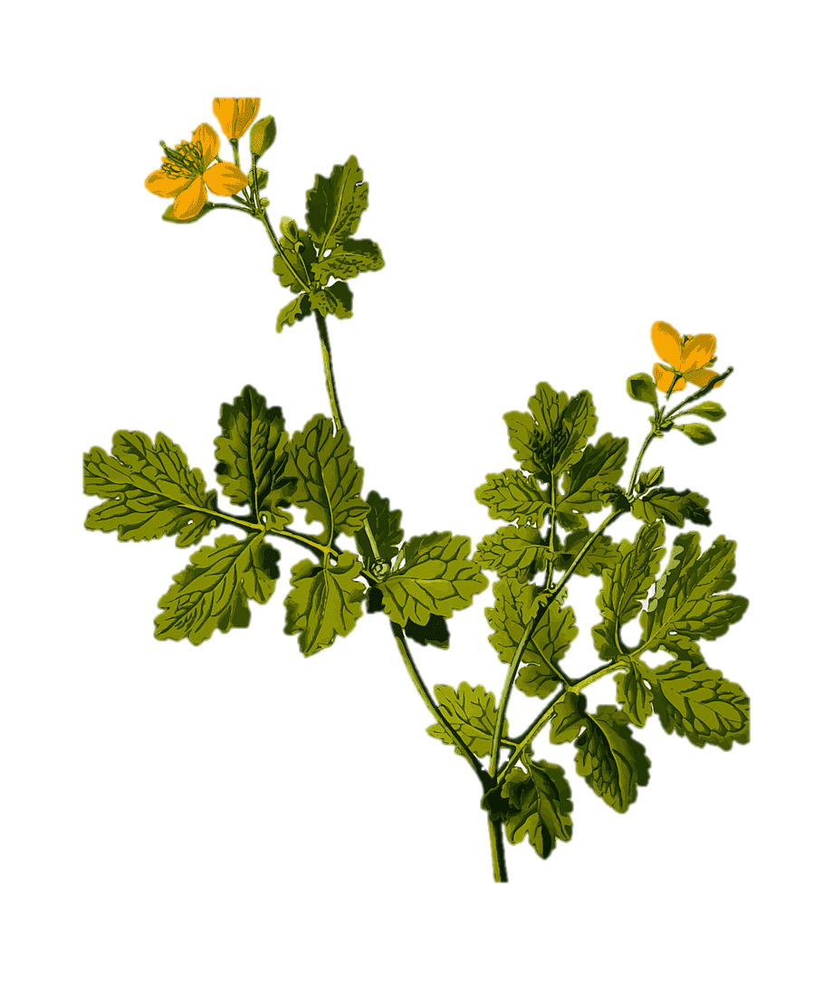
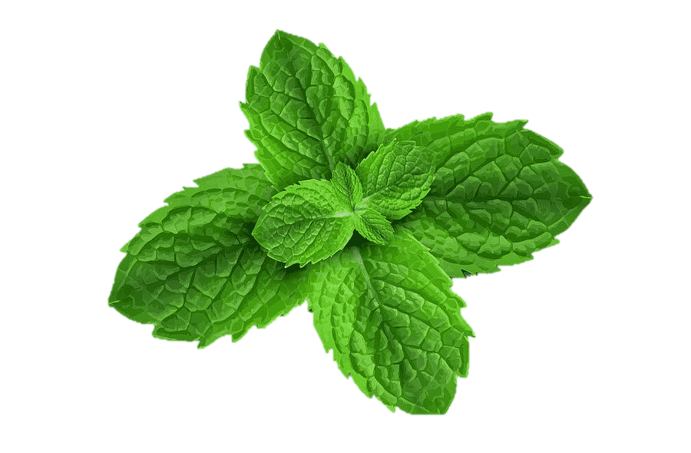
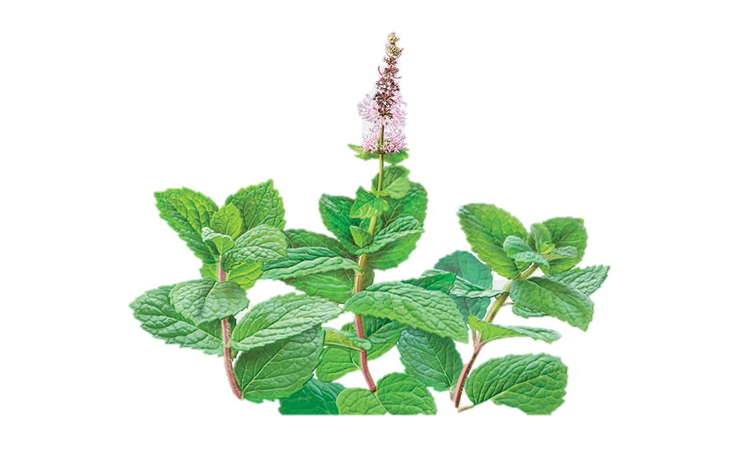
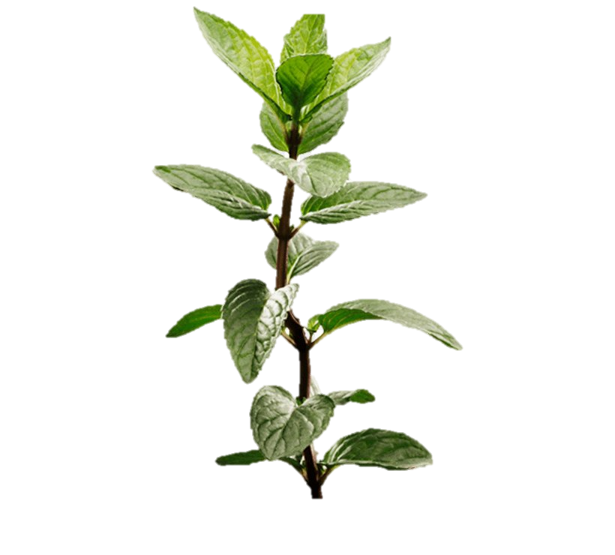
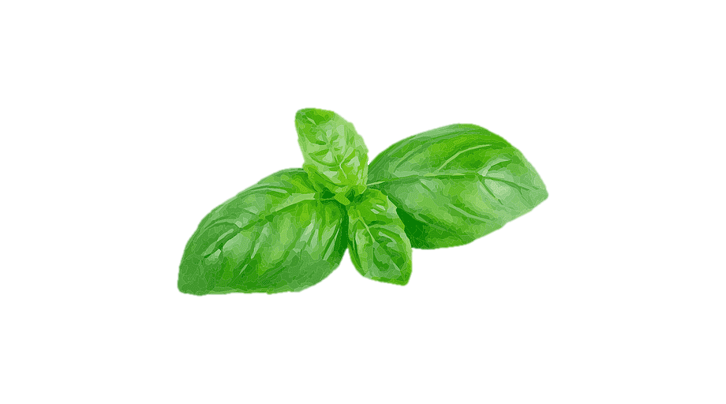
Medicinal herbs
Nika Vetma 8.a

Slide 2
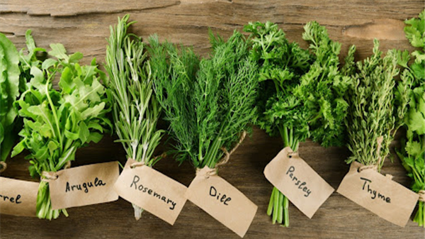
MEDICINAL HERBS
Plants used for maintaing health
Around 17,000 different plants
Pharmaceutic uses
Medicinal herbs
Alkaloids
Glycosides
Polyphenols
Terpenes

Slide 3
Medicinal herbs
Alkaloids
Glycosides
Polyphenols
Terpenes

Slide 4
ALKALOIDS
Bitter
Wellspread
Caffeine (caffea) , cocaine (coca), nicotine (tobacco)
Contain nitrogen

Slide 5
GLYCOSIDES
Can be Toxic
Used as medicine
Used for heart failure and heart diseases
Effect on heart, stomach and intestines

Slide 6
POLYPHENOLS
Boost heart health and immunity
Micronutrients in plants
Reduces risk of diabetes and obesity

Slide 7
TERPENES
Pleasent smell
Essential oils
Fruits, vegetables and trees

Slide 8
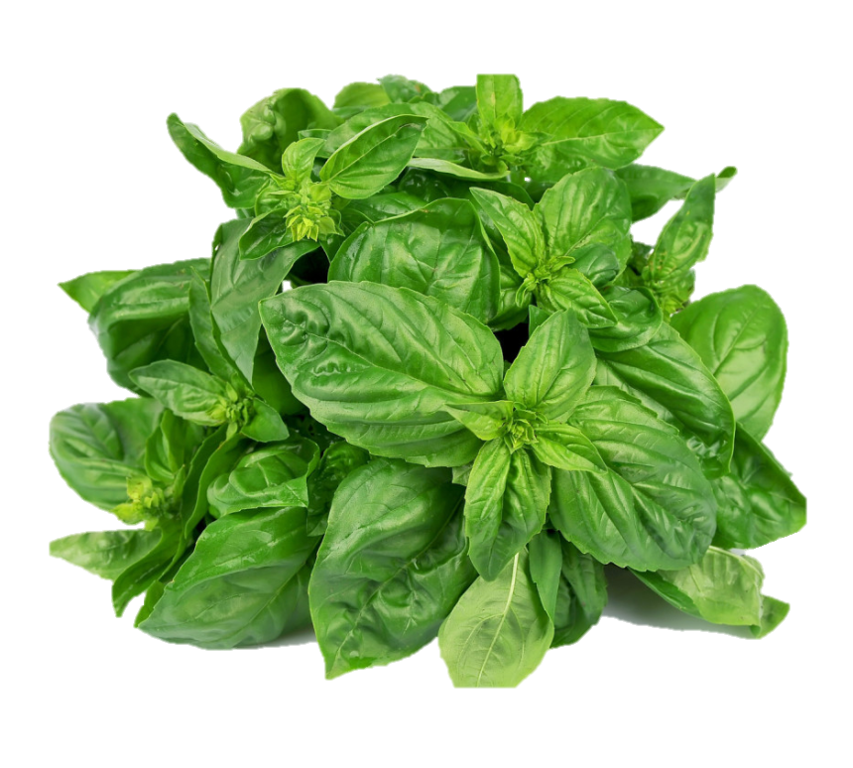
MEDICINAL HERBS
IN CROATIA

Slide 9
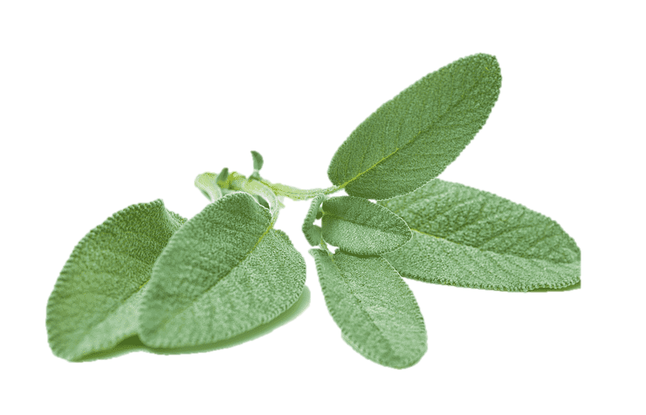
BASIL
Basil = basilikhon royal
Vitamins and minerals
Cancer, athritis and diabetes

Slide 10
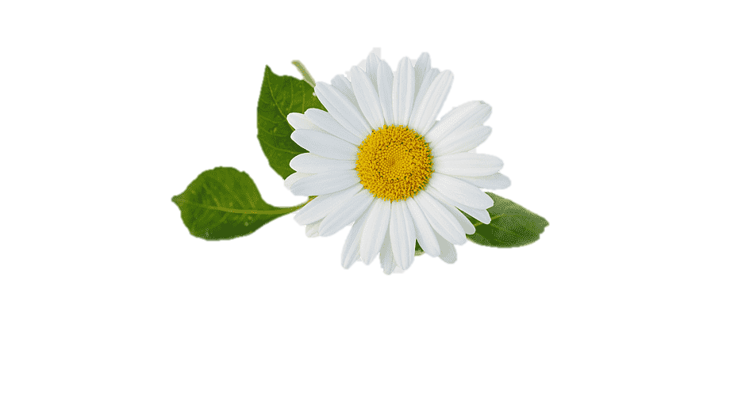
SAGE
Mint
Strong and unique flavour
Alzheimers disease (mild), antidepressants
High doses toxic

Slide 11
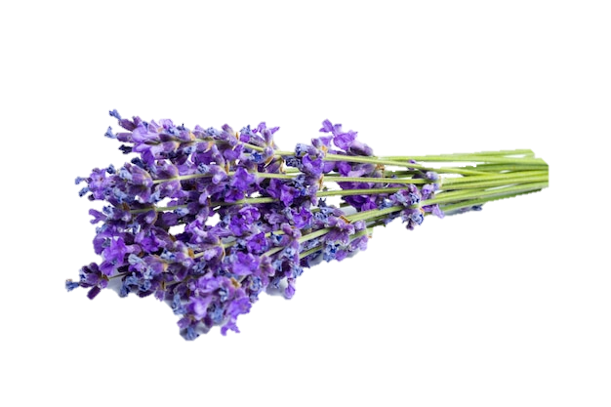
CHAMMOMILE
Gastrointestinal problems
Oil,creams and tea
Advised not to use during pregnency

Slide 12
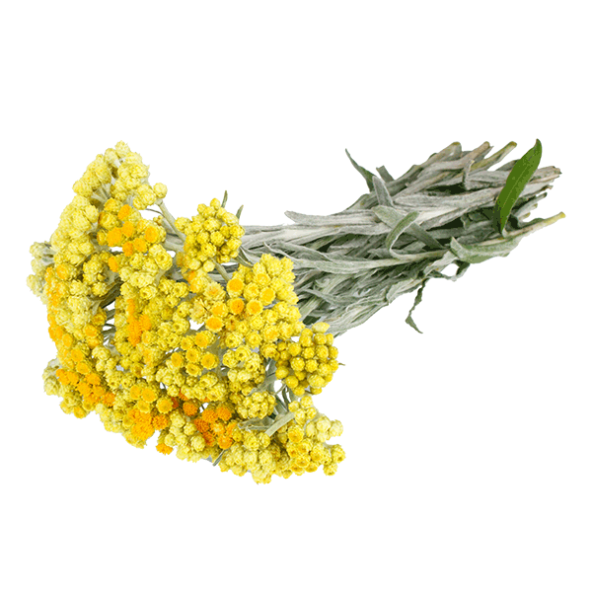
LAVENDER
Reduces pain and inflammation
Calms your mood
Helps with isomnia

Slide 13
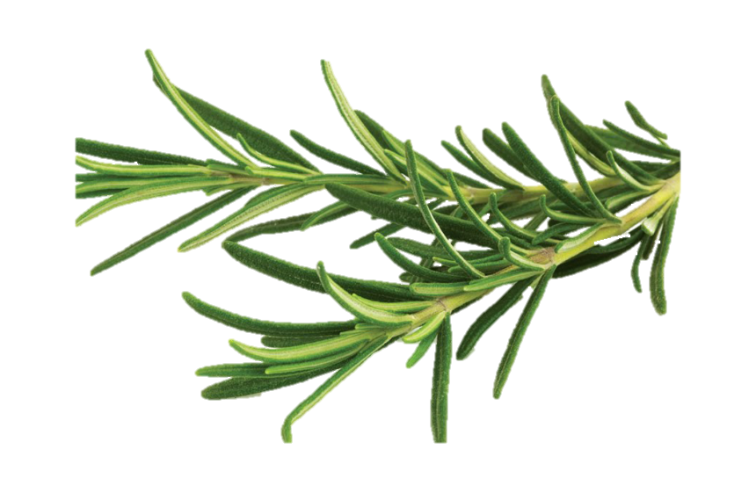
IMMORTELLE
Never dies
Helps with astma and liver problems
Oil and tea

Slide 14
ROSEMARY
Immune system, improving memory
Heals eyes and liver
Cooked with food

Slide 15
SOURCE :
https://en.wikipedia.org/wiki/Medicinal_plants
https://www.webmd.com/vitamins/ai/ingredientmono-303/basil
https://www.webmd.com/diet/health-benefits-sage
https://www.webmd.com/diet/supplement-guide-chamomile
https://www.webmd.com/diet/health-benefits-rosemary
https://health.clevelandclinic.org/health-benefits-of-lavender/
https://alternativa-za-vas.com/index.php/clanak/article/smilje

Slide 16
END

