Slide 1
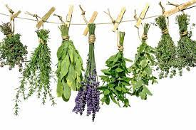
MEDICINAL HERBS
MARKO KROLO 6.b

Slide 2
The most famous medicinal plants in Dalmatia are:
Sage
St. John”s Wort
Dandelion

Slide 3
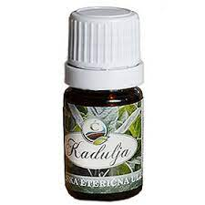
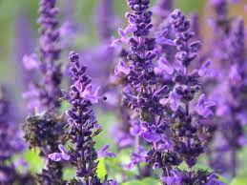
SAGE
-Medicinal plant that grows up to 60 cm
-It has a strong root
-It has long and oval leaves
-It has dark purple flowers
-Sage is used as a spice in the kitchen
-The essential oil is used in medicine and cosmetics
-It is often used for sore throat

Slide 4
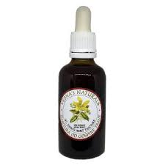
ST. JOHNS WORT
-It is a herbaceous plant that grows up to 100 cm
-It has yellow flowers
-It blooms from May to June
-It is used as an antidepressant ,sedative and antibiotic
-It is most often used to treat burns
-It is used as a spice

Slide 5
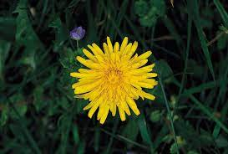
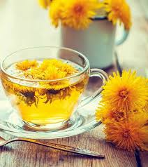
DANDELION
It is a plant that grows in parks and gardens
It has serrated leaves and a hollow steam
It has yellow flowers that bloom from April to October
Dendelion is edible
Dandelion is used in folk medicine for tea and
as an aperitif
It is rich in iron
It helps with stomach diseases

Slide 6
THANK YOU FOR ATTENTION

Slide 7
SOURCES:
www.tvornicazdravehrane.com
hr.m.wikipedia.org/wiki/kantarion
www.adiva.hr.ljekovito.bilje
www.plivazdravlje.hr.maslačak

