Slide 1
LIFE IN THE FUTURE
Filip Jovišić, 8.b

Slide 2
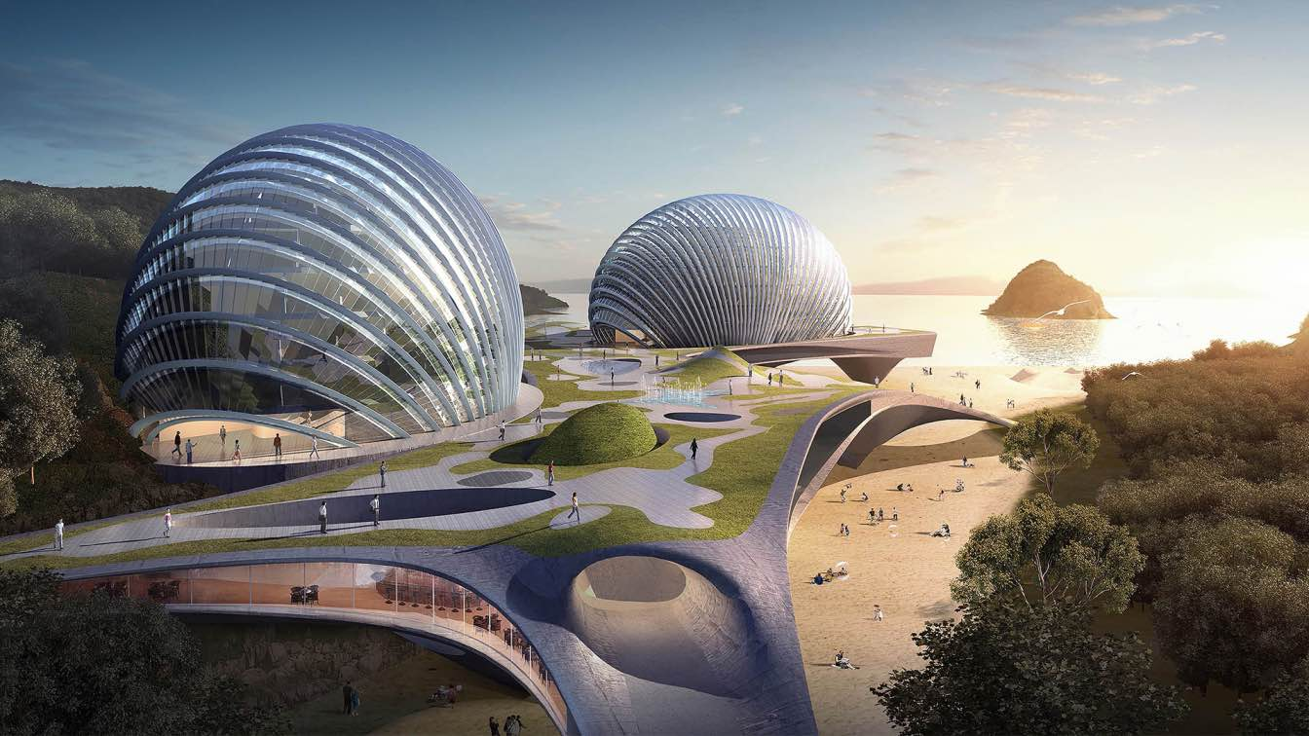
Accommodation in the cities
I think that in hotels there will be service robots that will serve us,bring food and clean our rooms.
I think hotels will be eco-friendly and hotels will recycle plastic and other things.
I think that in hotels there will be healthy and organic food with no pesticides.
Houses and skyscrapers will be made in unusual architectual shapes shapes.
https://amazingarchitecture.com/futuristic/hotel-nudibranch-a-new-eco-friendly-landmark-among-sandy-bays-in-china-concept-design-by-spactrum

Slide 3
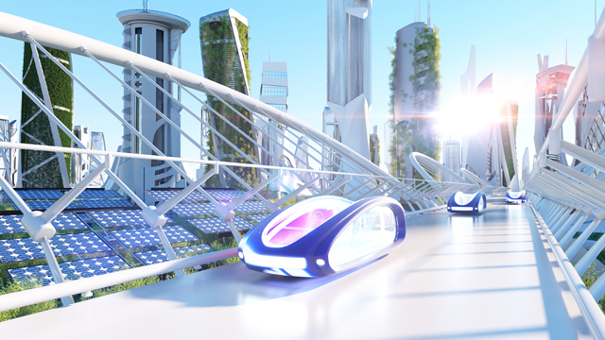
Transport in the cities of the future
I think that there will be electric and even flying cars.
I think that there will be self driving buses.
I think drones will deliver our packages.
https://www.nationalgrid.com/stories/journey-to-net-zero-stories/future-transport-driving-change-next-10-years

Slide 4
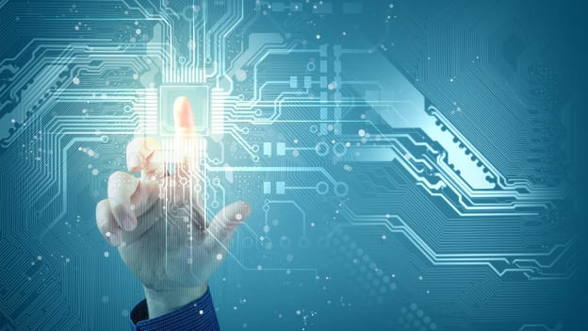
JOBS IN THE FUTURE
I think that the robots will take most of our jobs,do simple tasks and chores.Some robots wILL even perform surgeries,by the guidance of humans.
I think that there will be more software developers in the future.
I think there will be drone pilots .
https://www.peoplematters.in/amp-technology-jobs-of-the-future-where-are-they-headed-19749

Slide 5
Thanks For your attention!

