Slide 1
LIFE IN THE FUTURE
LARA BUBIĆ, 8.B

Slide 2
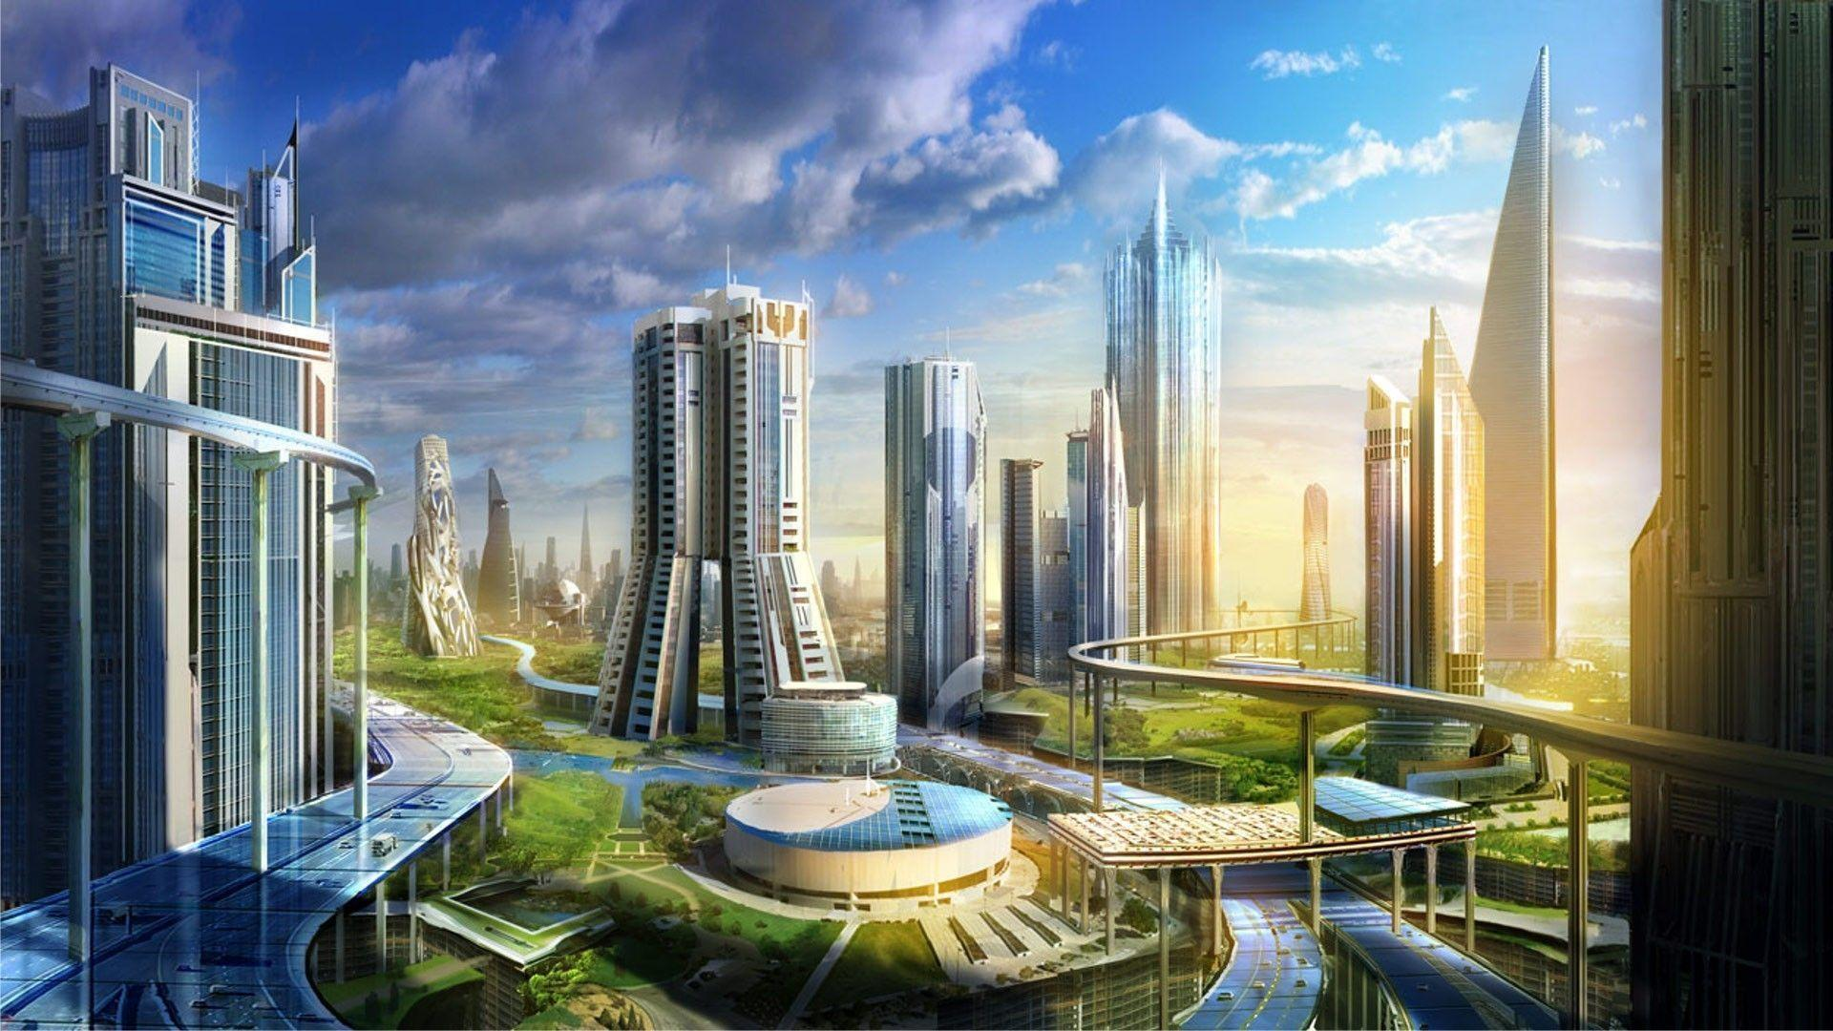
Life in the future
I think that life in the future will be a lot different than now.
It has its good and bad sides.

Slide 3
Cities in the future
I think that cities will only have buildings without houses.
The buildings will be completely covered with invisible and impenetrable windows.
Everywhere in the city will be clever means of transportation like small airships and flying cars,as well as electric ones.
There will be a lot of green spaces for people to relax .The cities wil be under big domes,protecting people from ozone holes.

Slide 4
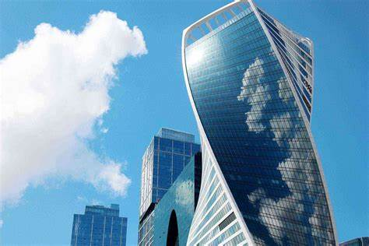
CITIES IN THE FUTURE

Slide 5
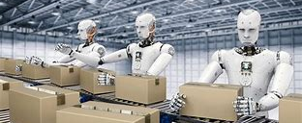
What about robots?
I think there will be robots in the future.
They wouldn't take all human tasks, but they will work as waiters or at the receptions.
They won't look like people.
They would do some chores instead of people.They will be able to communicate with humans.

Slide 6
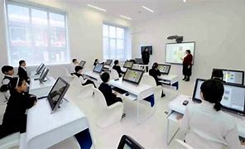
SCHOOL IN THE FUTURE
I don’t think there will be any school textbooks in the future.
Tablets will be used instead of books.
Every student will have their own desk and a moving chair.

Slide 7
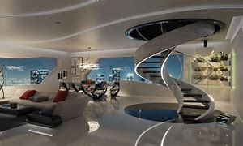
Apartments in the future
I think the apartments in the future will be big and spacious.
They won't have many details and will be very simple.
Everything will be bright and rounded with windows.
In the future apartments will have many devices that will reduce human effort.They would be eco-friendly.

Slide 8
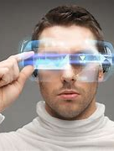
PEOPLE IN THE FUTURE
I think that people's bodies will change in the future because of technology.
People will have longer thumbs, more hunched backs and poor eyesight.

Slide 9
Sources:
https://www.bing.com/images/search?view=detailV2&ccid=RH44fuNM&id=0DAA3154DE47DF4FE864DD2F09A1C3CB327009F2&thid=OIP.RH44fuNME3O3q5DWYHjDVwHaEK&mediaurl=https%3a%2f%2fth.bing.com%2fth%2fid%2fR.447e387ee34c1373b7ab90d66078c357%3frik%3d8glwMsvDoQkv3Q%26riu%3dhttp%253a%252f%252fwallpapercave.com%252fwp%252f9BSuCkH.jpg%26ehk%3dTmzHrdPTQVD0nFNPbORLzg6dGat5I%252bv12d%252baMPtTNmI%253d%26risl%3d%26pid%3dImgRaw%26r%3d0&exph=1080&expw=1920&q=cities+in+the+future&simid=608041144783953661&FORM=IRPRST&ck=3923E3D9157F2A9D8A0198B23FC4DDE5&selectedIndex=0
https://www.bing.com/images/search?view=detailV2&ccid=UU0WHfaY&id=04BF447099AD18BC28E1FC0E888021219367BFF9&thid=OIP.UU0WHfaYsd6a5Ld_O_dB2QHaEK&mediaurl=https%3a%2f%2fblenderartists.org%2fuploads%2fdefault%2foriginal%2f4X%2ff%2f5%2fd%2ff5d28f40c9ceeb2c7e4ad63753ed1f136edd1f04.jpeg&cdnurl=https%3a%2f%2fth.bing.com%2fth%2fid%2fR.514d161df698b1de9ae4b77f3bf741d9%3frik%3d%252bb9nkyEhgIgO%252fA%26pid%3dImgRaw%26r%3d0&exph=1080&expw=1920&q=APARTMENTS+IN+THE+FUTURE&simid=608028393043491902&FORM=IRPRST&ck=A069A29075E412DDDC761F29F7404F34&selectedIndex=6
https://www.bing.com/images/search?view=detailV2&ccid=Y729AmLq&id=29EA7F81BBE2E4BA862813D6DC3CCB8B7DC87046&thid=OIP.Y729AmLqzEa2G4QZ40wgaAHaF4&mediaurl=https%3a%2f%2fthumbs.dreamstime.com%2fb%2fman-futuristic-glasses-future-technology-people-concept-43088287.jpg&cdnurl=https%3a%2f%2fth.bing.com%2fth%2fid%2fR.63bdbd0262eacc46b61b8419e34c2068%3frik%3dRnDIfYvLPNzWEw%26pid%3dImgRaw%26r%3d0&exph=636&expw=800&q=people+whit+glass+in+the+future&simid=608005707035385495&FORM=IRPRST&ck=841FF5540B0F3F1E3B9A7BBD5166D8CA&selectedIndex=13

Slide 10
souRCES:
https://www.bing.com/images/search?view=detailV2&ccid=i0SPQt0F&id=E9BAB05E4ED935B5A5080186A5D3F61FE3B1A8F6&thid=OIP.i0SPQt0FwfmSzRZqTXR0sAHaE8&mediaurl=https%3a%2f%2fwww.fodors.com%2fwp-content%2fuploads%2f2017%2f07%2fSkyscrapers-Evolution-Tower.jpg&cdnurl=https%3a%2f%2fth.bing.com%2fth%2fid%2fR.8b448f42dd05c1f992cd166a4d7474b0%3frik%3d9qix4x%252f206WGAQ%26pid%3dImgRaw%26r%3d0&exph=1400&expw=2100&q=Future+Buildings&simid=608017423709528181&FORM=IRPRST&ck=04CA951E94901EA358C4FDB7FCA1BA96&selectedIndex=15
https://www.bing.com/images/search?view=detailV2&ccid=sjQ7MePi&id=27745D7E7FC270627A6C4260C242B7F4D4BD940F&thid=OIP.sjQ7MePigTppKf_t11oI0QHaEQ&mediaurl=https%3a%2f%2fwww.thefuturist.co%2fwp-content%2fuploads%2f2016%2f09%2ffuturist.png&cdnurl=https%3a%2f%2fth.bing.com%2fth%2fid%2fR.b2343b31e3e2813a6929ffedd75a08d1%3frik%3dD5S91PS3QsJgQg%26pid%3dImgRaw%26r%3d0&exph=425&expw=740&q=schools+in+the+future&simid=608050421919255336&FORM=IRPRST&ck=3FAA9B1181A7CD8658B2529DF0E0AFFC&selectedIndex=17

Slide 11
THE END
Presentation made by:Lara Bubić, 8.b
I hope you enjoyED it!

