Slide 1
MY dream HOUSE
Jelena Jurić
5b

Slide 2
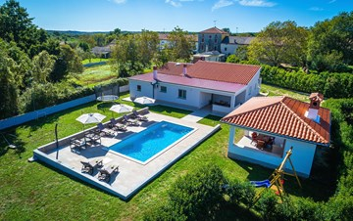
OUTSIDE
Outside there is a large swimming pool, a meadow with two goals for football and a small park with a swing and a slide for children. Finally,there is a garden with lots of fruit.

Slide 3
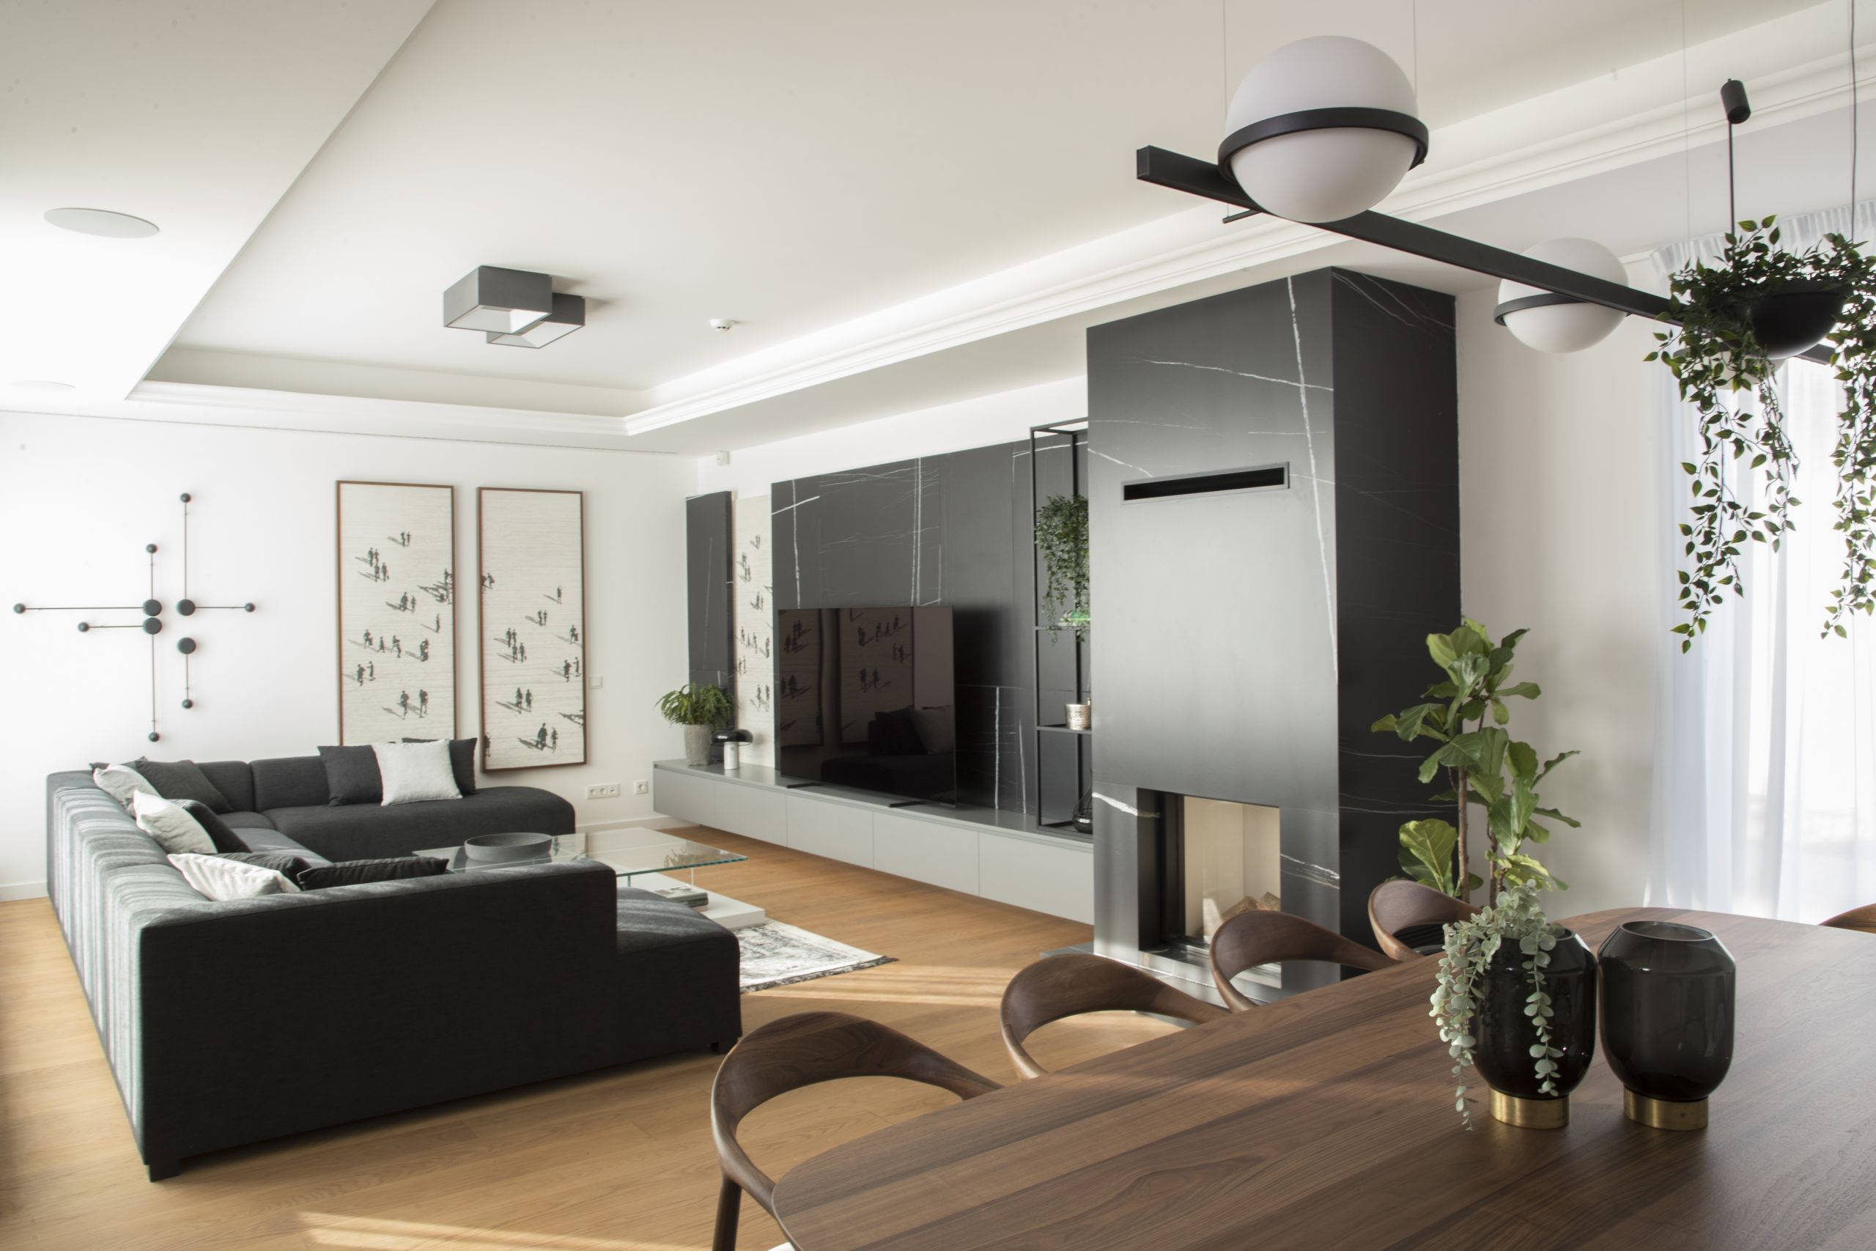
Inside
Inside there are seven rooms, three toilets.The first room has a window, two rooms have a double bed and the others have a single bed, a chldrens playroom,a large gym, a large living room and a nice kitchen.

Slide 4
furniture
I would like to have a lot of furniture and decorations.There is a comfortable sofa, a lot of wardrobes, beds and more things like books, small tables.These are the things that I would like to have in my dream house.

Slide 5
DECORATIONS
I realy like decorations around the house and I want to have a lot of them. I prefer decorations like flowers, a cloth on a small table and pillows on the couch. Decorations are everthiyng to me because they make the house more beatiful, so I want a lot of them in my dream house .

Slide 6
Thanks for YOUR atenntion!
SOURCES:
https://www.google.com/search?q=ku%C4%87a+izvana+s+bazenom+i+parkinson&tbm=isch&ved=2ahUKEwiK0vWuscn8AhXH6qQKHW8wBDoQ2-cCegQIABAA&oq&gs_lcp=CgNpbWcQARgDMgcIIxDqAhAnMgcIIxDqAhAnMgcI=isch&ved=2ahUKEwjBi6nxscf8AhXw_rsIHbvDB_0Q2I
https://www.google.com/search?q=velika+kuca+iznutra&tbm-cCegQIABAA&oq=velika+kuca+iznutra&gs_lcp=CgNpbWcQAzoECCMQJzoHCC
https://www.google.com/search?q=ku%C4%87a+iznutra++s+dekoracijama&tbm=isch&ved=2ahUKEwiC0IKFssn8AhWMUqQEHb48B8oQ2-cCegQIABAA&oq=ku%C4%87a+iznutra++s+dekoracijama&gs_lcp=CgNpbWcQA

