Slide 1
My dream house
Lucia Marović
Class: 5.b
Teacher: Marijana Buljan
School: OŠ Petra Kružića Klis
Date: 5.1.2023.

Slide 2
Rooms in the house
-I want my house to have 3 floors
-I want the kitchen and the living room to be downstairs
-Upstairs I want : a bathroom, a bedroom and children's room
- I want a playroom on the top floor

Slide 3
Layout of the premises
-In the kitchen I want : a cooker,a fridge, a court machine, a sink, cupboards, a toaster and a microwave
-In the living room I want : a sofa,a coffee table,a clock, windows, central heating and a TV set
-In the bathroom I want: a washbasin,a waching machine, a shower cabin,a toilet and a mirror
-In the bedroom I want :a big bed, TV, huge windows and a balcony
-In the children's room I want: a desk,a wardrobe, a single bed, a bedside cabinet, a carpet and a small balcony
-In the playroom I want: billiards, playstation 5,a table tennis and a game machine

Slide 4
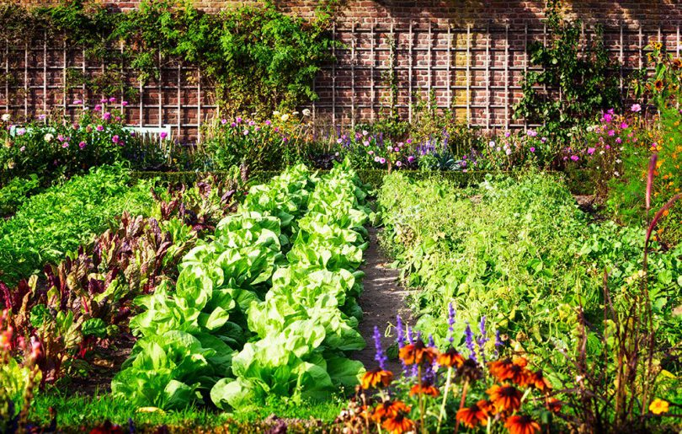
Outside
-Outside I want :a big garden with some fruits and vegetables growing,as well as lots of flowers on a green lawn. I want to have a fancy car in the garage which has sensors opening.

Slide 5
THANKS FOR LISTENING!

Slide 6
SOURCES:
https://www.google.hr/url?sa=i&url=https%3A%2F%2Fwww.jabuka.tv%2Fsto-je-to-kompatibilnost-biljaka-u-vrtu%2F&psig=AOvVaw1H8bNxPDTNyCEPcepivy1l&ust=1673003507443000&source=images&cd=vfe&ved=0CA0QjRxqGAoTCNjHjvmlsPwCFQAAAAAdAAAAABDHAw

