Slide 1
My dream house
By Mara Grubišić

Slide 2
Where is it?
It would be in the suburbs.
It is big.
It is for one person.
It is expensive and luxurious.

Slide 3
What has it got?
It has a big,beautiful garden,full of flowers.
It has a driveway.
It is overlooking the sea.

Slide 4
A view from the balcony
This is one beautiful balcony which has a look on the sea.

Slide 5
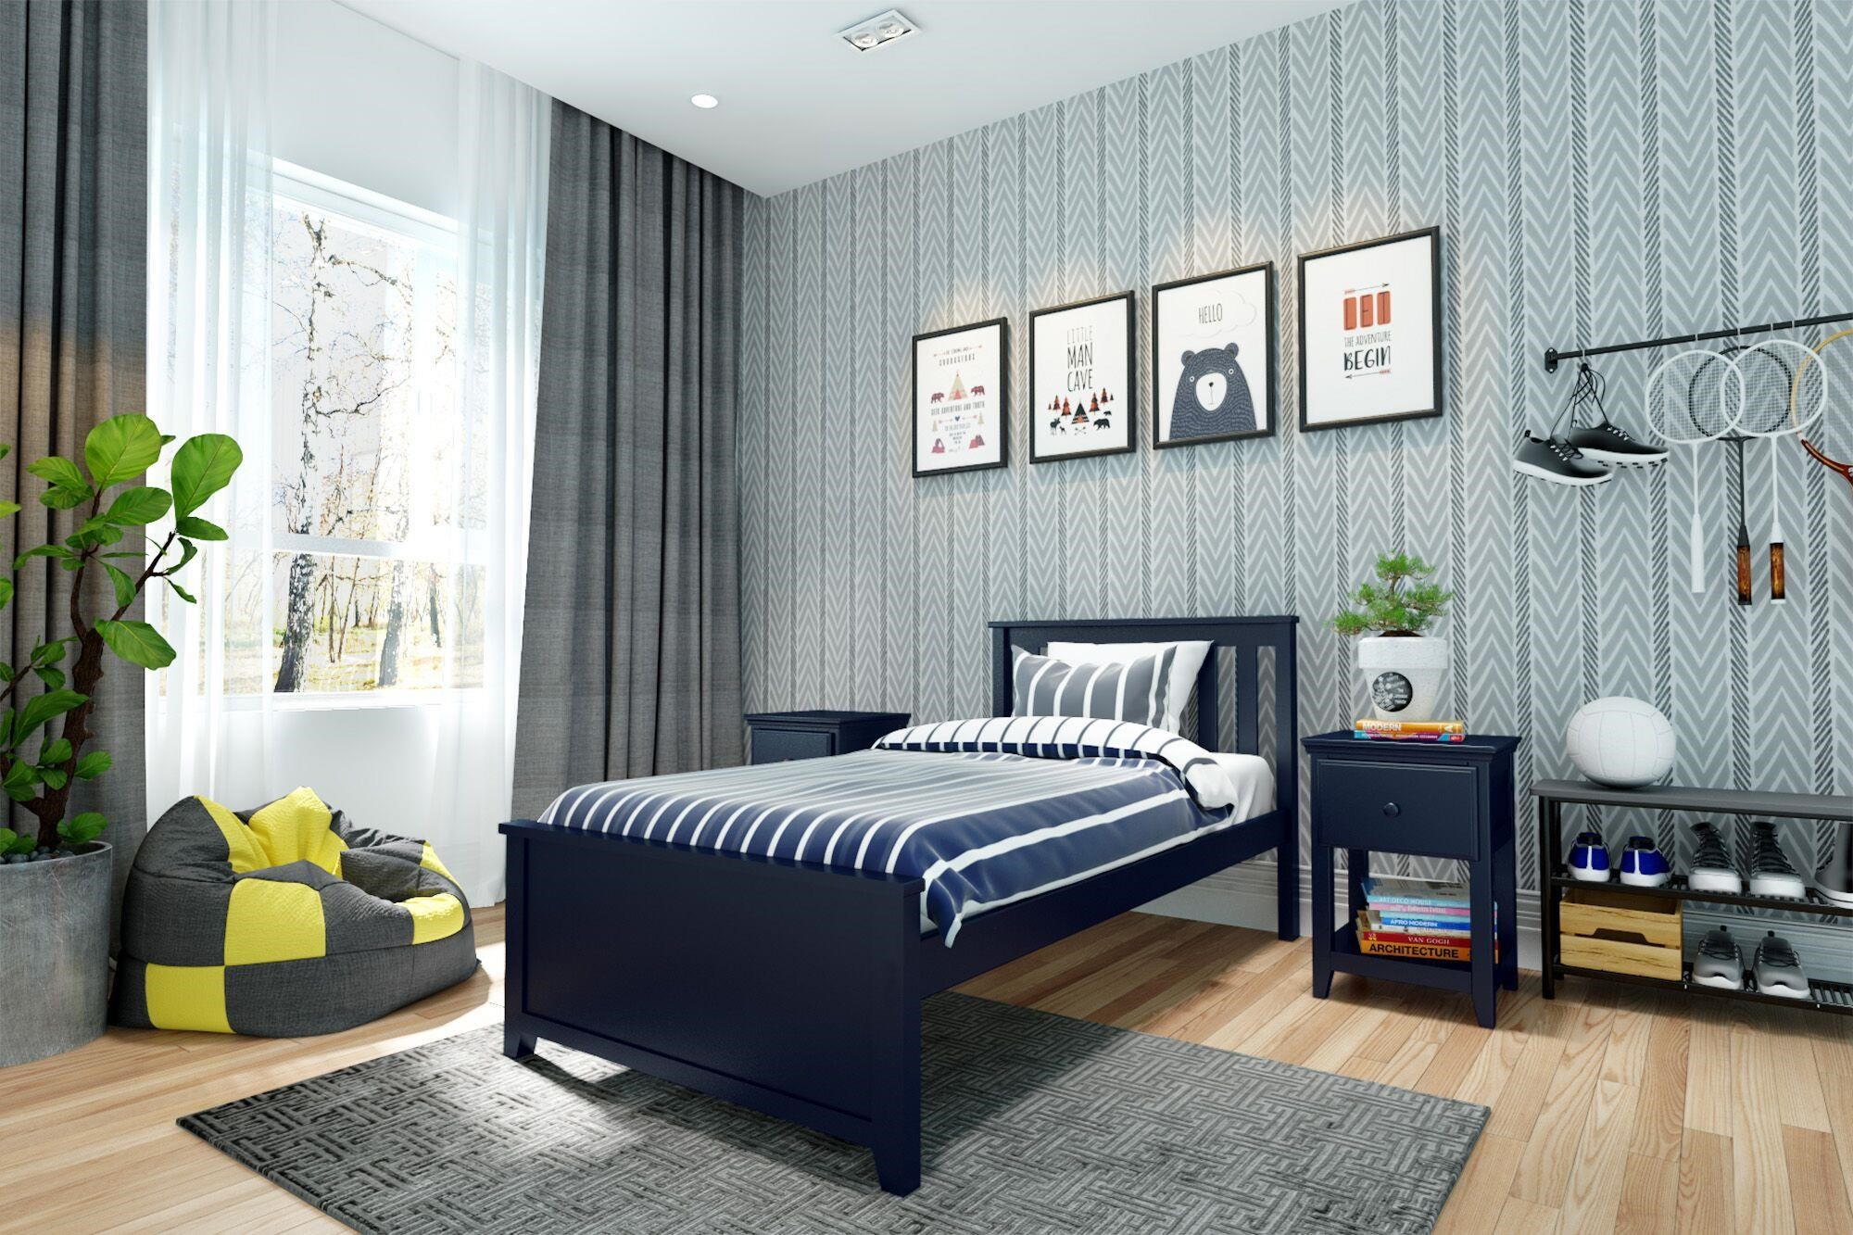
My room
There is a single bed.
There is a window with grey curtains.
There is a bedside cabinet next to the bed.
There are 4 pictures on the wall.
My room is great!

Slide 6
Sources
https://www.google.com/search?q=samostojece+kuce+na+moru&oq=&aqs=chrome.2.35i39i362l8.549435j0j7&sourceid=chrome&ie=UTF-8
https://www.google.com/search?q=rooms+with+single+bed&sxsrf=AJOqlzWsSURM-ALZpk2CEAg95_BmC0dzZA:1673709489596&source=lnms&tbm=isch&sa=X&ved=2ahUKEwiqi9bcrcf8AhWC7aQKHWthClEQ_AUoAXoECAEQAw&biw=1536&bih=696&dpr=1.25

Slide 7
THANKS FOR LISTENING!
GOODBYE!

