Slide 1
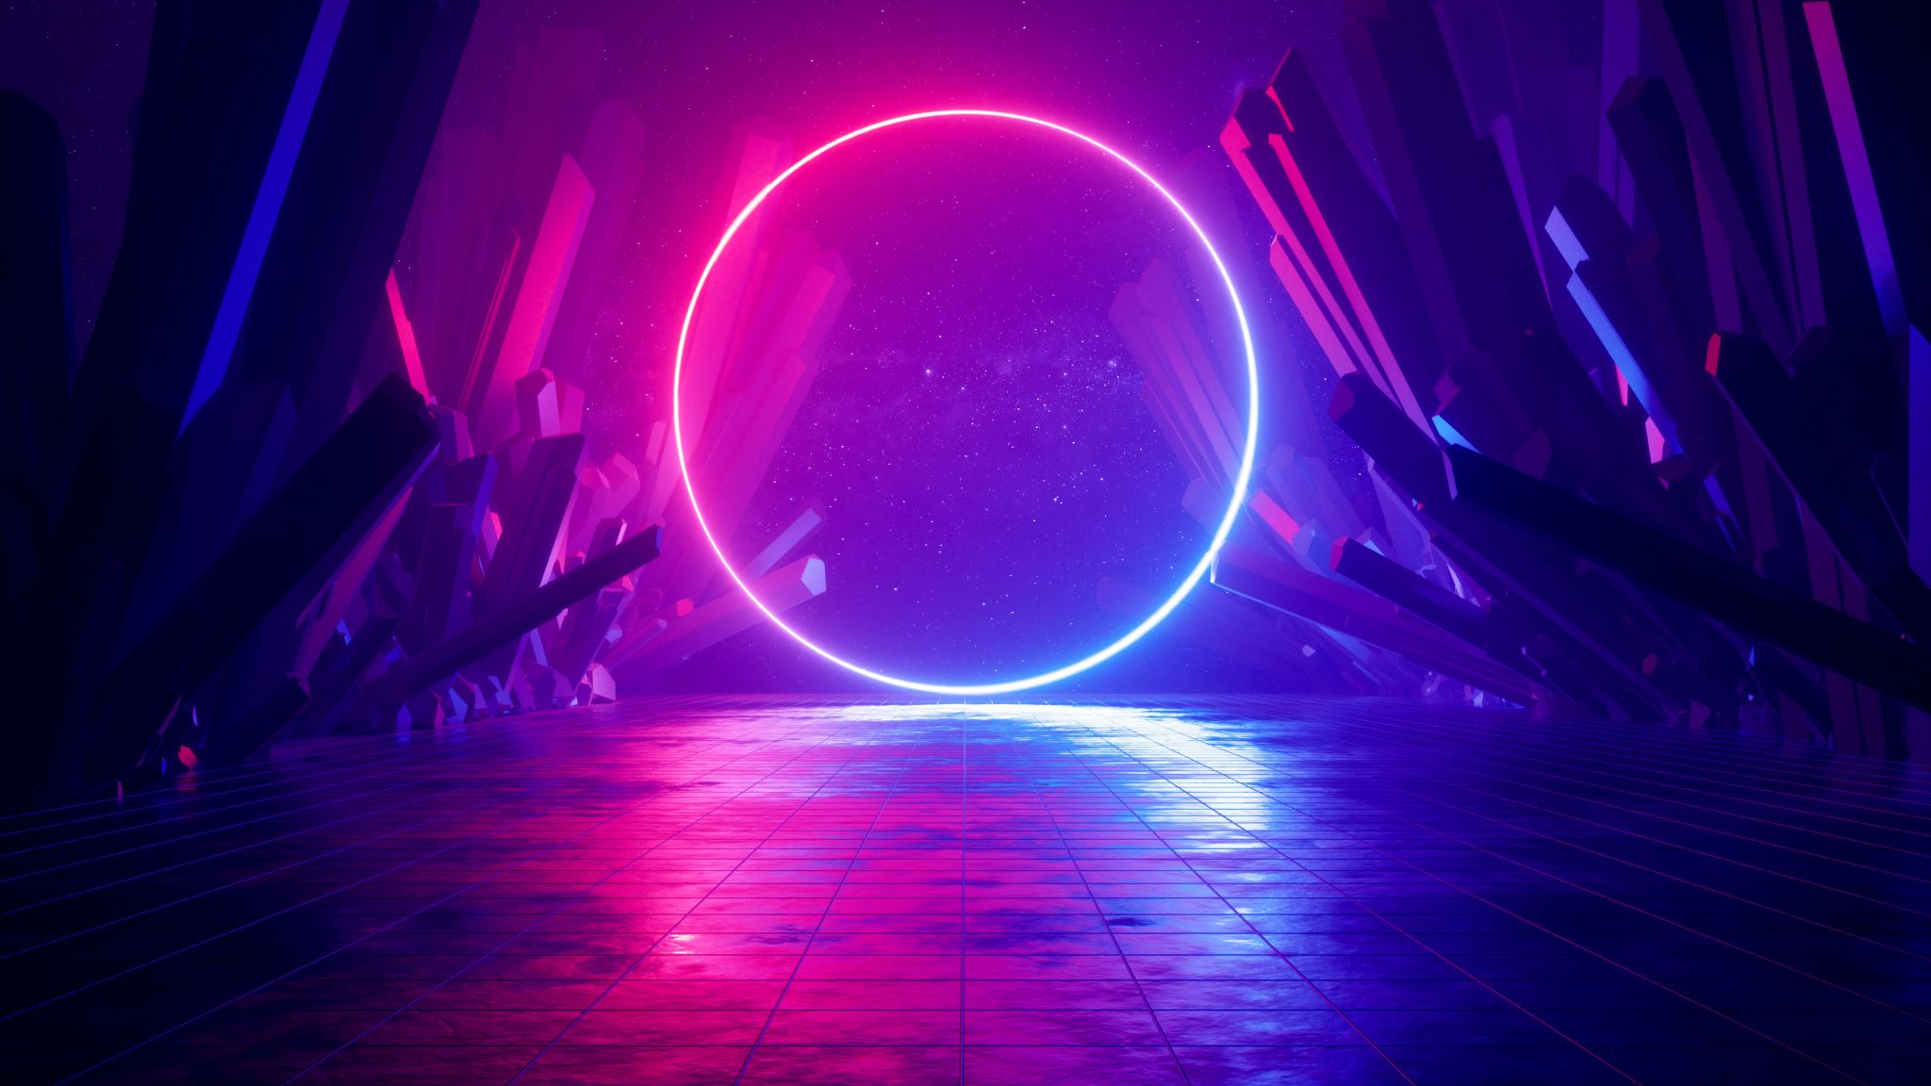


My dream house
By: Luka Boban :)

Slide 2
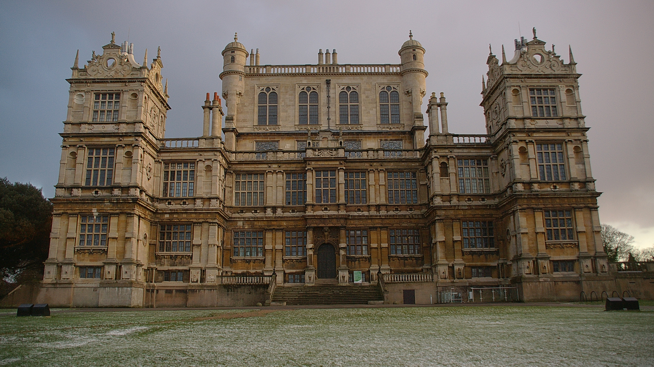
A HUGE HOUSE
My DREAM house is huge. It's 2 or 3 kilometers form the city. In my dream house there are big kitchens, 6 big living rooms, 4 huge bedrooms with big beds, one big gym and it has a replica of the Batcave downstairs.

Slide 3
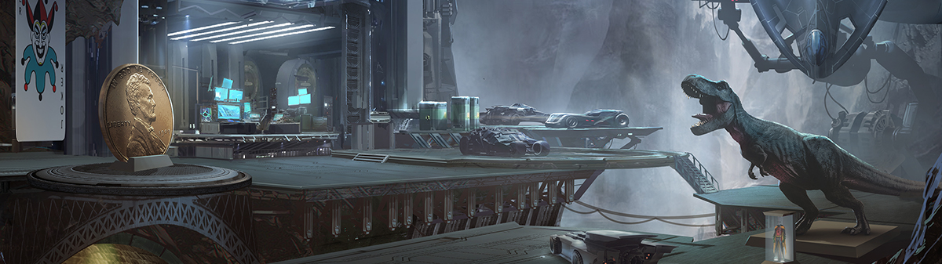
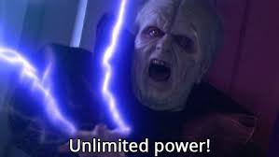
The Cave
The Batcave is bigger than The Manor (house). It has got a huge T-Rex, a Big penny, a Joker card, few Batmobiles, a big computer and a huge spaceship (rocket) with big battery life. And the rocket as well could go into my space house.

Slide 4
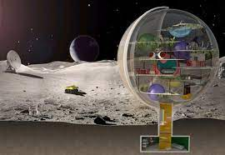
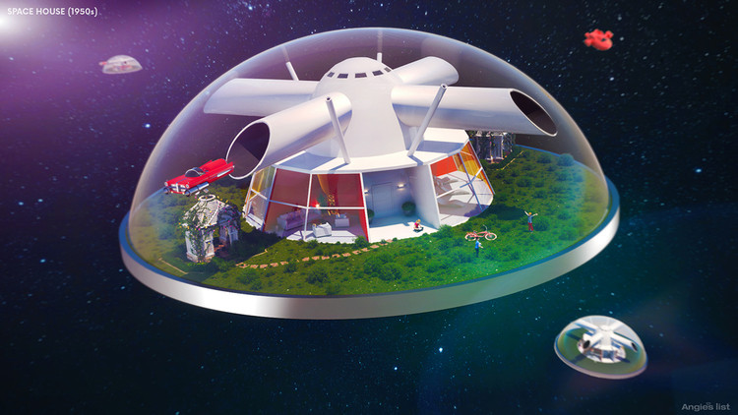
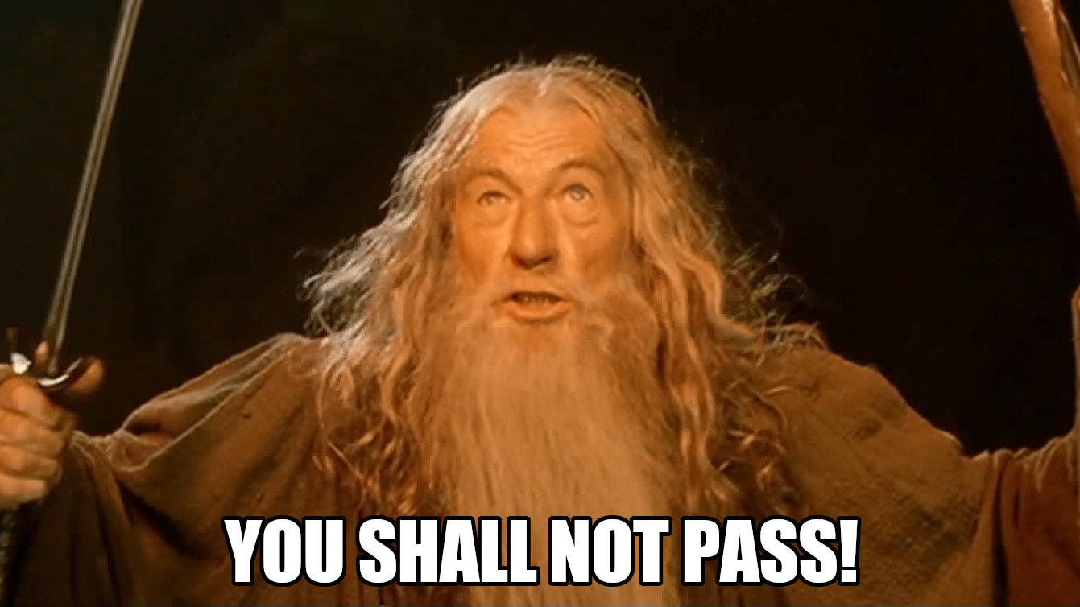
The Space House
I would love to live in space. In my space house there are nine rooms. There are 2 small living rooms, 2 medium kitchens, 3 bedrooms ( 2 guest rooms and my bedroom), a room for spaceship (rockets) and an office room. Outside of the house there is a strong wall.

Slide 5


SOURCES
Manor:
Wollaton_Park_MMB_07.jpg
Batcave:
DCU_Rewards_Batcave_BG1_5ea1d1c10a3f96.77279664.jpg
Background music:
https://www.youtube.com/watch?v=dQw4w9WgXcQ
This Photo by Unknown author is licensed under CC BY-ND.

Slide 6

MORE SOURCES
Stressed Emoji:
0addbc976e13e746f12273343457ff654.jpg
Space House:
02_Houses-of-the-futre-space-house.jpg
You Shall Not Pass:
You_Shall_Not_Pass!_0-1_screenshot.jpg
Unlimited Power!!!:
KXwmp7f.jpg

Slide 7


THANK YOU FOR YOUR ATTENTION ;)

