Slide 1
mY dream house
-Emanuela vidošević

Slide 2
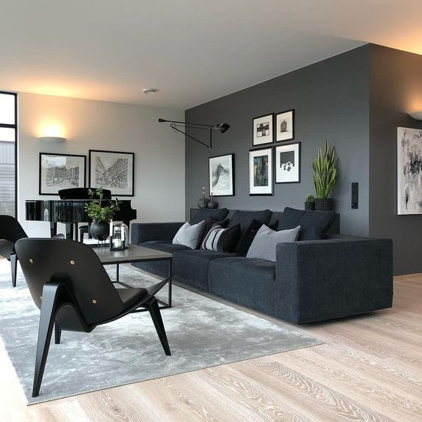
Living room
The living room would have one grey wall and others would be white.
It would be very basic and most likely would have fake plants.
Example:

Slide 3
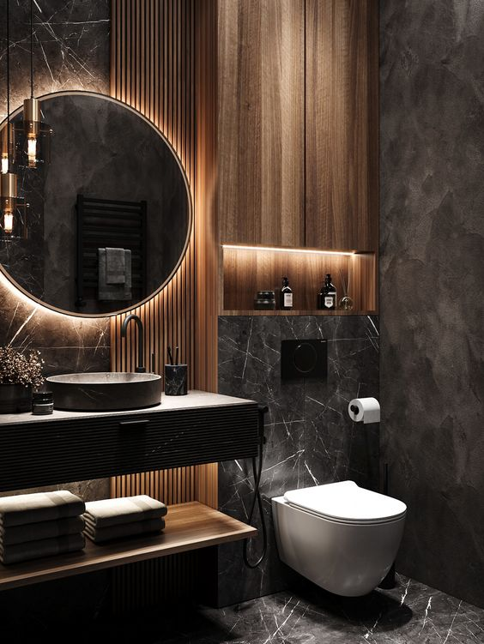
bathroom
I don’t have anything really to say about bathroom. i guess it would be basic as well. I really like bathrooms that have shades of gray or black in them.
Example:

Slide 4
bedroom
My bedroom would have a gaming set, gaming chair,carpet and a lot of shelves.the bed would be huge with few pillows.
It would have posters of some game charathers i like
Example:

Slide 5
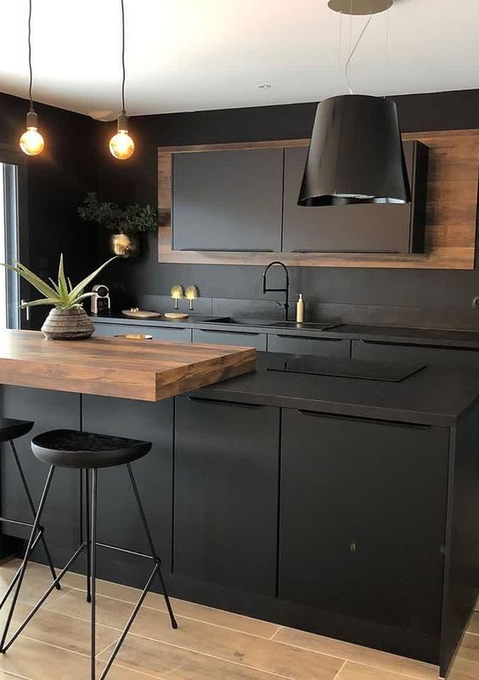
kitchen
The kitchen would have grey shades. It would have brown table with 4 chairs,fridge,brown floor with a lot of other stuff.
it would probably be smaller size because i don’t think it’s worth having a huge kitchen.
Example:

Slide 6
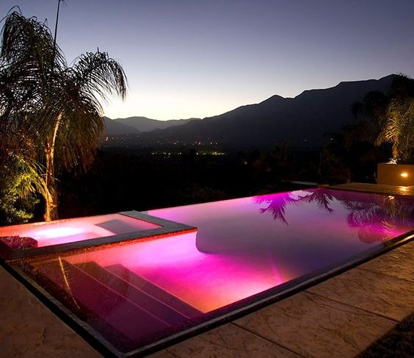
Outside of the house there would be a pool with ledlights. Examlpe:

Slide 7
links<3
Pinterest
Pinterest
Pinterest
Pinterest
Pinterest

Slide 8
Thank you. have a nice day!

