Slide 1
MY DREAM HOUSE
Prepared by Gabrijel Listeš

Slide 2
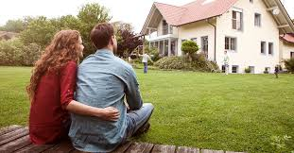
My home description
In my dream housethere is:
a living room with plasma screen TV, a little coffee table and a sofa with lots of small pillows
a kitchen with a fridge, an oven, a sink and a cupboard
a bedroom with a king size bed, a wardrobe, a desk and a chair
a bathroom with a toilet, a wash basin, a bathtub where I relax after hard work

Slide 3
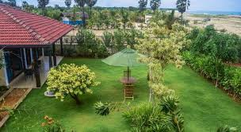
My green and healthy home
I have many plants which are placed on a wooden floor.
I love gardening so I have trees and plants around my house.
I create a rain garden which goes deep into the earth and keeps my garden lush and lively.
I start compost pile which helps my flowers and vegetables grow.
I use solar panels to get the warmth from the sun.

Slide 4
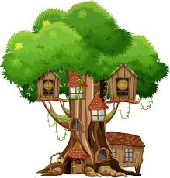
…
One thing I love the most is my treehouse where I love to spend time with my friends.
In my dream house there is a room with a corner where I can relax and spend my time. In that special room I have couch and a small bookshelf.
My house is peaceful, built with love and warmth.

Slide 5
Pictures link:
https://www.google.com/search?q=my+dream+green+house&tbm=isch&ved=2ahUKEwjF367n_cn8AhWixgIHHV69D5QQ2-cCegQIABAA&oq=my+dream+green+house&gs_lcp=CgNpbWcQAzoHCAAQgAQQEzoICAAQCBAeEBNQAFicDmDaEmgAcAB4AIAB8wKIAckNkgEHMC4xLjIuM5gBAKABAaoBC2d3cy13aXotaW1nwAEB&sclient=img&ei=GijEY8XqE6KNi-gP3vq-oAk&bih=754&biw=1536

Slide 6
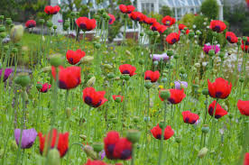
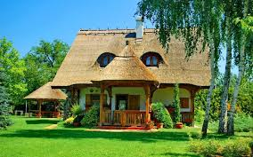
Thank you for your attention!

