Slide 1
Pear
Lucia Marović 5.b
OŠ Petra Kružića Klis
teachear :Marijana Buljan
subject:English

Slide 2
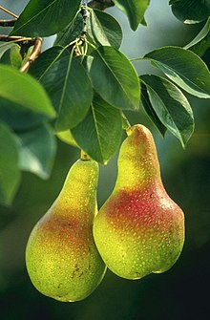
About pear
Pear is a genus of plants from the Ružovka family
Pear juice is good for newborns because it has a mild taste
contains vitamins: A, B1, B2, C, E
They can grow up highter than 20m

Slide 3
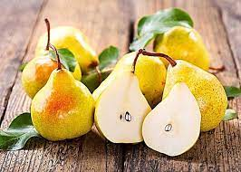
the benefit of the pear
There is a famous saying "one apple a day, the doctor out of the house“
one fist-sized pear contains about six grams of fiber, or almost a quarter of the recommended daily amount of 25 to 38 grams.
They help the digestive system to function well and digestion to be regular
it is easily digested

Slide 4
Seven dishes you can make with pears
1.Sandwich with pears
2.Salted pears
3.Pizza with pears
4.Pear with cabbage
5. Pear sauce
6. Pears with walnuts
7. Sangria with pears

Slide 5
Pear compote recipe
INGREDIENTS:
3 pears (peeled, cleaned and cut into cubes)
1 tablespoon of lemon juice
50 g of sugar
half a teaspoon of cinnamon powder
60 ml of water

Slide 6
Pear chips recipe
3-4 pears
2 dl of Greek yogurt
50 g of blue cheese
1 spoon of honey
http://www.vegicept.com/sastojak/kruska

Slide 7
Thank you for your attention
Lucia Marović 5.b

