Slide 1
PEAR
Mladen Katić
5.b

Slide 2
Did you know?
Pears are produced and consumed around the world, growing on a tree .
Pear tree is a species of genus Pyrus in the family Rosaceae, bearing the pomaceous fruit of the same name.
Several species of pears are valued for their edible fruit and juices, while others are cultivated as trees.
The tree is medium-sized and native to coastal and mildly temperate regions of Europe, North Africa, and Asia.

Slide 3
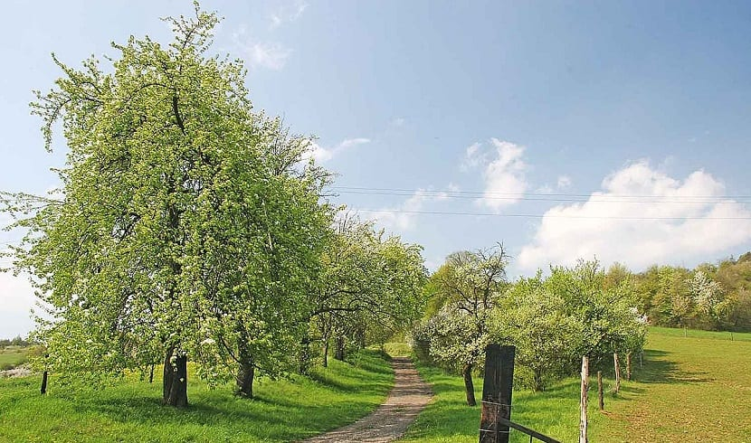
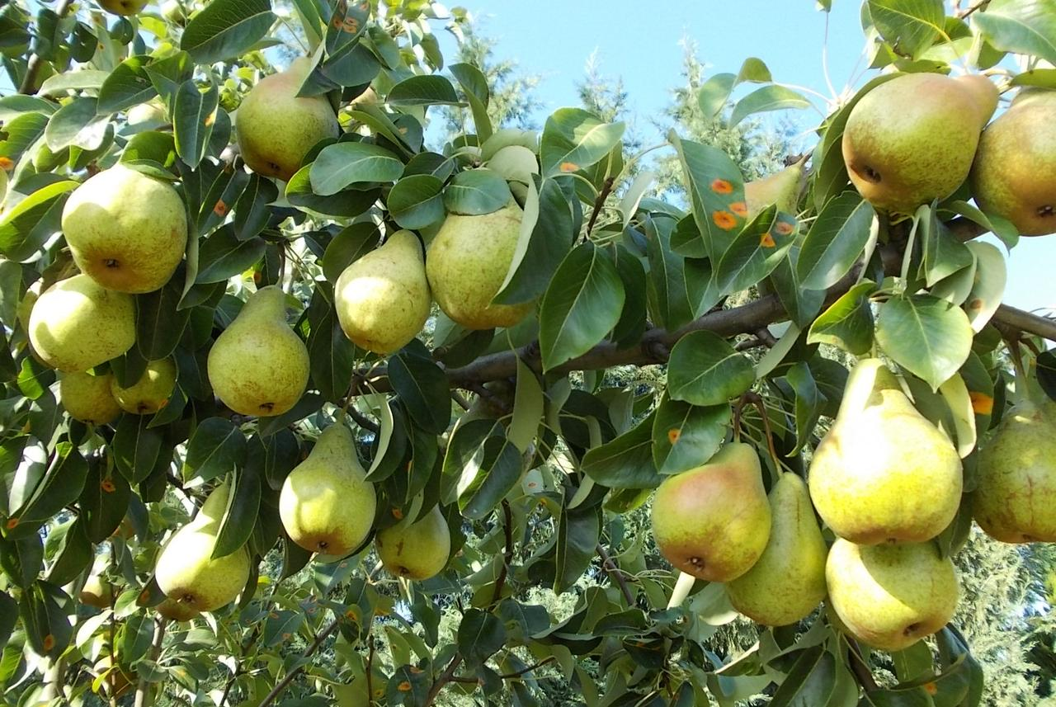
Pear wood is one of the preferred materials in the manufacture of high-quality woodwind instruments and furniture.
About 3000 known varieties of pears are grown worldwide, which vary in both shape and taste.

Slide 4
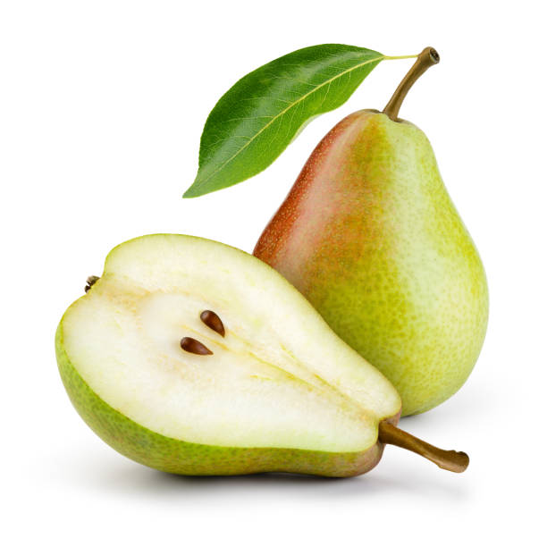
The pear is native to coastal and mildly temperate regions of the Old World, from Western Europe and North Africa east across Asia.
It is a medium-sized tree, often with a tall, narrow crown.
The leaves are alternately arranged, simple, glossy green on some species, densely silvery-hairy in some others.
Most pears are deciduous, but one or two species in Southeast Asia are evergreen.
SOURCES:https://en.wikipedia.org/wiki/Pear

Slide 5
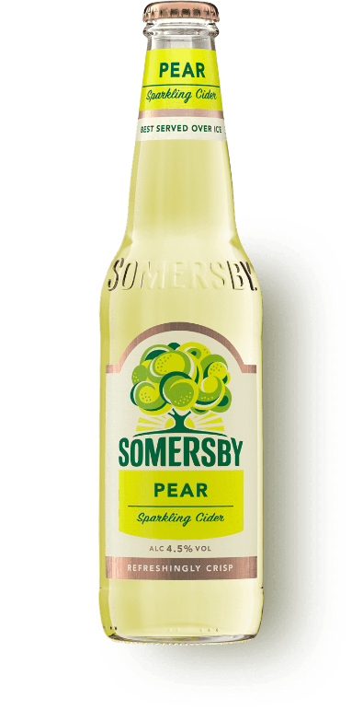
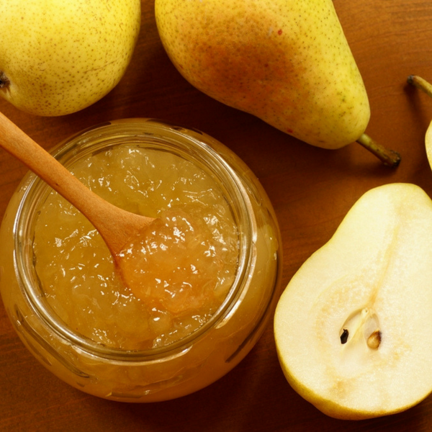
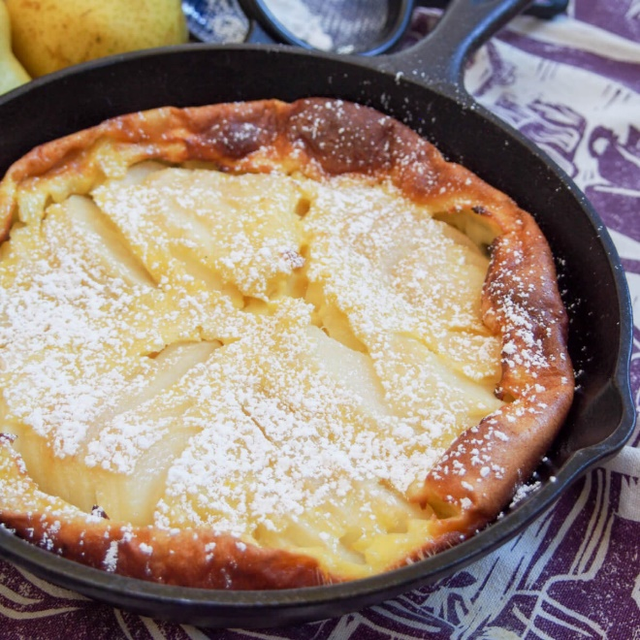
Cooking
Pears are consumed fresh, canned, as juice, and dried .
The juice can also be used in jellies and jams.
Fermented pear juice is called perry or pear.
Pear puree is used to manufacture snack foods.

Slide 6
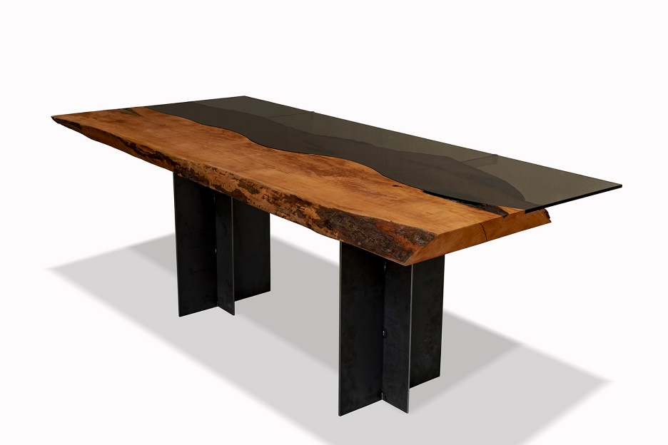
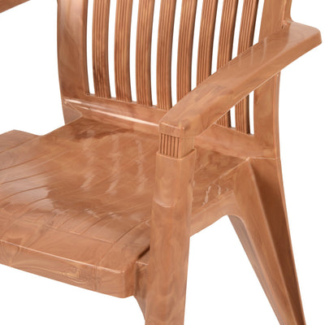
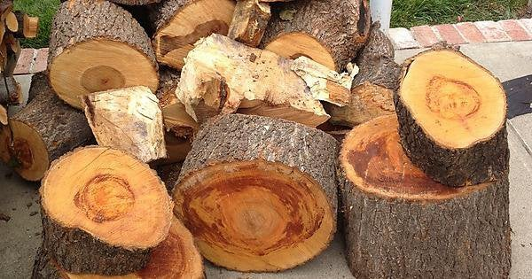
Pear wood
Pear wood is one of the preferred materials in the manufacture of high-quality woodwind instruments and furniture.
It is used for making the carved blocks for woodcuts.
It is also used for wood carving, and as a firewood to produce aromatic smoke for smoking meat or tobacco.
Pear wood is valued for kitchen spoons, scoops and stirrers.
Pear wood is the favored wood for architect's rulers because it does not warp.

Slide 7
The end Thank you! ☺

