Slide 1
My best friend
Davor mihovilović
6.A GRADE
Primary school petra kružića klis

Slide 2
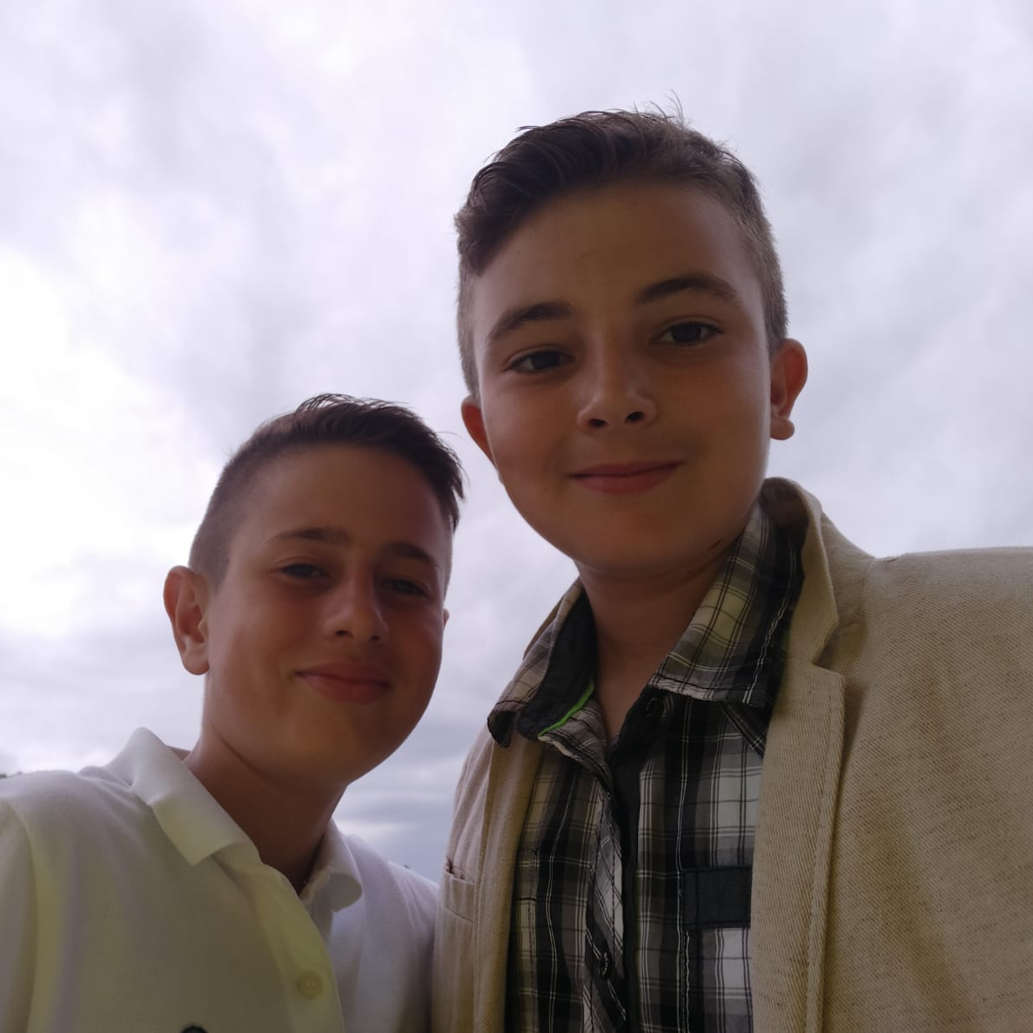
My best friend is Filip.
He is also my cousin.
He is twelve years old.
We go to the same school.

Slide 3
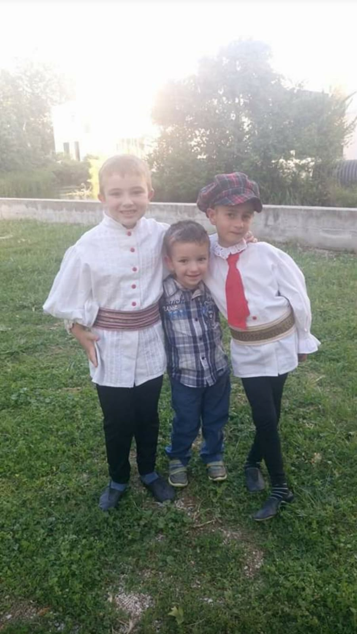
When we were little we went to the same kindergarten.
We were at the same show (IDE CUKNA).

Slide 4
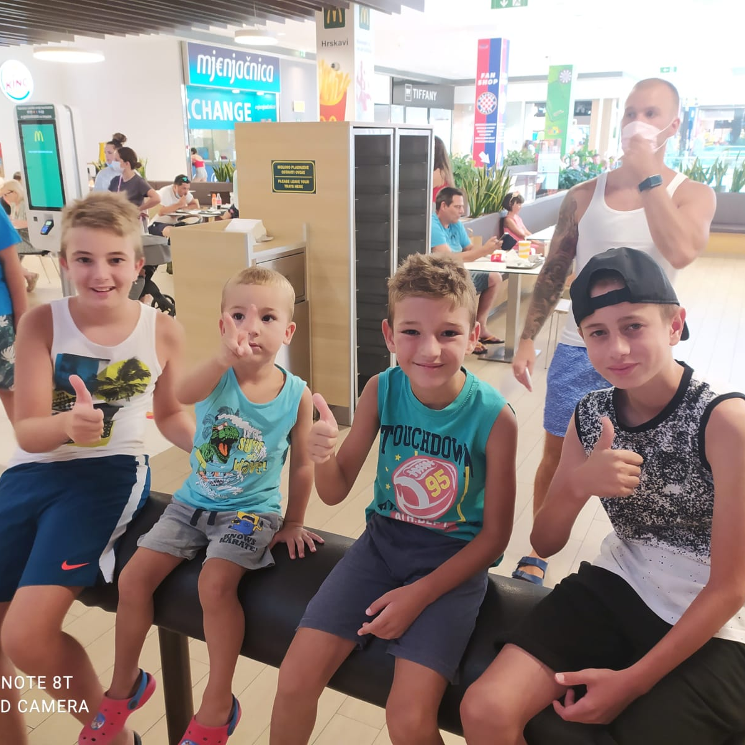
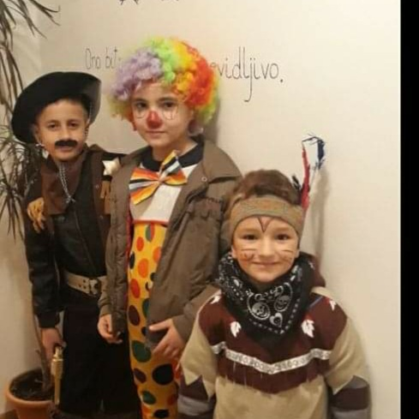
When we were little we were often together.
We often went to the sea together, to McDonald’s, to the cinema…

Slide 5
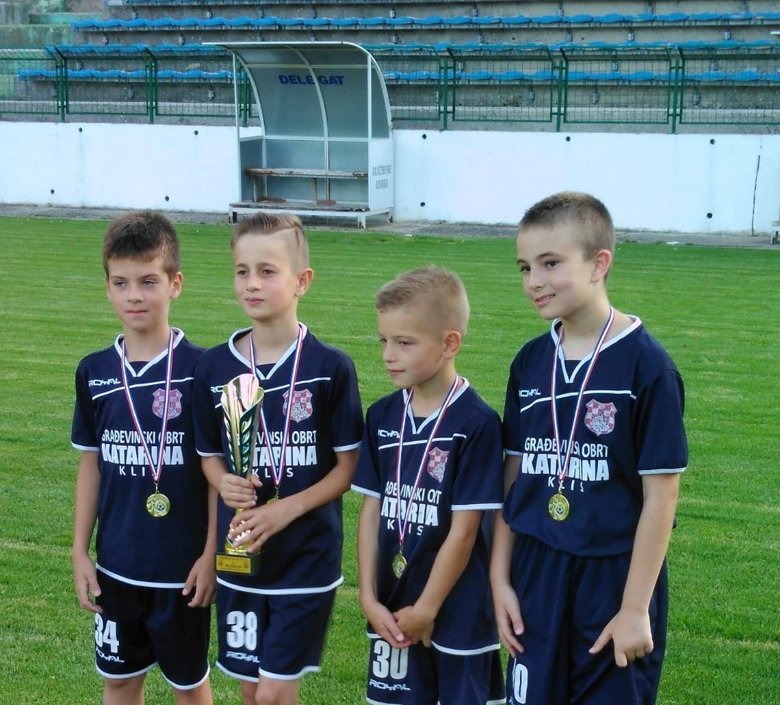
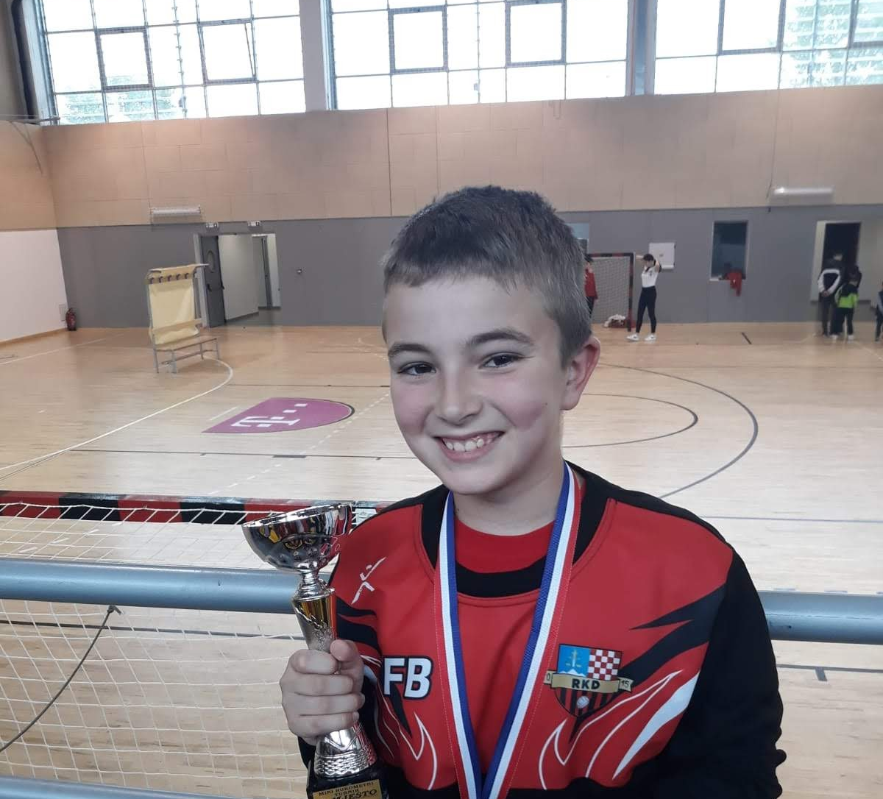
We used to train football together, but now Filip trains handball and I train football.
Filip is very good at handball.

Slide 6
We often watch matches of all kinds of clubs together.
Filip’s mom bakes us popcorn.

Slide 7
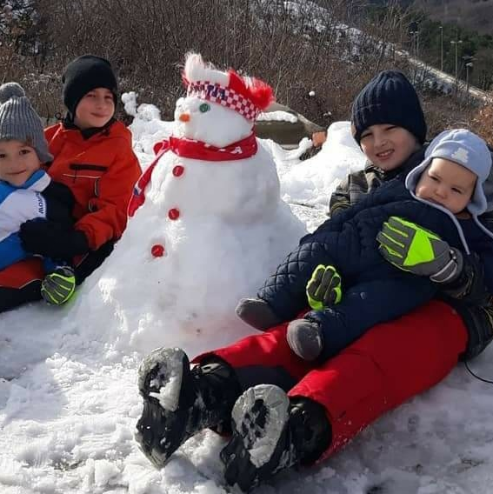
We often play together.
For example ,this winter we built the biggest snowman together.

Slide 8
We often play video games together. We like to play Fifa the most.

Slide 9
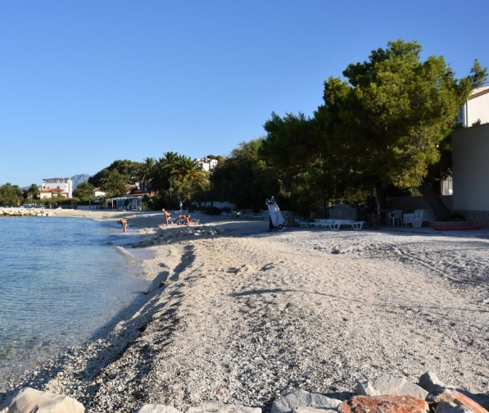
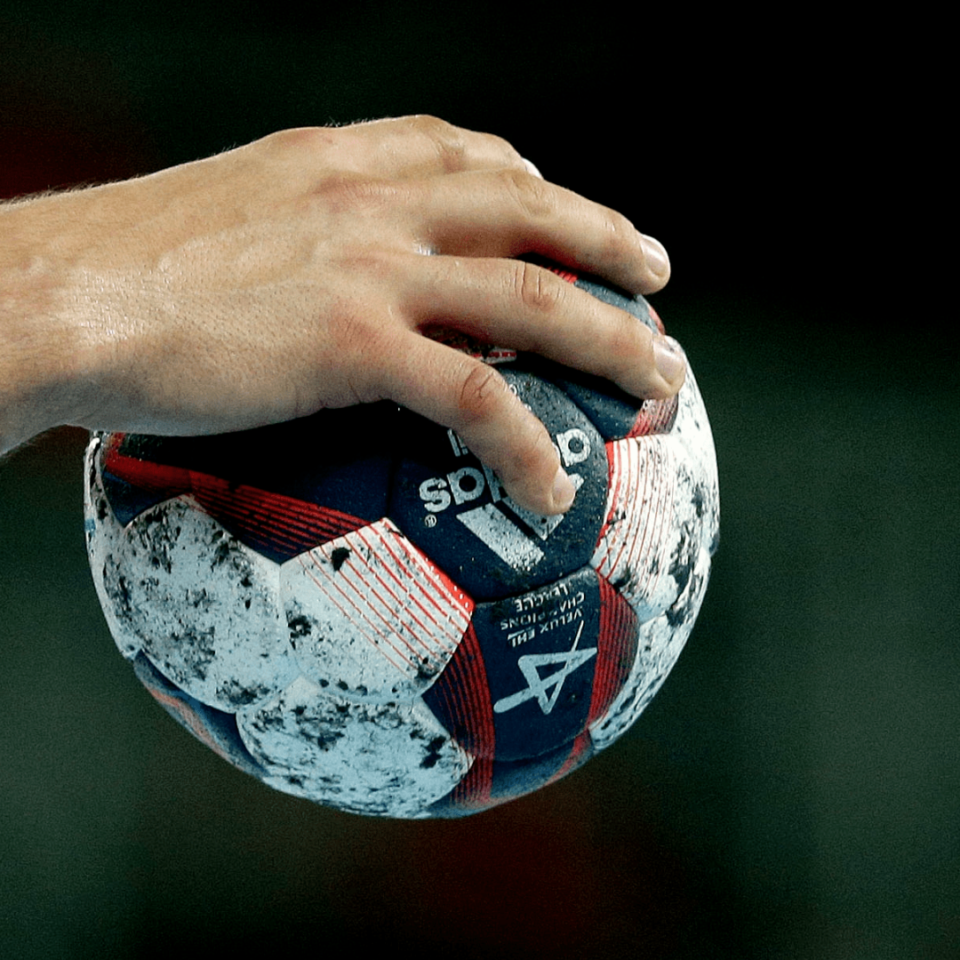
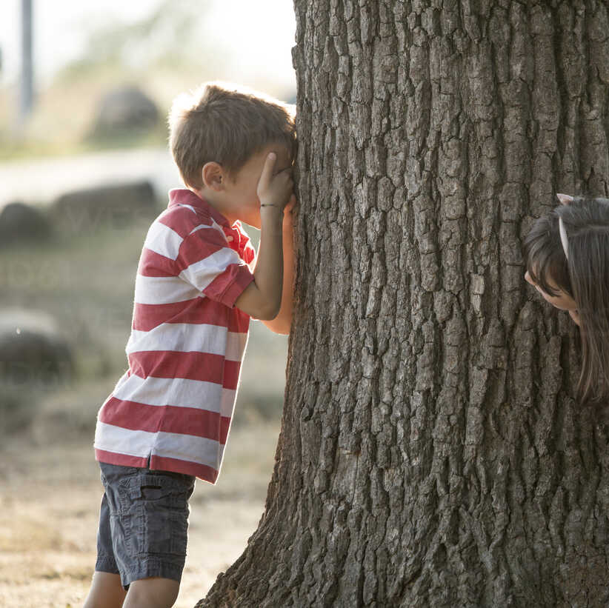
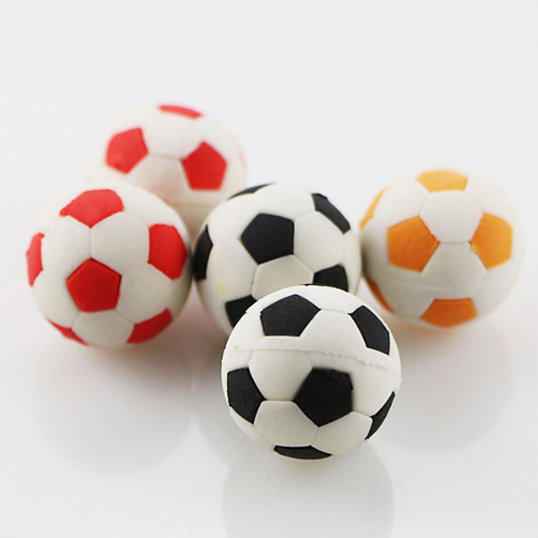
In summer Filip and I often go out and play all kinds of games or go to the sea together.
When we go to the sea we often compete who swims faster and dives better.

Slide 10
Thank you for your attention!

