Slide 1
BEST FRIENDS FOREVER
Anna Zoko 6.a oš Petra Kružića Klis, 12.11.2021

Slide 2
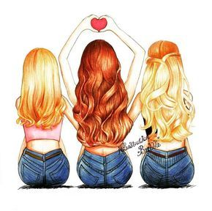
My best friends are Margarita AND Natalia

Slide 3
Margarita
Margarita is a real example of a good friend.She always helps everyone, keeps secrets and is very smart. She is kind, well-meaning and generous.
She is very beautiful, tall and skinny. She likes to wear baggy pants, her favourite colours are white and black.

Slide 4
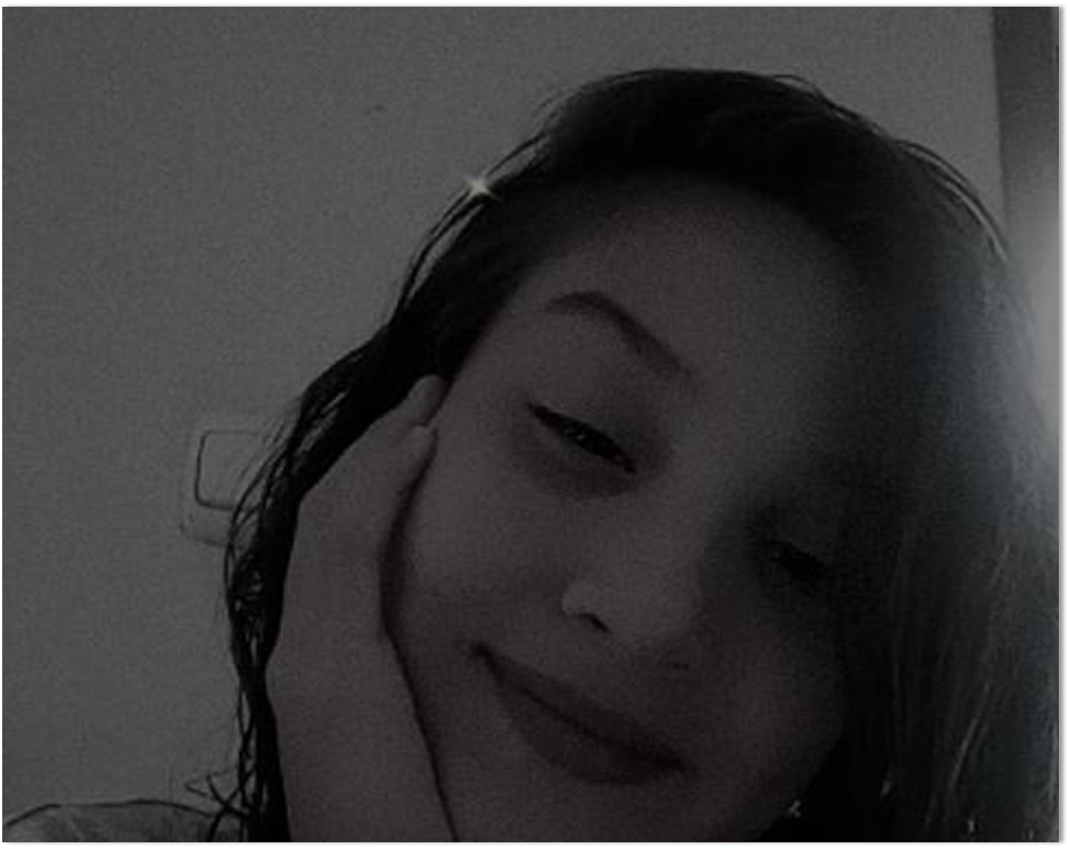
always smiling

Slide 5
Natalia
Natalia is a very beautiful girl. She has brown hair and brown eyes.
She is very smart, funny, good, energetic and a little bossy. She is the most popular person in school.

Slide 6
smiling girl

Slide 7
A B
A good friend: | A bad friend:
helps you | lies to you
cares abaut you | tells others your secrets
listens to your problems | ignores you
is there for you | doesn’t share things
keeps promises | gossips abaut you
Margarita and Natalia are examples from column A.

Slide 8
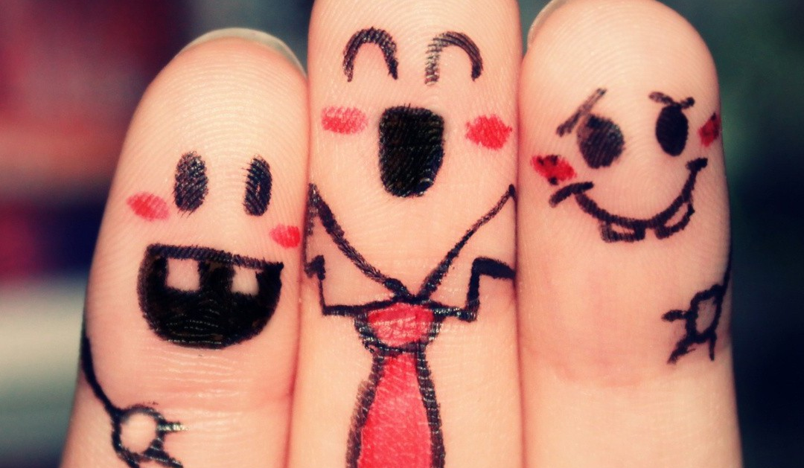
bff questions
1. Do you share all your secrets with your friend?- Yes of course .
2. Do you often fight with your friend?-Not ever.
3. Do you listen to your friends problems? – Yes I do.

