Slide 1
SCHOOL LIFE
Lara Bubić 7.b

Slide 2
MY DAD’s SCHOOL LIFE
From the 1st to the 4th grade my dad went to school on foot, but from the 5th to 8th grade he went to school by bus.
While he was going to school in Klis (from 1st to the 4th grade) there were only three students in his class.
While he was going to school in Solin(from 5th to te 8th grade) there were 32 students in his class.
Fun fact is that my dad went to school with our English teacher.

Slide 3
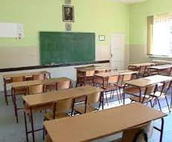
classroom
https://www.google.com/url

Slide 4
MY DAD’s SCHOOL LIFE
While they had breaks they were in the classroom talking. At the long breaks they were in the playground.
For brunch he had sandwiches he brought from home or something he would buy in store near the school.
They had no extracurricular activities.
His teachers were good.
My dad remembers his class teacher from biology because they often talked to her.
Of the equipment they had a greenboard, maps and an overhead projector.
My dad learned Englih at school

Slide 5
MY MUM’s SCHOOL LIFE
My mum went to school on foot.
There were 32 students in her class.
During a short break she moved to another classroom, and during a long break she was in the school yard.
For breakfast she ate sandwiches.
Of extracurricular activities they had volleyball and handball.
Some teachers were strict and some were gentle and fun.

Slide 6
MY MUM’s SCHOOL LIFE
My mum remembers some teachers.
She remembers the teacher of history and geography because he had a whip.
My mum also remembers the teacher of mathematics who was very strict.
She remembers the Croatian teacher because she had a strange accent .
Last teacher she remembers is her classmate who was a music teacher as well as mine.

Slide 7
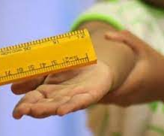
SWITCH
https://www.google.com/

Slide 8
MY MUM’s SCHOOL LIFE
At the time when my mom went to school most of topics were not for students to discuss. They knew what was allowed and what was not. Discussions were possible when some situations came up.
Of equipment she had: a greenboard, satin charts, instruments, and cabinets for maps.
She learned English language.

Slide 9
MY GRANDMA’s SCHOOL LIFE
She went to school on foot.
From 1st to the 4th in her class were 4 students, but from the 5th to the 8th grade in her calss were 20 students.
On the long breaks they were in the playground, and on the short breaks they went to the toilet or talked with friends.
For breakfast she eat school lunch(that was the sandwich with butter, ham…)
Of extracurricural activities they had a drama, choir and gymnastic.She never went to any of thses because of health problems.

Slide 10
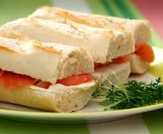
sandwich
https://www.google.com/url

Slide 11
My grandma’s school life
Her teachers were good.
She remembers her teacher of
tehnical education because he
was young and strict.
They didn’t have topics which
they weren’t allowed to discuss.
Of the equipment they had a plate and a globe.
Of foreing languages they had English

Slide 12
My grandpa’s school life
My grandpa went to school on foot.
In his class there were 8 students.
On the long breaks he ate school lunch (sandwich), and drank white coffe.
They didn’t have extracurricular activities.
His teachers were good.
He remembers a teacher of English because she was good, polite and always loved to help.

Slide 13
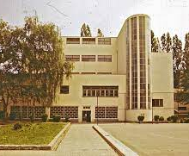
playground
https://www.google.com/url

Slide 14
My grandpa’s school life
They didn’t have topics which
they weren’t allowed to discuss.
Of equipment they had:
a greenboard, globe and a map
They learned English as a foreign language.

Slide 15
MY SCHOOL LIFE
From the 1st to the 4th grade I went to school on foot, but now from the 5th to the 7th grade I go to school by bus.
Now in my class there are 20 students. From the 1st to the 4th grade in my class were 2 students ,Aneta and me.
On the short breaks I talked to my friends or repeated material for the subjects.On the long breaks I went to the yard with my best friend.
For breakfast I usually bring brunch from home(pancakes, sandwich, fruit…), but sometimes I buy brunch at school.

Slide 16
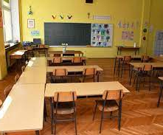
New classrooms
https://www.google.com/url

Slide 17
MY SCHOOL LIFE
From extracurricular activities we have: art group, drama group, literary, volleyball and judo.
My teachers are very kind to me and like to joke with us.
My classmistress teaches music, and I will remember her for always telling us that we are not the1st graders.
We do not really have topics that we shouldn’t talk about, but we mustn’t be rude and ask inappropirate things for school.
From the equipment in the classroom we have: a board, a projector, a computer for teacher anda a shelf for boxes.
I learn English, and we can learn an Italian language too .

Slide 18
The end
Made by:Lara Bubić 7.b
Now you should ask a question.
Thanks for watching.

