Slide 1
Life in the past
PRESENTATION

Slide 2
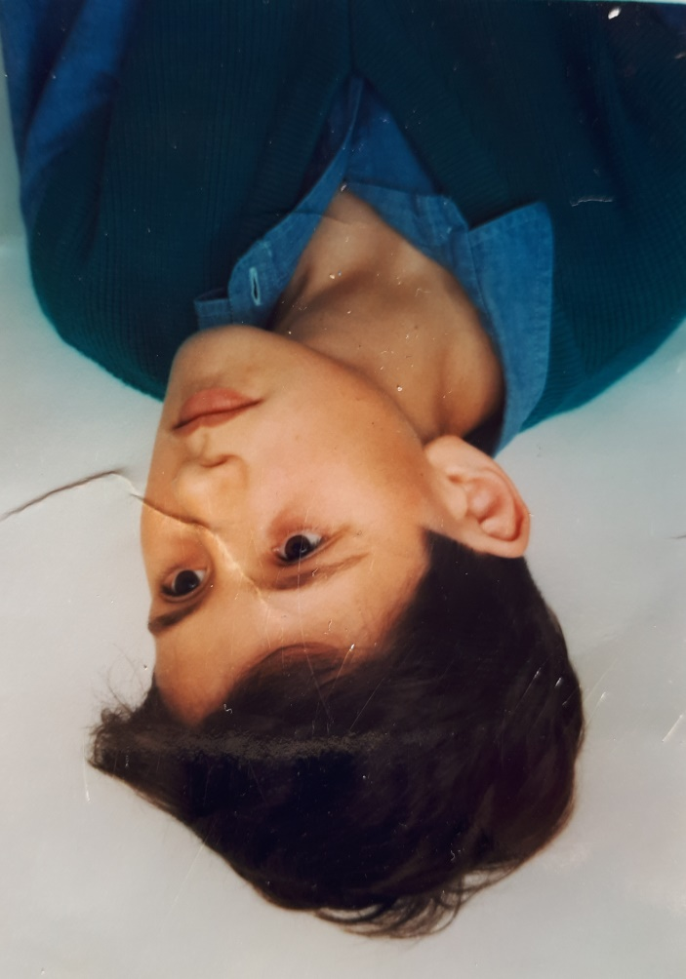
My father Zdenko and my mother Sandra as children

Slide 3
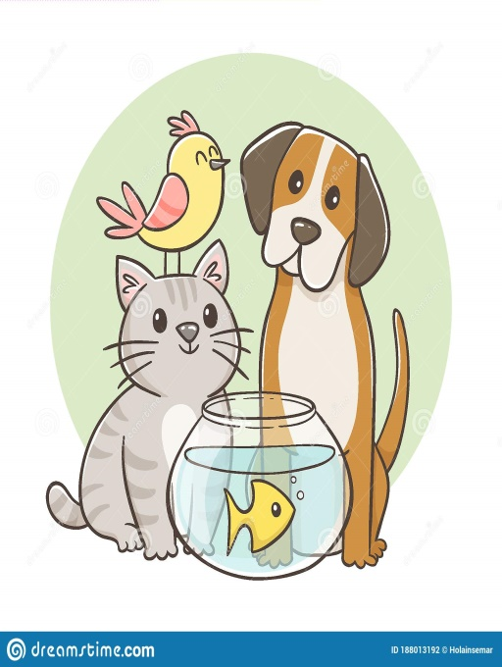
Home:
My mother and my father both lived in a flat as children. They did not have their own rooms. They shared room with their brothers.
My father didn’t have a lot of clothes, but my mother did. Her grandmother knitted pullovers for her and her mother made her dresses, skirts and pants. People didn’t buy new clothes often. They would usually pass on old clothes to relatives.
My mother had two pets: a bird and a goldfish. My father had a dog and a cat when he was a teenager.

Slide 4
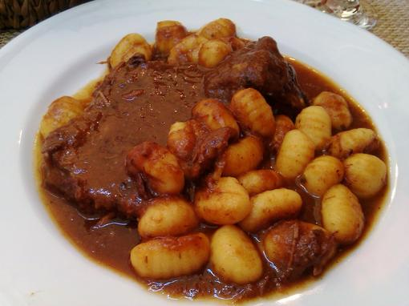
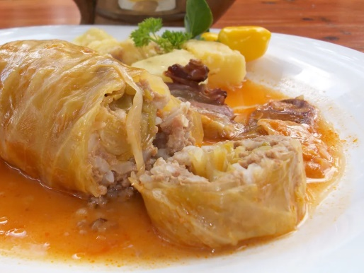
Home:
My mother’s family had lunch around noon, and my father’s family had lunch around 15 h.
My father had to vacuum, tidy up his room, go to the shop and take out the garbage. My mother had to help with food preparation for lunch, clean the house, go to the shop, make beds and put clothes to dry on a hanger.
My mother’s favourite dish from childhood is pašticada and my father’s is sarma.
Gastro -24 sata Coolinarika

Slide 5
Parents:
My mother’s and my father’s parents worked.
Both families had a car.
As children my mother and father were with their parents after their work, on weekends and during vacations.
My father had an allowance and my mother didn’t.
My mother’s parents shared house chores and my father’s mother did most of house chores.

Slide 6
Free time:
During the weekend my mother’s family went on day trips in nature or visited friends. My father’s family sometimes went to the village to visit grandparents and sometimes stayed at home.
During the summer my mother’s family always went camping on different islands. My father’s family sometimes went to the beach or spent time with friends.
My mother and father listened to pop and rock music. They used to listen music on MTV and from cassette player at home.
They watched TV in the evening and on weekends. My mother went to the cinema often and my father sometimes.

Slide 7
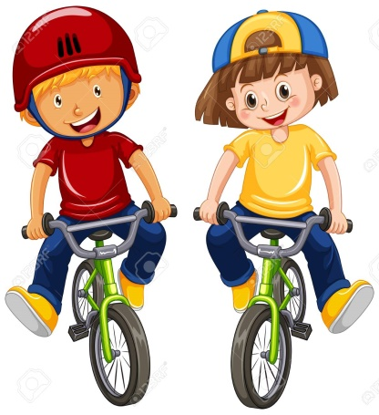
Opinion:
My mother worried about how to spend her free time and my father worried about schoolwork.
My father was happy to spend time at the beach and play with friends. My mother was happy to do arts and crafts, read books and spend time with her best friend.
Her biggest dream was to become a famous author. Father’s biggest dream was to travel to a foregin country.
123 RF

Slide 8
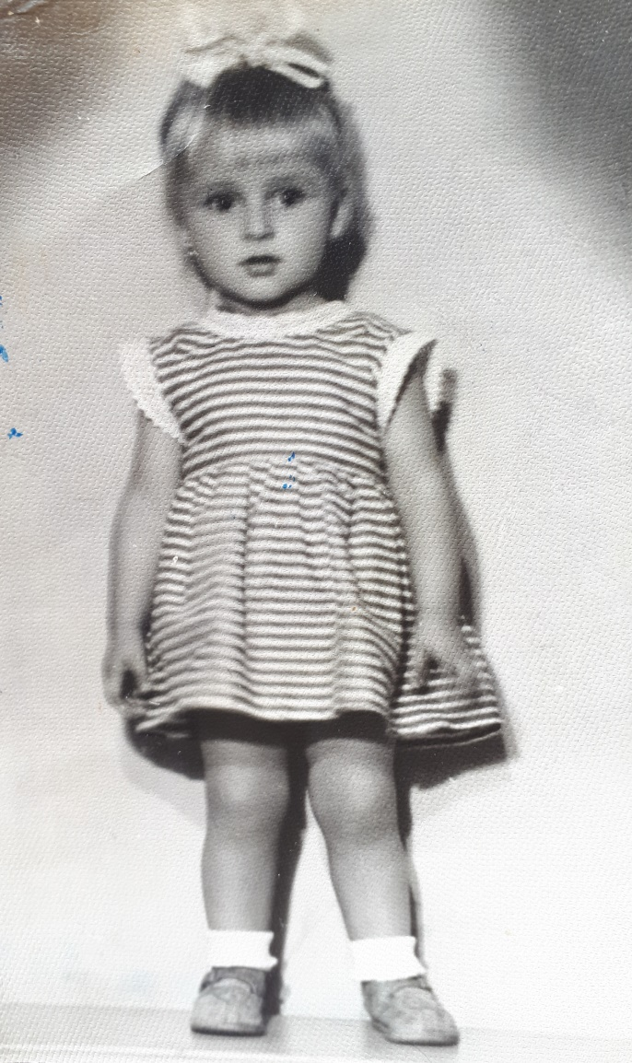
My gradfather Dule and my grandmother Slađa as children

Slide 9
Home:
My grandmother and my grandfather both lived in a flat as children. They did not have their own rooms. They shared room with their brothers.
My grandfather didn’t have a lot of clothes, but my grandmother did. Her mother knitted pullovers for her and made her dresses, skirts and pants. People didn’t buy new clothes often.
My grandmother and my granfather did not have any pets.
Both families had lunch around noon.
My grandfather had to dust the carpets and clean his room. My grandmother had to clean her room and go to the shop.
My grandmother’s favourite dish from childhood was French salad and my grandfather’s was knedle.

Slide 10
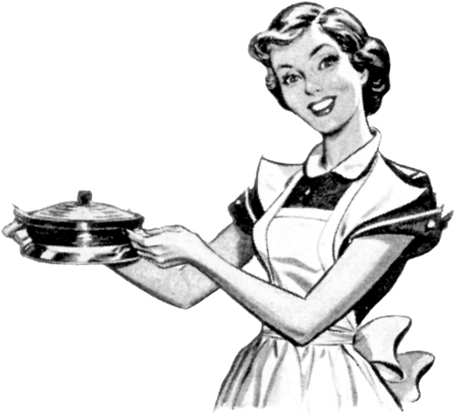
Parents:
Both in my grandmother’s and my grandfather’s family only fathers worked and mothers were housewives.
Both families did not have a car.
As children my grandmother and grandfather were with their parents a lot.
My grandfather and my grandmother didn’t have an allowance.
In my grandmother’s and my grandfather’s family mothers did most of house chores.
pik png

Slide 11
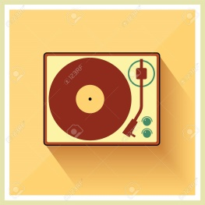
Free time:
During the weekend my grandmother’s family went on day trips in nature. My grandfather’s family sometimes went to the village to visit relatives and sometimes stayed at home.
My grandmother’s family always went to the beach with relatives during the summer. My grandfather’s family sometimes went to the beach or spent time with friends and relatives.
My grandmother and grandfather listened to pop and rock music. They used to listen to music on radio and LPs at home.
They sometimes watched TV. They rarely went to the cinema .
123RF

Slide 12
Opinion:
My grandmother worried about the murder of J.F. Kennedyat that time and my grandfather worried about Solar eclipse.
My grandfather was happy to go to the cinema. My grandmother was happy to go to the beach.
Her biggest dream was to travel around the world. Grandfather’s biggest dream was to find a hidden treasure. His friends called him „Pirate”.

Slide 13
Made by:
Filip Jovišić, 7.B

