Slide 1
THE CULTURAL AMBASSADOR
LIFE IN THE
PAST

Slide 2
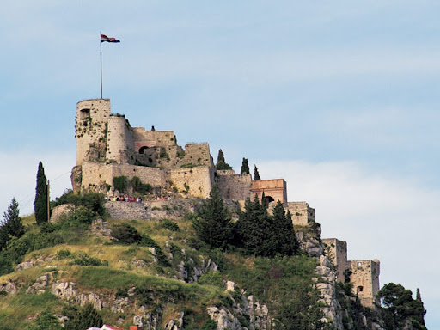
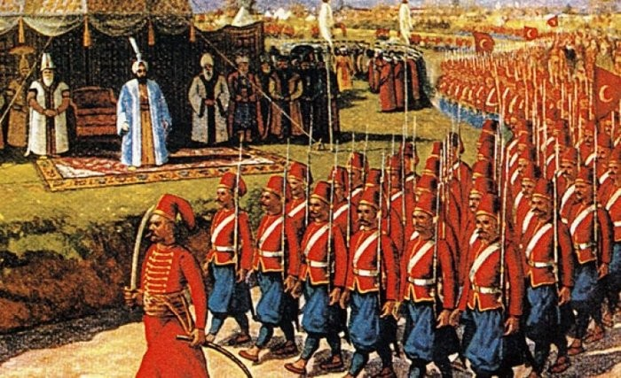
THE PAST OF MY PLACE
I live in the city of Klis. In the past Klis was famous for its’ Croatian rulers. Those rulers lived in it and lead the country from that city. The most important period of Klis was in the beginning of the 16th century when Klis was the frontier of defense against the Ottomans. On steep cliffs there is an old fort that served to defend against the enemy.
(dalmatia.hr)
(dailysabah.com)

Slide 3
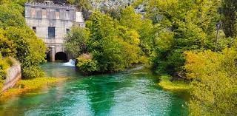
Southern boundary of the Klis is the river Jadro which supplies Split with drinking water as well as Solin, Klis and surrounding towns. Klis got it’s name from the gorges.
(solin-info. com)

Slide 4
MY DAD’S LIFE IN THE PAST(HIS CHILDHOOD)
My dad lived in a house and shared his room with his sister and his brother. He had a lot of clothes, but he would buy them three to four times a year. From pets, he head a dog, and from domestic animals pigs, chickens and horses. He had lunch at about two pm (depending on when his parents would come home from work) and his favourite dish was rissoto and cheesecake.

Slide 5
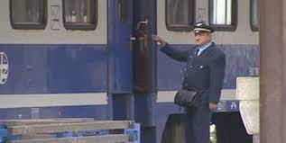
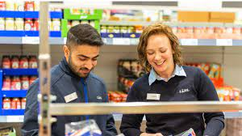
From housework he only had to tidy his room, but he dug, fed the animals and took care of the garden. His parents (my grandparents) had a car, because they needed it to go to work. My grandmother worked in the store as a saleswoman and my grandfather as a conductor. My dad would spend about four hours with his parents a day, because they worked a lot.My dad was often outside and spent little time in the house.
(ezadar.net.hr)
(careers.lidl.co.uk)

Slide 6
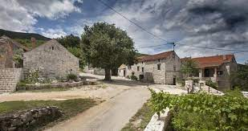
My dad got allowance only when he went to football games or for a snack in high school. During the weekend he loved going to the countryside and hang out with his friends. During the summer he often went to beach and to the village and helped his grandparents pick potatoes.
(planetware.com)
(smokvina.com)

Slide 7
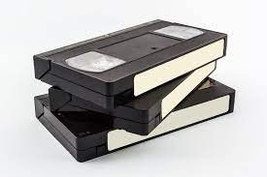
Of music he liked to listen to local music and rock music.He listened them through audio tape and gramophone. He watched TV one hour a day and went to the cinema once a month in high school because he didn’t like watching movies.
(express.24sata.hr)
He loved playing football and watching football matches. When he was younger his only concern was whenever Hajduk would win. He would be equally happy if he or Hajduk won. His biggest dream was to become an arhitect and for Hajduk to win Champions leauge.
(hntv.hr)

Slide 8
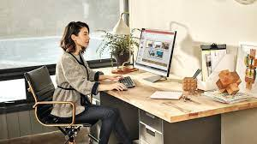
MY MUM’S LIFE IN THE PAST(HER CHILDHOOD)
My mum lived in a house and shared her room with her sister. She had a lot of clothes but most of that clothes was bought by her sister. She had a small cat Mikica. My mum had lunch around 12 pm (depending on time she came back from school). Her favourite meal was fried chicken. Out of housework she had to clean her room , vacum , help cook the lunch and plant vegetables with her dad. Her parents had a car. Her mum worked in an office , and her dad was an engineer.
(hr.bizzportal.ru)
(vonroey.be)

Slide 9
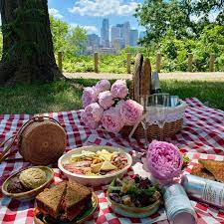
My mum spent about four hours outside so she didn’t have much time to be with her parents. My mum got allowance for snacks at school and for hanging out with her friends. During the weekend , she would hang out with her friends and visit her grandparents in Split. During the summer she went to the beach and on picnics.
(twincities.eater.com)

Slide 10
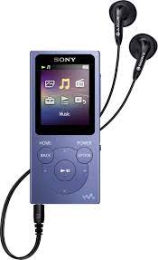
My mum loved to listen to folk and pop music , she listened it trough radio and mp3 player. She went to the cinema once a month , but she rarely watched TV. New friendships and presents from her sister would make her happy. Her biggest dream was to be a femeale doctor because her sister was one.
(aliexpress.com)
(istckphoto.com)

Slide 11
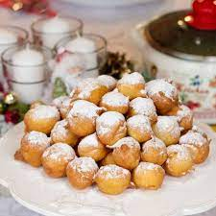
MY GRANDMOTHER’S LIFE IN THE PAST( HER CHILDHOOD)
My grandmother lived in an apartment and shared her room with her sisters . She had a lot of clothes (she bought it once a month). She didn’t have any pets. She would have lunch around 3pm. Her favourite snack was fritters. Out of housework , she would tidy her room and help her mom cook lunch. Her parents had a car and a TV. Her mum worked in a copy shop and her dad was an engineer. She spent 5 hours a day with her parents , because one of her favourite things was to play board games with them.
(recepttura.com)

Slide 12
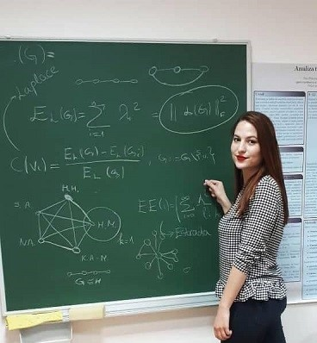
Out of music she liked to listen to folk and pop music.She listened it trough gramaphone and at concerts . She liked going to cinema once a month with her sisters. During the weekends she spent a lot of time with her friends. At summer she liked to travel and go to the beach. Her biggest dream was to become a teacher. (maths teacher).
(studentski.hr)

Slide 13
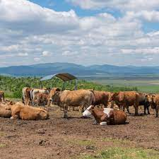
MY GRANDFATHER’S LIFE IN THE PAST(HIS CHILDHOOD)
My grandfather lived in a house and shared his room with his sister and brother. He didn’t have much clothes and he only bought it when he would outgrow it. He had one dog , 3 cows , a horse and chickens. He would study for 3 hours (depending on how long would he be on a farm). His favourite meal was spaghetti and salad. Out of housework he didn’t have to do anything but he had to take care of animals.
(jutarnji.hr)

Slide 14
His dad didn’t have a car. His father was a construction worker , his mother worked on a farm. He spent almost all of his days with his parents (he didn’t have much time to hang out with friends). He didn’t get any allowance from his parents because he didn’t have any time for playing or hanging out.
He listened to folk , pop and rock music. He listened it on concerts and events. He went to the cinema on Saturdays in the House of Culture. He didn’t have any concerns exept that one day animals would run away and then that his mum would yell at him.

Slide 15
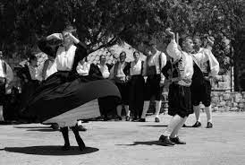
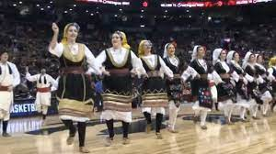
(vecernji.hr)
(ultimateclassicrock.com)
(24sata.hr)

Slide 16
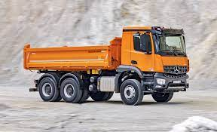
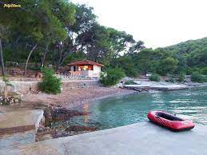
He was the happiest person in the world when he got new clothes. During the weekends he went to church and took care of animals. During the summer, he would go 2 weeks on a holiday to his aunt Zorka. His biggest dream was to live on the beach and to own a truck.
(kamion-bus.hr)
(mojsmjestaj.hr)

Slide 17
THANKS FOR YOUR ATTENTION
THANKS FOR YOUR ATTENTION
Made by: Matea Munitić

