Slide 1
Barley
Manuela Melvan, 8.b
Engleski jezik
Osnovna škola Petra Kružića Klis

Slide 2
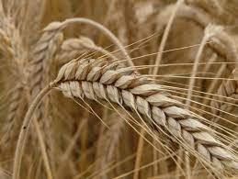
About barley
Barley is the main grain of cereals.
It grows in temperate climates.
It was one of the first cereals grown, especially in Europe and Asia.
It is used as food for
animals and humans.
Barley is also used as
beer malt.

Slide 3
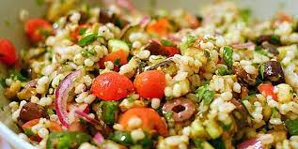
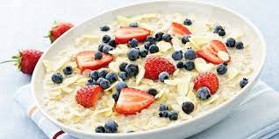
Barley and cooking
Barley is one very tasty and adaptable cereal.
We can use it in sweet and savory combinations.
It goes great with fruits and vegetables so we can cook it in stews.
We can also mix it in salads or prepare a very tasty breakfast.
Barley porridge
Bearley salad

Slide 4
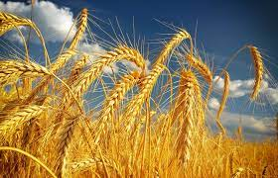
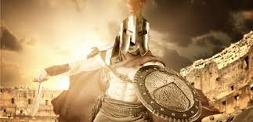
Barley and history
Barley is one of the oldest cultivated cereals, it was grown in the Stone Age.
Barley is extremely nutritious and healthy, as evidenced by the fact that even gladiators ate it.
People called the gladiators barley eaters.

Slide 5
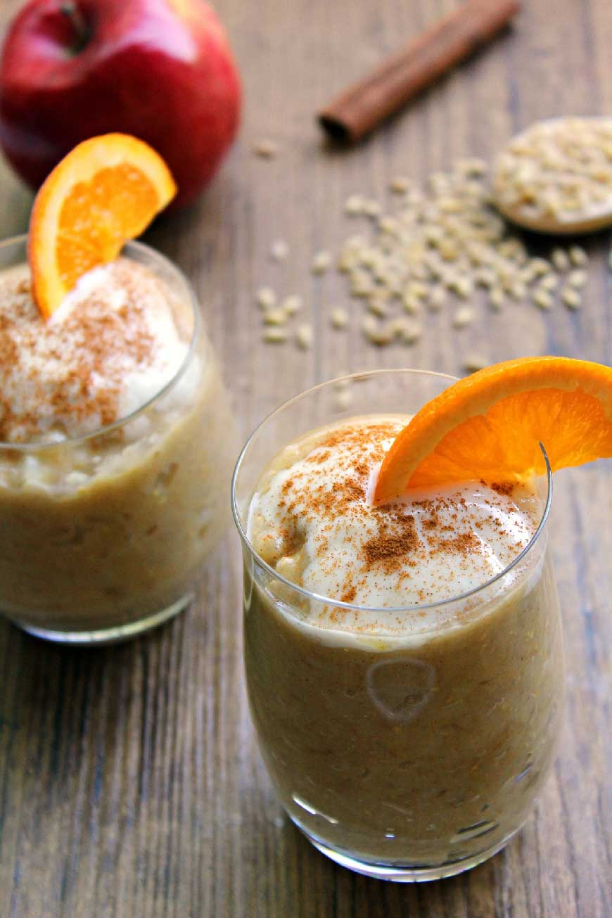
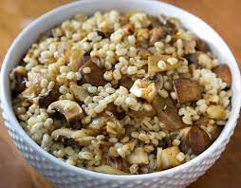
Recipes with barley
Barley pudding
Barley pudding
Barley stew
Barley with mushrooms
Barley and carrot soup
Barley and vegetable salad
Barley with
mushrooms

Slide 6
Here’s why I chose barley
I chose barley because I really like to eat it when my grandmother prepares it according to an old recipe from Gizdavac.
My whole family loves to eat it.
We prepare barley dishes almost every day.
My grandmother likes to say that barley was eaten by "peasants" when they returned from the fields, so she does not prepare it for important events.

Slide 7
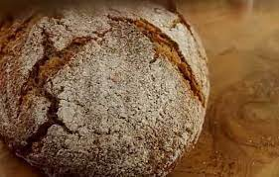
My favorite recipe with barley
When my grandmother prepares barley dishes, I like barley bread the most.
My grandmother once told me that barley bread is one of the healthiest breads in the world.
I love it because I can eat
it with everything.

Slide 8
Sources
Coolinarka
https://www.coolinarika.com/?pretrazivanje=%7B%22pojam%22%3A%22Je%C4%8Dam+%22%7D
Hrvatska enciklopedija
https://www.enciklopedija.hr/natuknica.aspx?id=28881
Wikipedija
https://hr.wikipedia.org/wiki/Je%C4%8Dam

Slide 9
THANK YOU FOR YOUR ATTENTION!!

