Slide 1
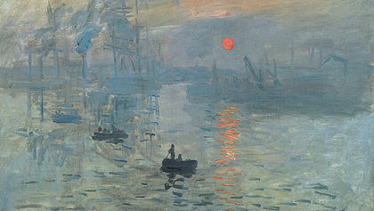
barley
Oscar-Claude Monet (Paris, France, November 14 1840. – Giverny, France, December 5 1926.), Impression, Sunrise (French: Impression, soleil levant)
⊱┄┄┄┄┄┄┄┄┄┄┄┄┄┄┄┄┄┄┄┄┄┄┄┄┄┄┄┄┄┄┄┄┄⊰
Cvita Grubišić, 8.b.

Slide 2
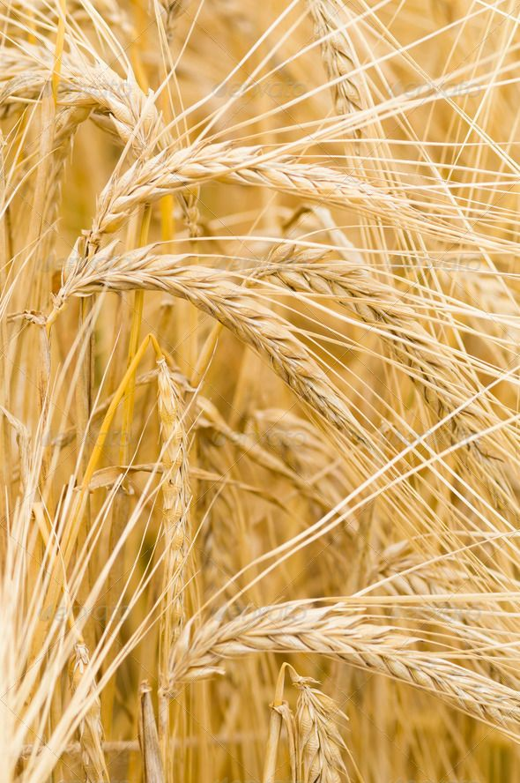
HORDEUM VULGARE
⊱┄┄┄┄┄┄┄┄┄┄┄┄┄┄┄┄┄┄┄┄┄┄┄┄┄┄┄┄┄┄┄┄┄⊰
Cereal plant of the grass family Poaceae and its edible grain
The fourth largest grain crop globally (after wheat, rice and corn)
Commonly used in breads, soups, stews and health products
Primarily grown as animal fodder and as a source of malt for beer and other alcoholic beverages

Slide 3
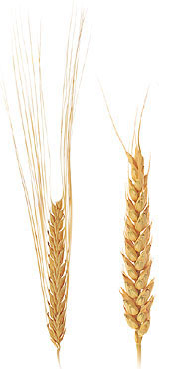
DESCRIPTION
⊱┄┄┄┄┄┄┄┄┄┄┄┄┄┄┄┄┄┄┄┄┄┄┄┄┄┄┄┄⊰
six-row
Features upright stems with few leaves
Two varieties:
six-row, spike notched to the opposite sides, three spikelets at each notch, each containing a flower (higher protein content and more suitable for animals)
two-row, central flowers and lateral flowers that are normally sterile (higher sugar content and more suitable for malt production)
two-row

Slide 4
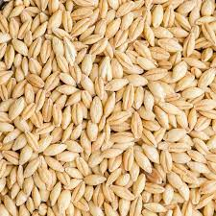
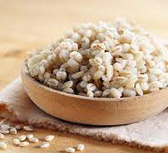
HEALTH BENEFITS
⊱┄┄┄┄┄┄┄┄┄┄┄┄┄┄┄┄┄┄┄┄┄┄┄┄┄┄┄┄⊰
Rich in vitamins, minerals, fiber, molybdenum, selenium, manganese
Has good amounts of copper, vitamin B1, chromium, phosphorus, magnesium and niacin
Packs lignans, a group of antioxidants that are linked to lower risks of cancer and heart disease
Can help reduce obesity and similar complications (diabetes, cardiovascular disease)

Slide 5
Nutrient | Six-row barley | Two-row barley | Recommended adult intake
Energy / Calories | 354 | 352 | 1 600 – 3 000
Protein (g) | 12.5 | 9.9 | 46 – 56
Fat (g) | 2.3 | 1.2 | 20 – 35
Carbohydrate (g) | 73.5 | 77.7 | 45 – 65
Fiber (g) | 17.3 | 15.6 | 22.4 – 33.6
TABLE OF NUTRITIONAL VALUE OF SIX-ROW AND TWO-ROW BARLEY PER 100 GRAMS
Calcium (mg) | 33 | 29 | 1 000 – 1 200
Iron (mg) | 3.6 | 2.5 | 8 – 18
Magnesium (mg) | 133 | 79 | 320 – 420
Phosphorus (mg) | 264 | 221 | 700
Potassium (mg) | 452 | 280 | 4 700
Sodium (mg) | 12 | 9 | 2 300
Manganese (mg) | 1.9 | 1.32 | 1.8 – 2.3
Selenium (mcg) | 37.7 | 37.7 | 55
Folate (mcg) | 19 | 23 | 400

Slide 6
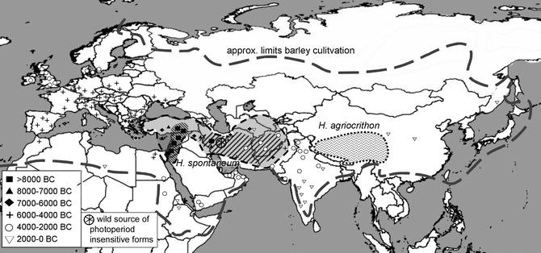
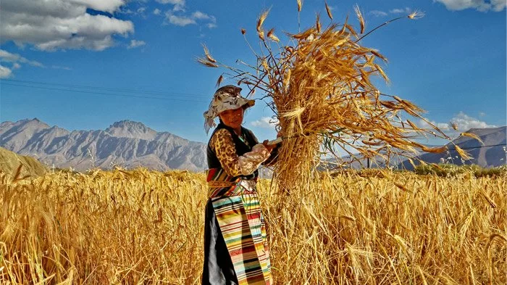
ORIGIN OF BARLEY
⊱┄┄┄┄┄┄┄┄┄┄┄┄┄┄┄┄┄┄┄┄┄┄┄┄┄┄┄┄⊰
One of the first cultivated grains of the Fertile Crescent (about 8 000 BCE from its wild progenitor Hordeum spontaneum)
Domesticated 5 000 BCE in Egypt, 2 350 BCE in Mesopotamia, 3 000 BCE in northwestern Europe, 1 500 BCE in China
Chief bread plant for Hebrews, Greeks, Romans and 16th century Europe
Tibet domesticated barley independently

Slide 7
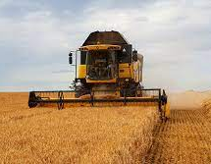
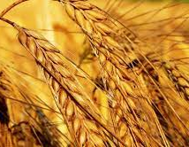
PRODUCTION
⊱┄┄┄┄┄┄┄┄┄┄┄┄┄┄┄┄┄┄┄┄┄┄┄┄┄┄┄┄⊰
In 2017 141.9 million bushels produced, with an average price of $4.68/bushel (total value of 614.3 million according to NASS)
The biggest producers of barley are EU, Russia, Ukraine, Australia, Canada, Turkey, Iran, USA, Argentina, Kazakhstan
The biggest importers of barley are Saudi Arabia, China, Iran, Libya, Japan

Slide 8
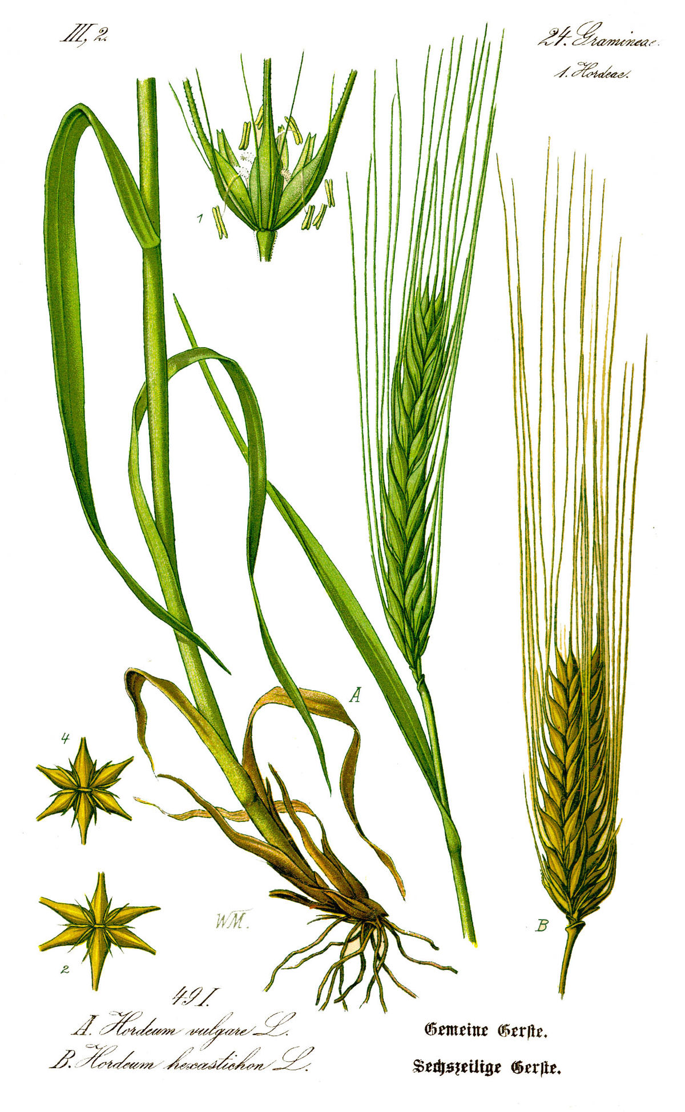
USES OF BARLEY
⊱┄┄┄┄┄┄┄┄┄┄┄┄┄┄┄┄┄┄┄┄┄┄┄┄┄┄┄┄⊰
Malt for beer, whisky and similar alcoholic drinks; barley water and roasted barley tea made by boiling barley in water
Can be feed to cows, sheep, pigs, poultry (domesticated birds)
Recently, barley biofuel work has been started in limited areas

Slide 9
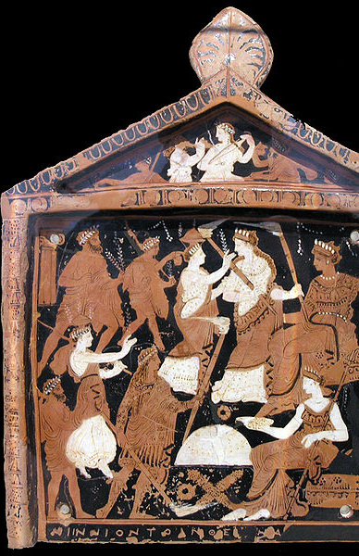
CULTURAL SIGNIFICANCE OF BARLEY
The Ninnion Tablet (around 370 BCE) depicting the Eleusinian Mysteries
⊱┄┄┄┄┄┄┄┄┄┄┄┄┄┄┄┄┄┄┄┄┄┄┄┄┄┄┄┄⊰
In the Bible valued less than wheat (II Kings 7:1; Revelation 6:6), an important crop in the vicinity of Bethlehem (book of Ruth)
In Greek mythology it’s supposed to represent Persephone because it dies and spends the winter in the underworld, coming back in spring
Barley water is a sacred drink of the Eleusinian Mysteries (ancient Greek harvest festival, in honor of Demeter)
Taliesin was the Welsh god who watched over barley fields
Ancient Egyptians and Greeks consider barley sacred gift from the gods

Slide 10
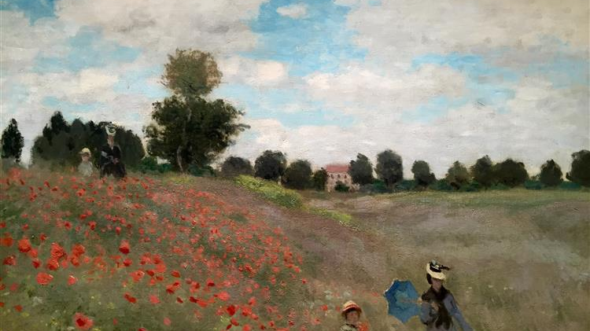
SOURCES
Oscar-Claude Monet (Paris, France, November 14 1840. – Giverny, France, December 5 1926.), The Poppy Field near Argenteuil (French: Les Coquelicots)
⊱┄┄┄┄┄┄┄┄┄┄┄┄┄┄┄┄┄┄┄┄┄┄┄┄┄┄┄┄⊰
https://www.medicalnewstoday.com/articles/295268
https://www.healthline.com/nutrition/barley-benefits
https://www.britannica.com/plant/barley-cereal
https://www.agmrc.org/commodities-products/grains-oilseeds/barley-profile
https://commodity.com/soft-agricultural/barley/
https://plant-breeding-genomics.extension.org/uses-for-barley/
https://ww2.odu.edu/~lmusselm/plant/bible/Barley.php
https://blog.kathrynmcgowan.com/2010/09/13/barley-water-an-ancient-refreshing-drink/
http://accidentalscientist.blogspot.com/2006/06/barley-food-of-gods.html

Slide 11
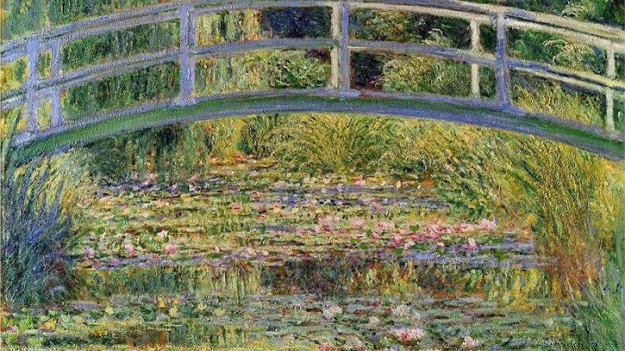
End <3
Oscar-Claude Monet (Paris, France, November 14 1840. – Giverny, France, December 5 1926.), Bridge over a Pond of Water Lilies (French: Le Bassin aux nymphéas, harmonie verte)

