Slide 1
tHe good and the bad points of using technology
PETRA BAČIĆ

Slide 2
Devices that I use daily
Mobile phone, tablets,tv are the devices that I use every day.
Picture from: Fleet cost & Care

Slide 3
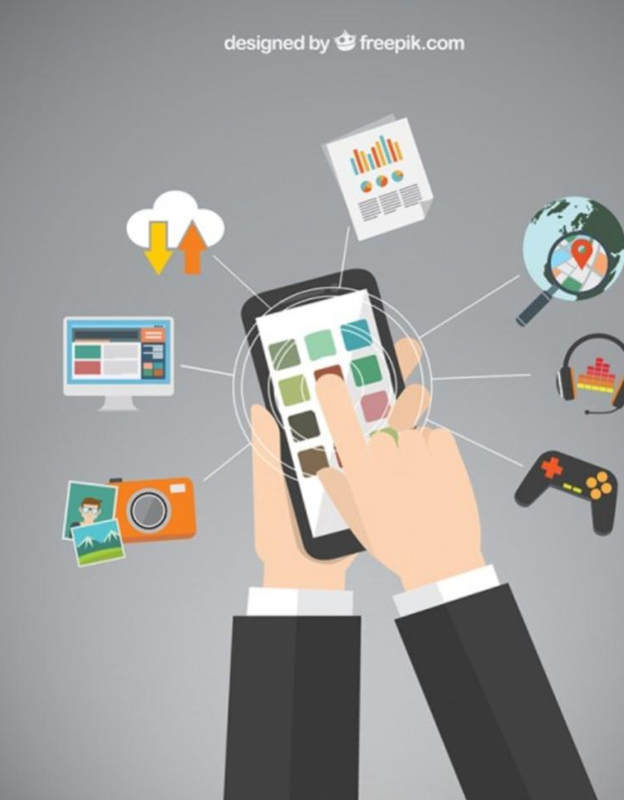
Why do I use them?
Picture from: LibGuides at Texsas Wesleyan University
I use those devices for entertainment, school, talking to friends and family

Slide 4
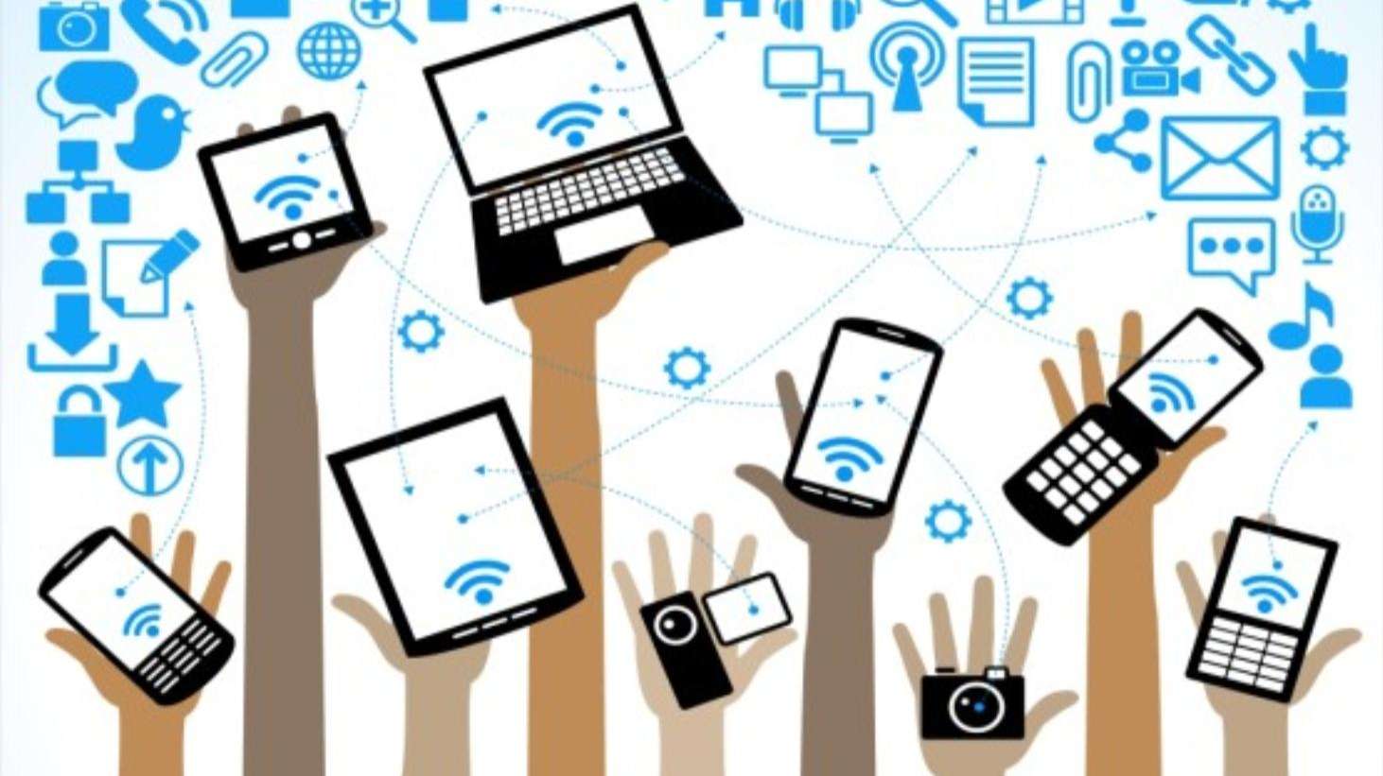
How much time do I use it?
I use it maybe 5 hours a day, because online school started so I always have to use my tablet every morning from 7:30 to 1pm . I also check it regularly during the day to see if I got some notifications. Before online school started I used my phone for maybe an hour or two a day , just talking to my friends, checking up on my family ,playing video games,listening to music,watching cute cat videos, interesting documentaries and more.
Picture from: LD@school

Slide 5
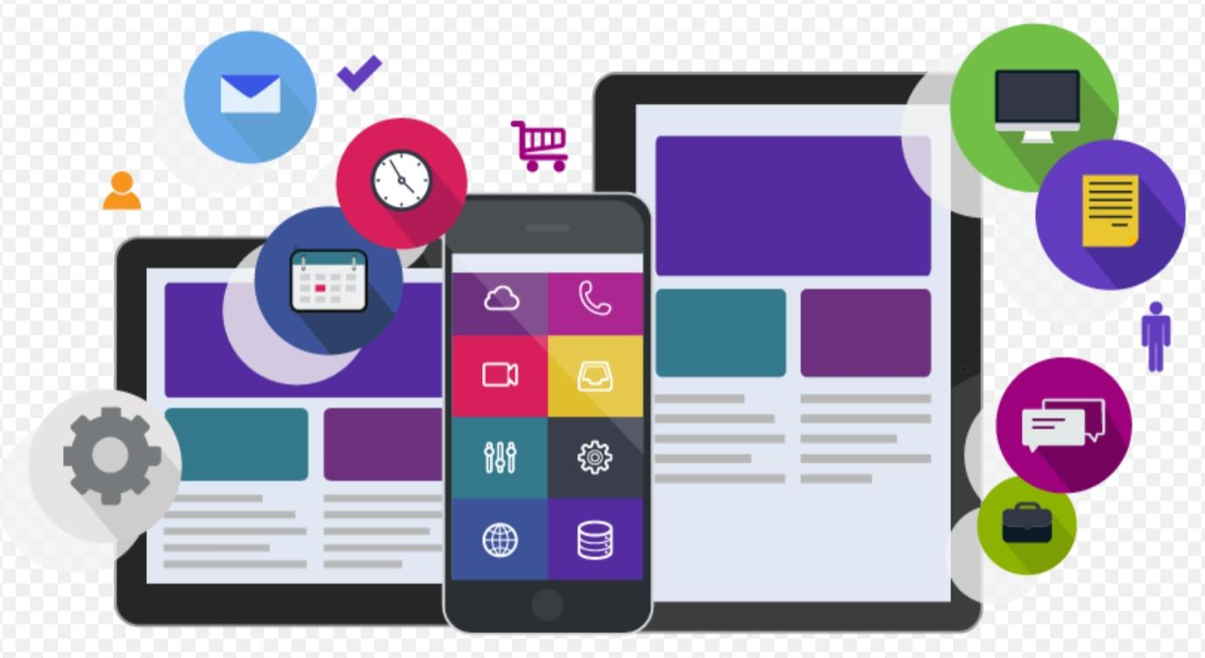
How much do I think I should be using it?
At least 1-2hours a day, when I don’t have online school.
Maybe even less than that.
Picture from: Level Access

Slide 6
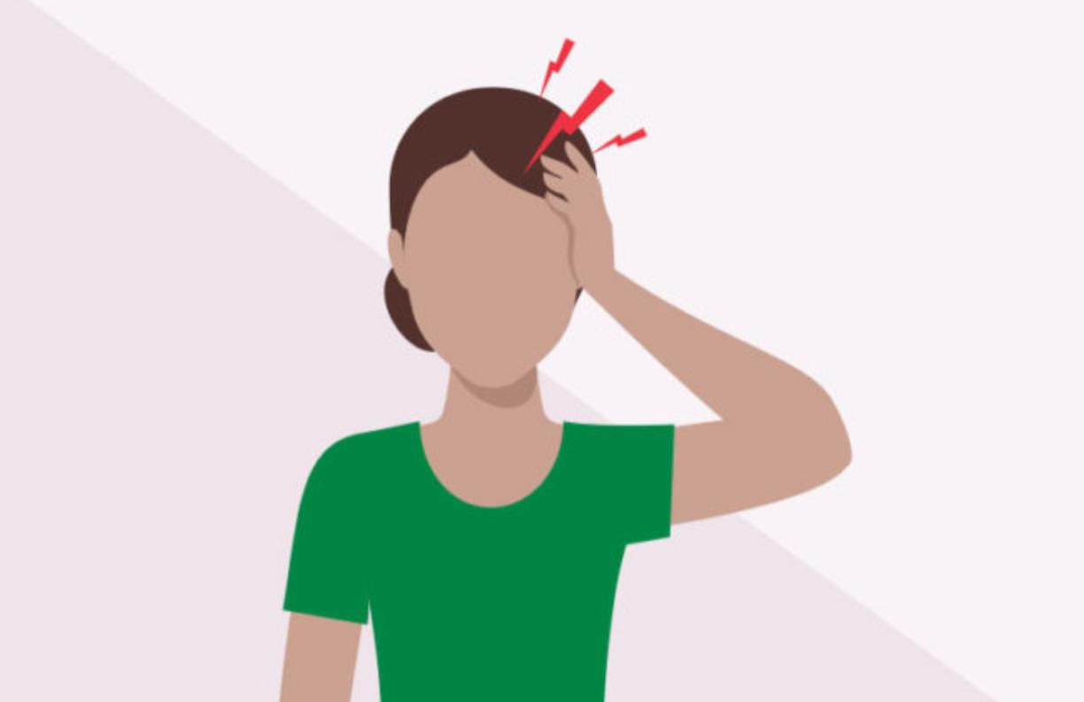
Do I ever have headaches,shoulder pain ,stiff neck and more?
Picture from: Buoy Health
I have headache ,shoulder pain ,stiff neck and back pain a lot. It happens almost every day now that I have online school. I usually drink a lot of water and regularly take small breaks to stretch and prevent that from happening. I think that’s really important.
Picture from: Cleveland Clinic Health Essentials

Slide 7
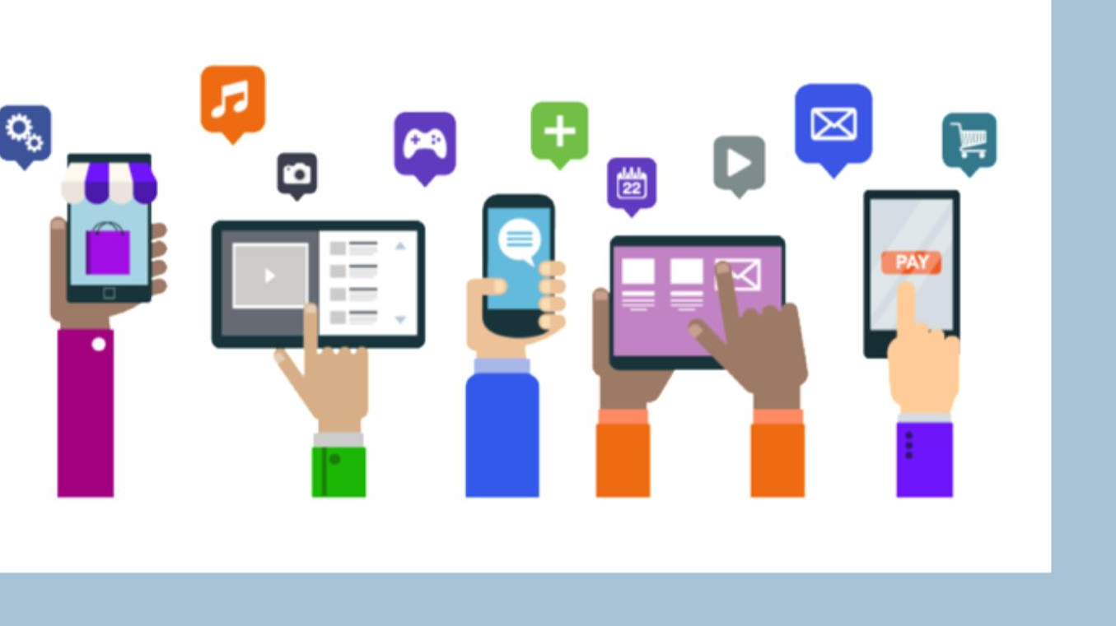
Do I experience blurry vision,itchy eyes and more?
I experience blurry vision and itchy eyes. I don’t really know what to do about it other than taking a break and washing my face to cool myself a bit.
Picture from: Level Access

Slide 8
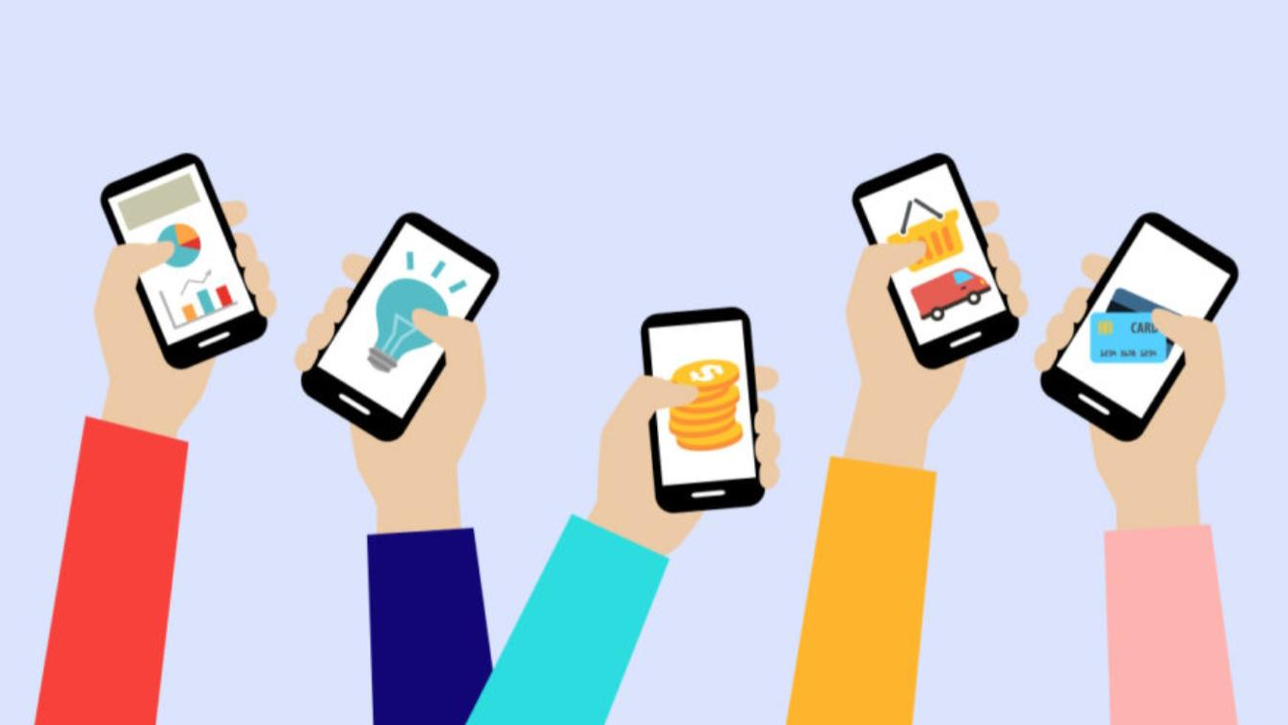
How can technology help us and how technology can’t help us
How can technology help us in everyday living:
It can help us study
It can help us to stay in contact with our loved ones
It can entertain us
How can technology not help us in everyday living:
It can become an addiction
We can waste a lot of time on it
We can lose focus on school and stop spending time with friends and family and become unsocial
Picture from: Adobe XD

Slide 9
Thank you for watching!

