Slide 1
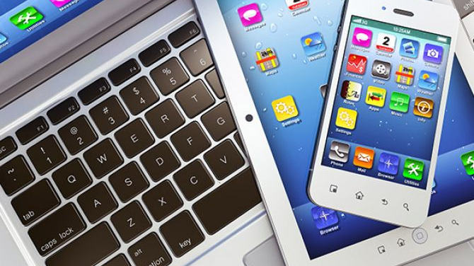
THE GOOD AND BAD Points of using technology
Ante Golem

Slide 2
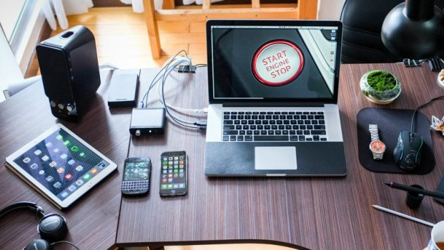
Cell phones, Tv, tablets or other devices appear every day in a person’s life.
I use some of them every day. For example a mobile phone, TV, laptop.
I play games and correspond on my mobile phone.I watch matches, some interesting shows and more on TV.
Now that school is at distance, I mostly use school tablet because I follow the teaching contents.

Slide 3
I watch TV mostly in the evening because there are more matches and that’s entertaining. I’m on my smartphone 3 hours a day and I think that’s a lot.These days it’s even more because of school.
I have never had a stiff neck,shoulder pain or itchy eyes. Sometimes I have a headache.

Slide 4
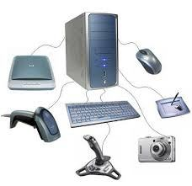
Technology can help us communicate, we can have fun and educate ourselves.It helps us organize and it is practical. We are more connected, more educated, in touch with the latest news. We can follow sports and listen to music every day.
Technology can be expensive and can cause many health problems.Devices must be charged or power consumed. Various radiations emanate from it. They don’t last long so many people pay a lot of money to be in touch with the latest gadgets and devices. Technology is useful, but it can also harm human health. I think people need to think about what’s going on with nature and stop destroying it in order to save the planet and themselves.

Slide 5
SOURCES
https://pcchip.hr/ostalo/zanimljivosti/kako-tehnologija-utjece-na-nas-zivot-1-dio/

