Slide 1
The good and bad points of using technology
Manuela Melvan
7.b

Slide 2
What technology do you use every day?
Lately, I spend my free time using all kinds of devices.
I use a tablet, laptop and my smartphone.Sometimes I even turn on YouTube on my television.
I also have a PlayStation at home so I spend most time on it.
Nowadays, everything has changed. Everything around us is connected to technology. I would dare say that in a couple of years robots will work instead of humans.
Apple

Slide 3
What do you use it for?
Personally, I spend most of my time playing games, watching YouTube and scrolling through TikTok.
But of course, there are other apps like Snapchat, WhatsApp and Instagram.
I use mobile apps for fun, learning and education.
I sometimes spend most of my day sitting or lying down watching TV, like most kids my age.
Asus

Slide 4
How much time do you use it?
I think I spend most of my time on my smartphone.
Every day I spend 6 to 8 using technology devices and gadgets.
Especially now when it’s online school.
During online school, I spend most of my time doing homework and studying , which takes me at least 6 to 7 hours.
I use the remaining time playing games for 2 to 3 hours or maybe learning new contents.
htc

Slide 5
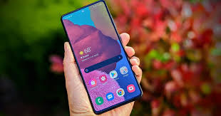
How much do you think you should be using it?
My opinion is that technology harms our eyesight and that we should use it less. Of course some do not understand this, so they spend half or more of their day in front of the screen without rest.
In a situation like this in the middle of a pandemic, we can’t see each other in person, so we see each other via a video call.
I think that children and adults who live in the countryside should spend more time outside.
Samsung Galaxy

Slide 6
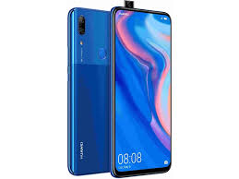
Have you ever had a stiff neck, shoulder pain a headache?
HUAWEI P Smart Z
Before I realized how much technology can harm, I had shoulder pain and headaches, even my eyesight got worse.
Now that I have realized how much technology harms us a I no longer have headaches, back pain, shoulder pain and my vision has returned to normal.
I’ve concluded that since I have been using technology less and spend more time outside I feel a lot better.

Slide 7
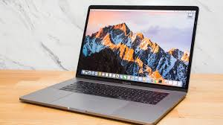
How can technology help us in everyday living?
Of course, technology has its good sides.
The benefits can be seen during a pandemic now, when we are not allowed to have contact with people who are not in our household.
Technology helps us maintain contact virtually.
Technology helps us make new friendships,connect with some interesting people from all over the world. It can even help people in need by organizing charities and raising money online for the unfortunate ones.
MacBookPro

Slide 8
Thank you for your attention! Sources:

